Slide 1
LifeGate
February 23, 2025

Slide 2
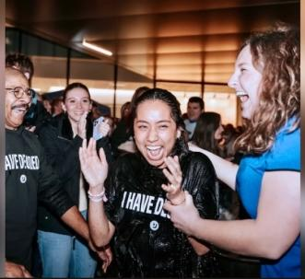
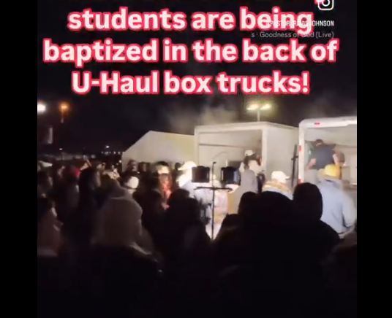
The Power of God Working
In All The Challenges

Slide 3
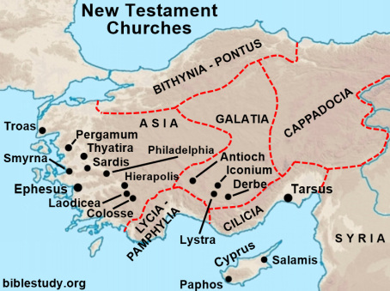
THE BOOK OF COLOSSIANS
Written By Paul - Either in prison in Rome or Caesarea – around 57 AD

Slide 4
TO GET THE FULL FORCE OF COLOSSIANS CHAPTER THREE
YOU HAVE TO UNDERSTAND THAT PAUL’S
BIGGEST MESSAGE IS THAT THE MOSAIC LAW DOES NOT PURIFY THE HEART – SO THEN THE GENTILES GO “YIPPEE – WE ARE FREE FROM THE LAW – WE CAN DO WHAT WE WANT.” –
AND PAUL SAYS – “NO- GOSPEL OBEDIENCE THAT BRINGS
THE HOLY SPIRIT IS MORE POWERFUL THAN THE LAW.”
You, my brothers, were called to be free. But do not use your freedom to indulge the sinful nature; rather, serve one another in love. ¹⁴ The entire law is summed up in a single command: "Love your neighbor as yourself." ⁻⁻ ¹⁶ So I say, live by the Spirit, and you will not gratify the desires of the sinful nature. Galatians 5:13-16 (NIV)
Live as free men, but do not use your freedom as a cover-up for evil; live as servants of God. 1 Peter 2:16 (NIV)

Slide 5
The Greatest Motivation For RIGHTEOUS LIVING
Is Who Christ Is
And Then What He Has Done For Us
Since, then, you have been raised with Christ, set your hearts on (SEEK AFTER) things above, where Christ is seated at the right hand of God. ² Set your minds (AND AS A RESULT YOUR AFFECTION) on things above, not on earthly things. (THE SYSTEMS OF PLEASURE, POWER, EGO-STROKING FULFILLMENT) ³ For you died, and your life is now hidden (AS A TREASURE) with Christ in God. ⁴ When Christ, who is your life, appears, then you also will appear with him in glory. Colossians 3:1-4 (NIV)
But seek ye first the kingdom of God, and his righteousness; and all these things shall be added unto you. Matthew 6:33 (KJV)

Slide 6
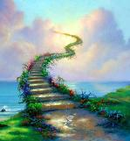
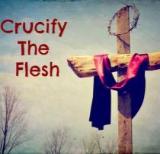
THERE IS A MUTUAL EXCLUSIVITY TO PURSUING THE WORLD
AND FLESH OR PURSUING GOD AND HEAVEN
2 Set your minds on things above, not on earthly things. 3 For you died, and your life is now hidden with Christ in God.
FEEDS THE FLESH
FEEDS THE SPIRIT
Pursuing The World
Pursuing God
THE MORE YOU PURSUE THE WORLD THE LESS HUNGER YOU WILL HAVE FOR THE LORD AND HIS PRESENCE, HIS WORD AND HIS KINGDOM
THE MORE YOU PURSUE CHRIST AND HEAVEN’S VALUES THE LESS PULL THE WORLD WILL HAVE ON YOU

Slide 7
Paul Is The Greatest Teacher On The FULLNESS Of What the Death Burial And Resurrection Of Christ Accomplished For Us
He was delivered over to death for our sins and was raised to life for our justification. Romans 4:25 - just as Christ was raised from the dead through the glory of the Father, we too may live a new life. Romans 6:4
THE FATHER SEES US THROUGH CHRIST – BUT HE STILL SEES US IN OUR WILLINGNESS OR UNWILLINGESS TO ALLOW CHRIST TO PERFECT US
PRACTICAL
POSITIONAL
Into an inheritance that can never perish, spoil or fade--kept in heaven for you, ⁵ who through faith are shielded by God's power until the coming of the salvation that is ready to be revealed in the last time. 1 Peter 1:4-5
For the word of God is living and active. Sharper than any double-edged sword, it penetrates even to dividing soul and spirit, joints and marrow; it judges the thoughts and attitudes of the heart. ¹³ Nothing in all creation is hidden from God's sight. Everything is uncovered and laid bare before the eyes of Him to whom we must give account. Hebrews 4:12-13
Reckoned To our account Upon Placing Faith In
Christ
Wrought In Our Hearts Because of the Revelation of The costliness
Of Christ’s
Sacrifice
SALVATION IS BOTH INSTANTANEOUS AND A PROCESS OF OBEDIENCE
Because by one sacrifice He has made perfect forever those who are being made holy. Hebrews 10:14 (NIV)
Here is the KEY TAKEAWAY – WE CAN’T CLAIM POSITIONAL RIGHTEOUSNESS AS FIRE INSURANCE WHILE WE REFUSE GOD’S SANCTIFYING WORK IN OUR LIFE

Slide 8
HOW IS CHRIST OUR LIFE?
3 For you died, and your life (Zoe- To be quickened made alive) is now hidden with Christ in God. 4 When Christ, who is your Life, appears, then you also will appear with Him in glory. Colossians 3:3,4
¹⁰ The thief comes only to steal and kill and destroy; I have come that they may have life, and have it to the full. John 10:10 (NIV)
“In him was life, and the life was the light of men.” John 1 :4 It describes the kind of life uniquely possessed by God. Eternal, immortal, life not derived from anywhere or anyone else – but given to us. (Jim Crooks)
Jesus answered, "I am the way and the truth and the life. No one comes to the Father except through me. John 14:6 (NIV)
LONGER DEFINITION OF ZOE – means the absolute fullness of life, both essential and spiritual, which belongs to God, and through Him gives both the life of Christ to us through His death burial and resurrection which produces in us a vibrant spiritual life, devoted to God, to be consummated by a new more perfect body when Jesus appears, and that body will last forever with God Who is our LIFE.

Slide 9
ALLOWING THE LIFE OF CHRIST
TO MOTIVATE RADICAL TRANSFORMATION
⁵ Put to death, (reckon as not worthy of our attention) therefore, whatever belongs to your earthly nature: sexual immorality, impurity, lust, evil desires and greed, which is idolatry. ⁶ Because of these, the wrath of God is coming. ⁷ You used to walk in these ways, in the life you once lived. ⁸ But now you must rid yourselves of all such things as these: anger, rage, malice, slander, and filthy language from your lips. ⁹ Do not lie to each other, since you have taken off your old self with its practices ¹⁰ and have put on the new self, which is being renewed in knowledge in the image of its Creator. Colossians 3:5-10 (NIV)
Dead To: Get rid of Old | Alive To: Put on New Self
Sin | Holiness
World | Heaven
Self | Christ
Flesh | Spirit

Slide 10
Paul Inspired By The Holy Spirit – Consistently Taught
On This Issue Of New Life In Christ
You used to walk in these ways, in the life you once lived. 8 But now you must rid (THROW OFF) yourselves of all such things as these: anger, rage, malice, slander, and filthy language from your lips. 9 Do not lie to each other, since you have taken off (STRIPPED AWAY) your old self with its practices 10 and have put on (CLOTHED WITH) the new self, which is being renewed in knowledge in the image of its Creator. Colossians 3:7-10
Surely you heard of Him (CHRIST) and were taught in Him in accordance with the truth that is in Jesus. 22 You were taught, with regard to your former way of life, to put off your old self, which is being corrupted by its deceitful desires; 23 to be made new in the attitude of your minds; 24 and to put on the new self, created to be like God in true righteousness and holiness. Ephesians 4:21-24 (NIV)

Slide 11
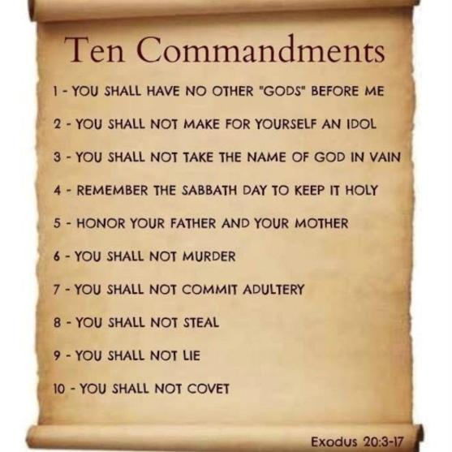
The Lord Calls Us Into His Pure Love (MORAL LAW)
And Really Makes it about These Four Pillars

Slide 12
Breaking Hidden Idolatry
Is Critical To Salvation
We have to get into the trenches of life concerning true Biblical Righteousness and seek a way to communicate the destructive nature of a double-minded heart which is in bondage to self-will: Where we absolutely say we are in love with God and we want Him but we choose to live in compromise in a particular area of life that we do not give God control over. This is one of the most prolific sins of our generation and of any generation. “Oh I want to serve God, I like the idea of God, I like that He loves me, and I want to go to heaven with Him but I am going to serve my own flesh in this one area without repenting and turning away from it.” (IT IS IDOLATRY)

Slide 13
NO ONE HAS A HEADS UP ON OVERCOMING
THEIR FLESH OR OLD NATURE – CHRIST IS THE ONLY ONE WHO CAN DELIVER US ALL
11 Here there is no Greek or Jew, circumcised or uncircumcised, barbarian, Scythian, slave or free, but Christ is all, and is in all.

Slide 14
PURE PEACE – IS TOUGH TO COME BY
RELATIONSHIPS ARE ALWAYS BEING CHALLENGED
THIS WORLD-WIDE
REVIVAL IS GOING TO
BRING AN EMPHASIS ON HEALED RELATIONSHIPS
12 Therefore, as God's chosen people, holy and dearly loved, clothe yourselves with compassion, kindness, humility, gentleness and patience. 13 Bear with each other and forgive whatever grievances you may have against one another. Forgive as the Lord forgave you. 14 And over all these virtues put on love, which binds them all together in perfect unity. 15 Let the peace of Christ rule in your hearts, since as members of one body you were called to peace. And be thankful.

Slide 15
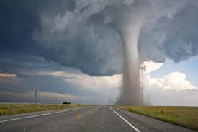
I Don’t Know Why We Have So Many Tornados
In Relationships Right Now?
Relationships are under very unusual and constant stress right now. That's why we're praying the grace of God on each other’s lives so that we can all die to self learn and grow through the conflict, not overreact or overemphasize each other's faults but find a way through it by praying forgiveness, healing, and blessing over each other even though we are imperfect.

Slide 16
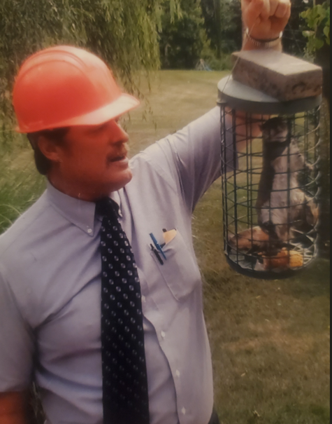
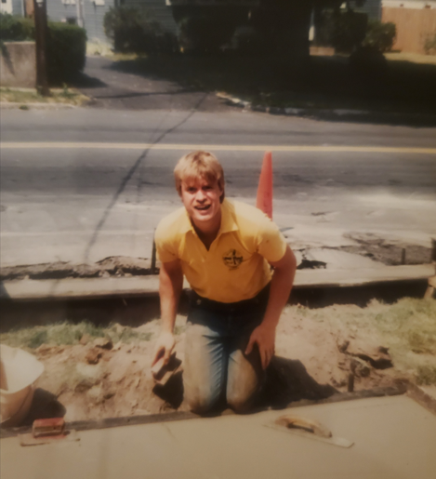
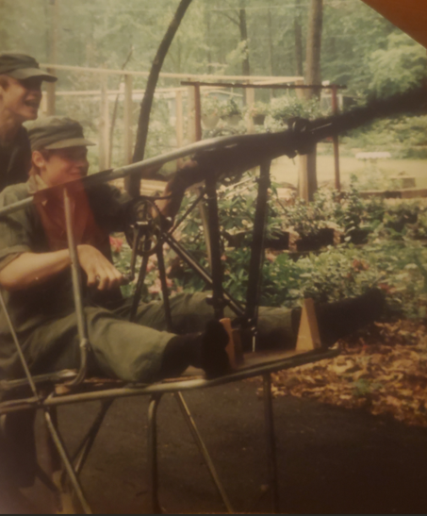
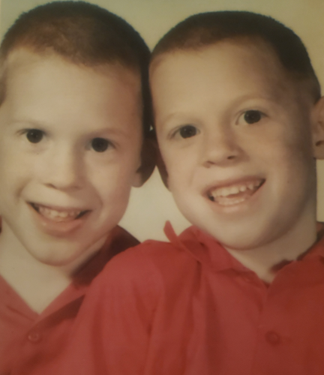
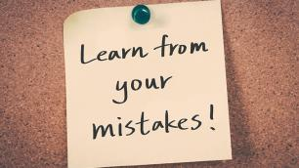
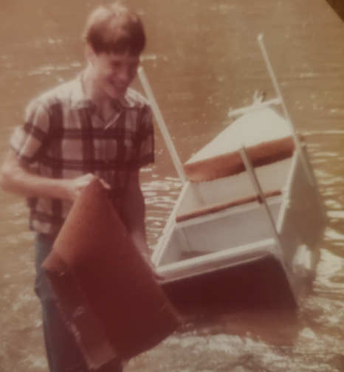
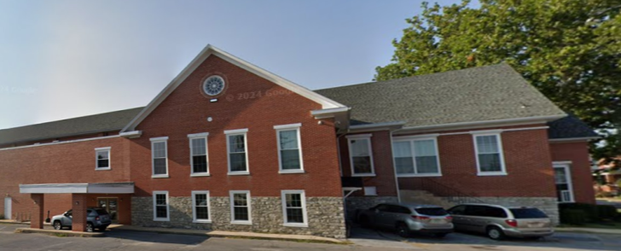
ALLOWING GOD TO HEAL US THROUGH
REVELATION AND HUMILITY
Bear with (ENDURE – SUFFER- PUT UP WITH) each other and forgive whatever grievances you may have against one another. Forgive as the Lord forgave you. 14 And over all these virtues put on love, which binds them all together in perfect unity.
NOT JUST SHARING YOUR HURTS – BUT WILLING TO RECEIVE ADJUSTMENTS AND HEALING
LANCASTER FELLOWSHIP

Slide 17
THE GLORIOUS NATURE OF JESUS
IS THAT HIS MATCHLESS LOVE AND SACRIFICE
ALWAYS STRETCHES US TO LOOK WHERE WE
NEED TO CHANGE AND BE GRACIOUS TO OTHERS
SO WHEN YOU LOOK AT SOMEONE WHO IS STRUGGLING TO GRASP THEIR NEED FOR CHANGE AND IT FRUSTRATES YOU – LOOK IN YOUR OWN HEART AND IDENTIFY WHAT YOU ARE POSSIBLY NOT WILLING TO CHANGE? – “Search me, O God, and know my heart; test me and know my anxious thoughts. 24 See if there is any offensive way in me, and lead me in the way everlasting.”
Psalm 139:23-24 (NIV)

Slide 18
AT THE END OF THE DAY –
PAUL SAYS WE NEED TO BUILD EACH OTHER UP
AND WORSHIP BEYOND ALL THE DRAMA
16 Let the Word of Christ (ABOUT YOUR SALVATION AND HEALING AND MISSION TO BLESS OTHERS) dwell in you richly as you teach and admonish one another with all wisdom, and as you sing psalms, hymns and spiritual songs with gratitude in your hearts to God. 17 And whatever you do, whether in word or deed, do it all in the Name of the Lord Jesus, giving thanks to God the Father through Him. Colossians 3:1-17 (NIV)

Slide 19
KING DAVID FELT THESE SAME BATTLES AND INTERCEDED THAT GOD WOULD MEET HIS FRIENDS AND BLESS THEM
May the LORD answer you when you are in distress; may the Name of the God of Jacob protect you. 2 May He send you help from the sanctuary and grant you support from Zion. 3 May He remember all your sacrifices and accept your burnt offerings. Selah 4 May He give you the desire of your heart and make all your plans succeed. 5 We will shout for joy when you are victorious and will lift up our banners in the Name of our God. May the LORD grant all your requests. Psalm 20:1-5 (NIV)

Slide 20
A Quick Heart Check
Who are you trusting in? – who is your source of joy – people or God?
Do you know you don’t have to do anything to make people love you – or do you feel pressured to perform?
Do you know what it is like to have true freedom from rejection?
Are you easily offended?
Are there relationships – you are constantly feeling negative about – or punished by?
Are you genuine no matter how you are received? Have you made the hurt of your heart more important than the people around you?
Is it possible that there are people who do want to love you – but you sabotage them?
Stop fishing for love – you already have it fully in Christ.
Again, is Jesus your foundational Source of fulfillment?

Slide 21
FINAL APPLICATION
And over all these virtues put on love, which binds them all together in perfect unity. 15 Let the peace of Christ rule in your hearts
John Gottman

