Slide 1
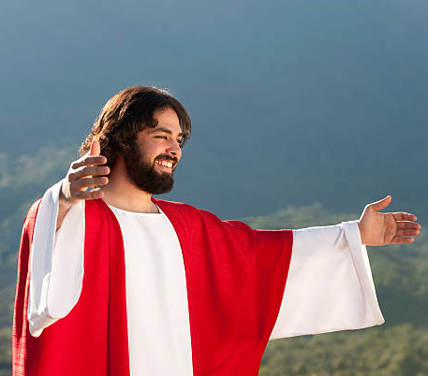
Walking in the Riches of Christ:
Going from head knowledge to daily awareness
Combining a deep appreciation of His sacrifice with a greater determination to let my life be an example of His generosity and kindness.
Never forgetting the goodness He’s shown me when dealing with the challenges of other relationships.
Tapping into those riches when there seems to be no sense of support.

Slide 2
The extent to which Jesus went to affect our lives
His commitment:
- Created the universe
- Created a tiny dirt ball for our survival
Established relationship
Wanted family and peoples to participate in His expansion of kingdom
Gave us dominion over the earth and all creatures
Our demise of His plan:
Disobeyed and did what we wanted to…
He reluctantly pushed mankind out of relationship.
Ended our chances to spend eternity in heaven
Instead destined for an eternity in hell.
His determination to fix the problem

Slide 3
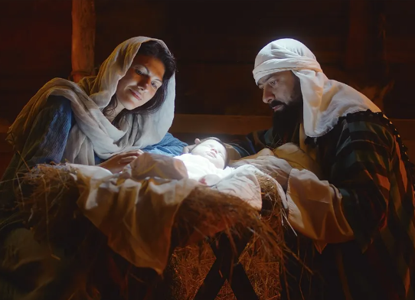
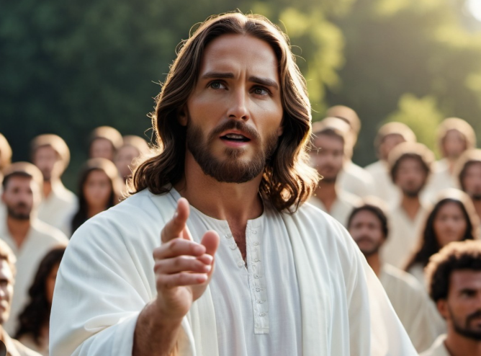
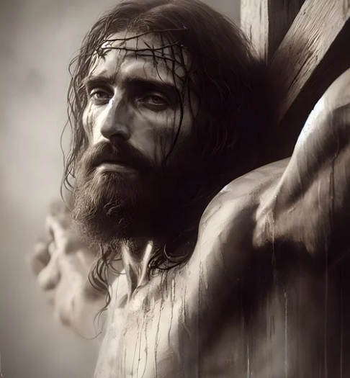
Total commitment to seeing our lives redeemed

Slide 4
Jesus Made a way and left nothing stand in the way
Physical healing, emotional healing, restored relationships, future hope, freedom anxiety

Slide 5
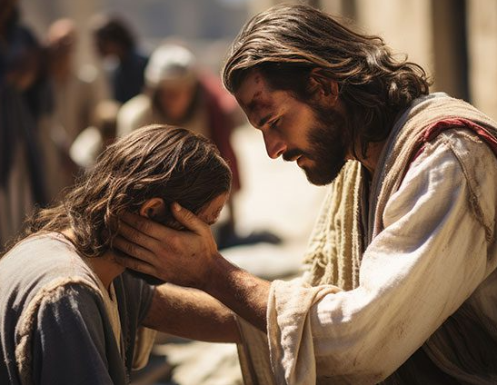
The underlying foundation of Christ’s determination to reach us and offer a new life, full of richness…..He is always thinking of the needs of others first!! He is compelled by compassion and grace for all. Phil. 2: 3-10

Slide 6
As Christ followers, we are indebted to His sacrifice and dedication to our salvation and enrichment of this earthly life.
Theres a response of worship, and dedication to serving Him as Lord of our lives…
There is a humility and compassion to treat others around me with them grace and favor He has sown me.
Phil. 2: 5 - Maintain the same attitude Jesus did
Rom. 15: 1-3 Don’t please yourself, help others
Eph. 4:32 - Forgive each other as Christ forgave you

Slide 7
Our world is in real trouble. Nations are crumbling..
France, Ukraine, South Korea, Syria, Israel, Romania,
Venezuela, Georgia, Cuba, Hati, United Kingdom

Slide 8
God is allowing the world to be shaken politically, socially, spiritually…
Heb. 12: 27
⁵ Be careful that you do not refuse to listen to the One who is speaking. For if the people of Israel did not escape when they refused to listen to Moses, the earthly messenger, we will certainly not escape if we reject the One who speaks to us from heaven! ²⁶ When God spoke from Mount Sinai his voice shook the earth, but now he makes another promise: “Once again I will shake not only the earth but the heavens also.”^{[c]} ²⁷ This means that all of creation will be shaken and removed, so that only unshakable things will remain.
²⁸ Since we are receiving a Kingdom that is unshakable, let us be thankful and please God by worshiping him with holy fear and awe

Slide 9
All of us living in this shaking…..
Shaking in our society… moral decay, violence, abuse, neglect, addiction,…
Family decline, disruptions, destruction…
Economic, decline, destruction…. Uncertainty
Political, undermining, lack of trust, anger…
Spiritual…. Satan is coming against the church,
Christians, schools, families, society…
How do we tap into the riches of Christ and flourish when everything around us is being attack?
Remind ourselves, that Jesus is right there…the one who gave up everything to secure my salvation, is willing to help me through life’s shakings. Romans 8: 32
Remind ourselves that the world is watching each of us to see how we’re reacting to the shaking. Are we any different? Is our hope in something deeper?
Remind ourselves that God is going to use the shaking to both strengthen and build up our spiritual muscles and help us be there for others who are just learning what the attacks of the enemy are all about.

Slide 10
4. Don’t forget that the shaking is also meant to send a message to Satan and his followers that God wins in the end! The Gates of Hell can’t prevail against the Church!
Matt. 16:18
27 Above all, you must live as citizens of heaven, conducting yourselves in a manner worthy of the Good News about Christ. Then, whether I come and see you again or only hear about you, I will know that you are standing together with one spirit and one purpose, fighting together for the faith, which is the Good News. 28 Don’t be intimidated in any way by your enemies. This will be a sign to them that they are going to be destroyed, but that you are going to be saved, even by God himself. 29 For you have been given not only the privilege of trusting in Christ but also the privilege of suffering for him. 30 We are in this struggle together. Phil. 1: 27-30

Slide 11
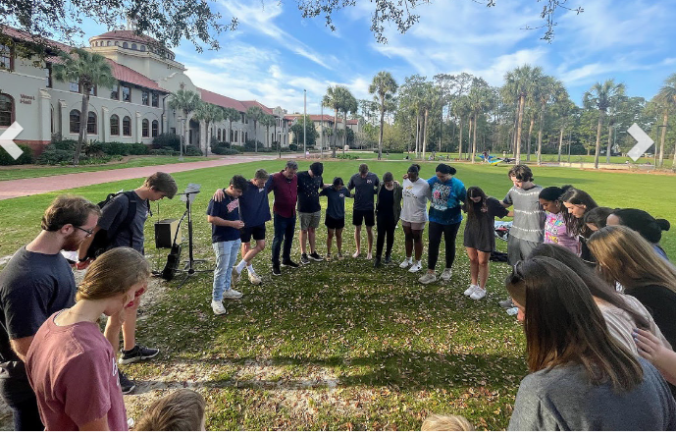
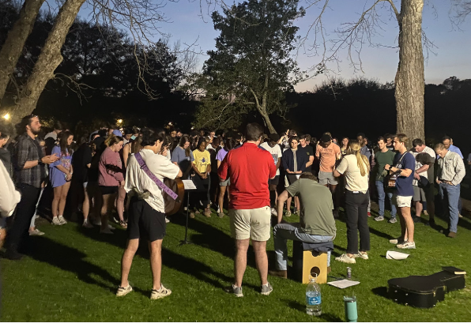
We are also in the midst of a renewal and harvest!!
Bible sales in 2024 are up 22% - 13.7 million bibles sold
Thousands of college and Highschool youth turning to Lord
People in our own community radically turning to Christ
Transgenders, Gays, prostitutes, comedians turning Christ
Societal disgust for perverted and twisted radical left ideas
People standing up in places of influence to speak out for decency and righteousness

Slide 12
Worship the Lord Jesus for bringing
All of us into the picture at such a time as this….
Paul’s prayer for the church to remember the goodness,
riches and love afforded us in Christ. Eph. 3: 10- 20
Church is example of God’s character to heavenly realm
God’s eternal plan was always to have a family
We can come in prayer with boldness and confidence
Don’t lose heart in the shaking
Paul demonstrated deep worship for the Lord as he meditates
He asks that the Holy Spirit will give us inner strength
Christ will abide and set up residence in our hearts, we will grow deep in Him
Be able to grasp how long, high and deep is His love
Be able to taste that love when nothing seems tobe working!
Have the fullness of Lofe that comes from God

Slide 13
Conclusions:
God wants us to daily reflect on the host of blessings and promises He’s afforded us in Christ.
(It’s a spiritual vitamin for when the trials come)
Helps build up your spiritual immunity system
Determine to be an example of Christ kindness and compassion, no matter how difficult your life’s circumstances might be currently.
Be ready to forgive and work with fellow brothers and sister you may struggle with at times. The grace God has shown you is a million times more than you’ll ever have to show someone else!
Lean into other believers to help adjust your perspective. The enemy wants us to go it alone. As hard as it might be, talk to others and get support and refreshment, value of your spiritual family is essential.

Slide 14
Don’t waste any part of your day, letting the enemy rob you of Joy, Hope in the Lord, ability to see the good in each opportunity.
Don’t waste any part of your day on negative thoughts. Live each day as if it is the only day you have left. Look for the good in each day. Stay away from negative people who will try to suck the joy out of your life.
Never be a victim of circumstances. Live victoriously. Be an ambassador for Christ. Don’t waste your time on selfish ambition.
When people do hurt you, use it as an opportunity to spur you on to be different then they are.

Slide 15
INVENTORY: Height, depth and width of His Love for you:
Did Jesus every protect you from terrible situation?
from serious injury/ accident From bad business deal
Has there been healing and blessing at times on you or family? Sickness, emotional turmoil, restored relationships
Has the Lord forgiven you of sins, faults and mistakes?
Has the Lord provided for you financially, beyond your ability
Are you in a different place over all then 10 years ago, 5 years ago, year ago
Are there people who have blessed you, with their kindness,
support, practical help…. Prayers.
Has God given you family to walk through this life? Spouse,
children, grandchildren…
Do you have neighbors who care about you, that are a blessing?
Do you realize the freedoms and blessing God has given you each day, that other nations don’t have?

