Slide 1
THE LORD IS ALREADY ANTICIPATING OUR PROBLEMS
HE IS PREPARING US FOR HARVEST
HE WILL CLEARLY COMMUNICATE OUR NEXT STEPS
LifeGate
November 3, 2024

Slide 2
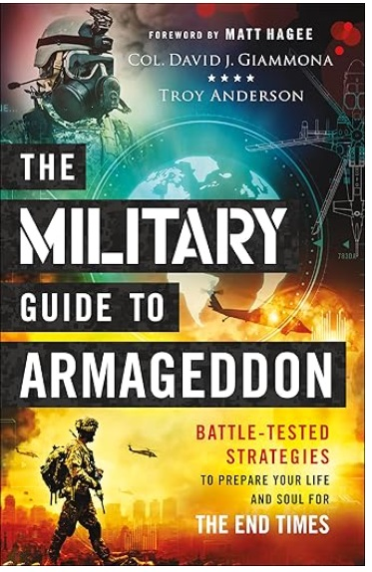
Raising Up End-Times Warriors
What the Church needs more than anything today is an army of supernatural, Bible-believing, Holy Spirit–empowered people of God who are ready and willing to turn a generation upside down for Jesus and do mighty exploits, as templated in the New Testament.
The early Church, as described in the book of Acts, did turn the ancient world upside down, and today’s end-times warriors of Christ need to reclaim the sound theology and radical zeal of the first-century Christians. The early Church revolutionized the ancient world in one generation. One of the reasons they were able to do this is that they carried with them the urgency of the Biblical message about “the great and dreadful day of the LORD” (Joel 2:31).
Retired Col. David J. Giammona

Slide 3
Allowing God To Shape Us
And let us consider how we may spur (stimulate, motivate) one another on toward love and good deeds. ²⁵ Let us not give up meeting together, as some are in the habit of doing, but let us encourage (exhorting, beseeching) one another--and all the more as you see the Day approaching. Hebrews 10:24-25 (NIV)
“And yet we still make them welcome and a friend who we can relate to in the hopes that our lives would kindle something in them for a greater breakthrough.”

Slide 4
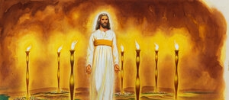
THIS IS OUR GLORIOUS LEADER
TAKING US THROUGH THE STORM
I turned around to see the voice that was speaking to me. And when I turned I saw seven golden lampstands, ¹³ and among the lampstands was Someone "like a son of man," dressed in a robe reaching down to His feet and with a golden sash around His chest. ¹⁴ His head and hair were white like wool, as white as snow, and His eyes were like blazing fire. ¹⁵ His feet were like bronze glowing in a furnace, and His voice was like the sound of rushing waters. ¹⁶ In His right hand He held seven stars, and out of His mouth came a sharp double-edged sword. His face was like the sun shining in all its brilliance. ¹⁷ When I saw Him, I fell at His feet as though dead. Then He placed His right hand on me and said: "Do not be afraid. I am the First and the Last. ¹⁸ I am the Living One; I was dead, and behold I am alive for ever and ever! And I hold the keys of death and Hades. Revelation 1:12-18 (NIV)
Based upon My finished WORK on the Cross and My Resurrection to the Father’s righthand - I anticipate all your needs and make provision to MEET ALL YOUR NEEDS.

Slide 5
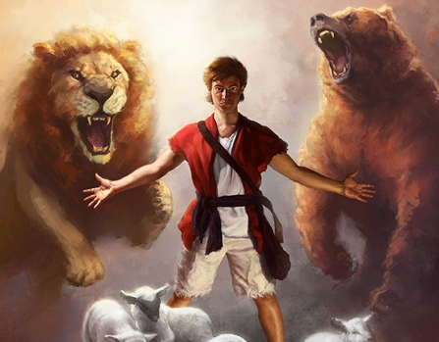
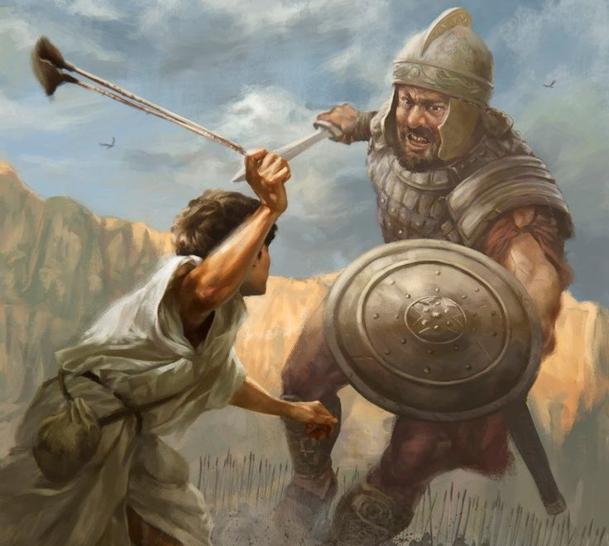
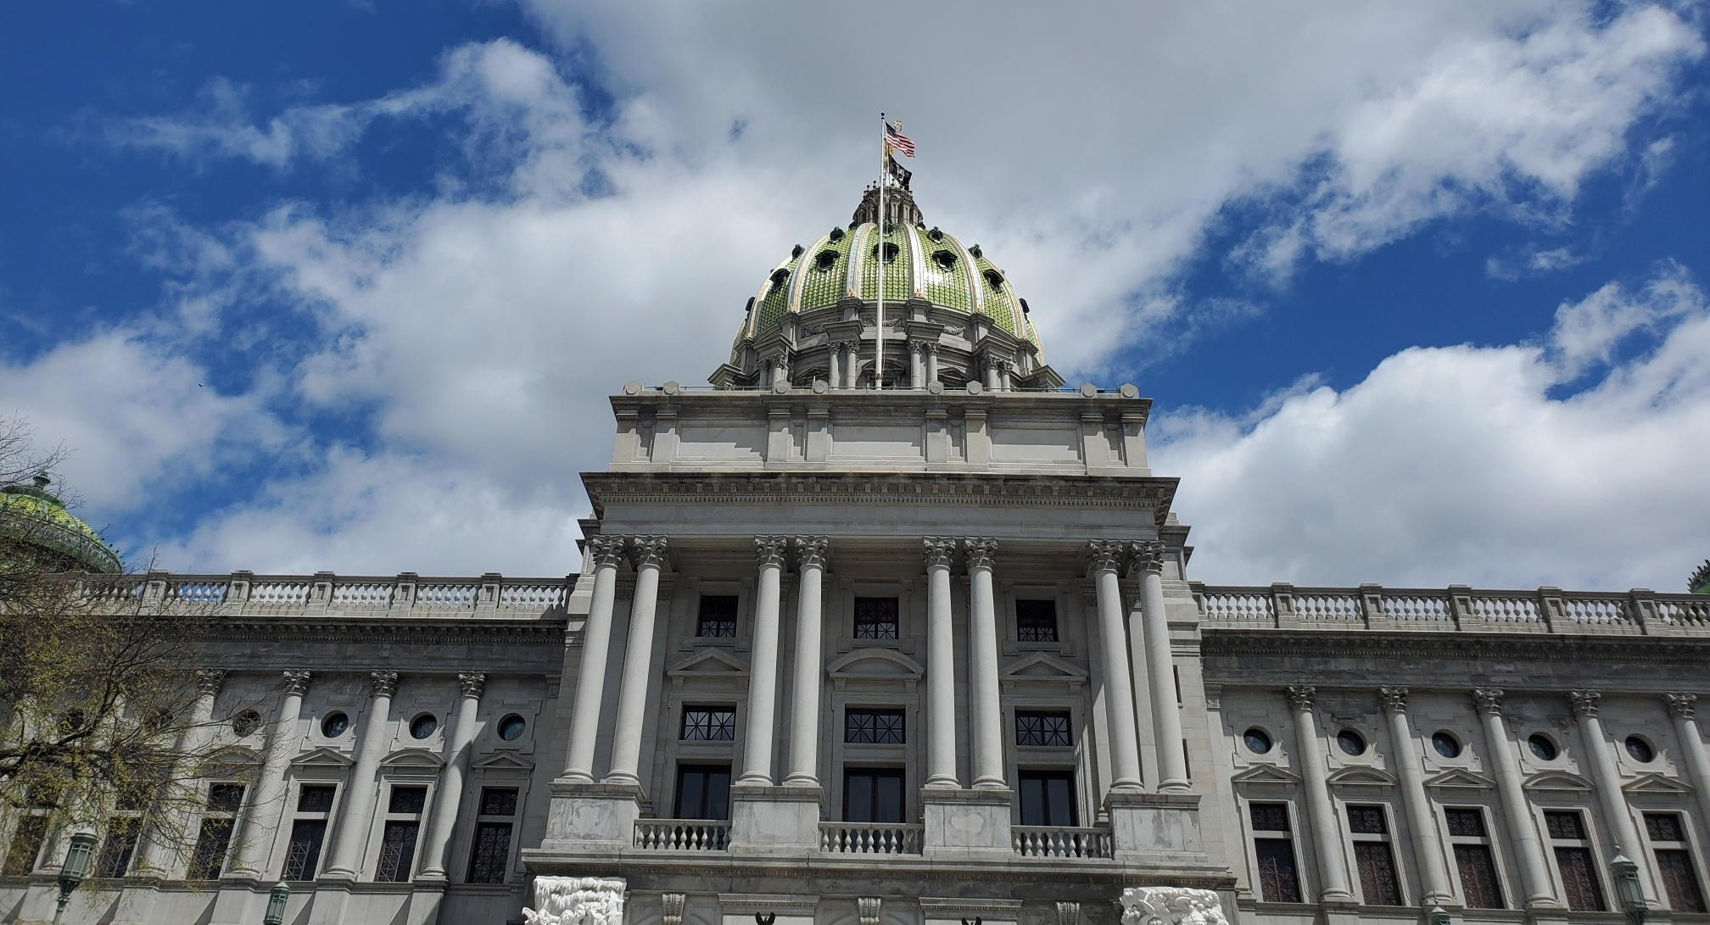
FAITH BUILDS ON FAITH
BREAKTHROUGH BUILDS ON BREAKTHROUGH
WE ARE NOT USED TO PREVAILING IN PRAYER FOR OUR NATION TO BE SAVED FROM DESTRUCTION
Hannah Was Desperate
"Not so, my lord," Hannah replied, "I am a woman who is deeply troubled. I have not been drinking wine or beer; I was pouring out my soul to the LORD. ¹⁶ Do not take your servant for a wicked woman; I have been praying here out of my great anguish and grief." ¹⁷ Eli answered, "Go in peace, and may the God of Israel grant you what you have asked of him." 1 Samuel 1:15-17 (NIV)
And the LORD was gracious to Hannah; she conceived and gave birth to three sons and two daughters. Meanwhile, the boy Samuel grew up in the presence of the LORD.
1 Samuel 2:21 (NIV)

Slide 6
PROFOUND SHIFT IN FAITH UNDERSTANDING
(BY THE CENTURION)
When they came to Jesus, they pleaded earnestly with him, "This man deserves to have you do this, ⁵ because he loves our nation and has built our synagogue." ⁶ So Jesus went with them. He was not far from the house when the centurion sent friends to say to him: "Lord, don't trouble yourself, for I do not deserve to have you come under my roof. ⁷ That is why I did not even consider myself worthy to come to you. But say (speak – command) the word, and my servant will be healed. ⁸ For I myself am a man under authority, with soldiers under me. I tell this one, 'Go,' and he goes; and that one, 'Come,' and he comes. I say to my servant, 'Do this,' and he does it." ⁹ When Jesus heard this, He was amazed at him, and turning to the crowd following him, he said, "I tell you, I have not found such great (so vast) faith even in Israel." ¹⁰ Then the men who had been sent returned to the house and found the servant well. Luke 7:4-10 (NIV)

Slide 7
“If I were God.”
“Why Does God do it that way?”
Why are the “Principles of Intercession” such a mystery? Why doesn’t God answer sometimes – or answer more quickly?
Why is God so slow to anger – Couldn’t He restrain wickedness better if He brought judgment immediately?
Why does effective “mountain-moving” faith seem impossible or too complicated to attain?
Why is God so hard to find for so many people?
Why does God allow us to deceive and miss Him ourselves?
Why does God allow things to go “sideways” even for His people that are IN THE WILL OF GOD?”
Why does God seemingly bless people who are out of the will of God?

Slide 8
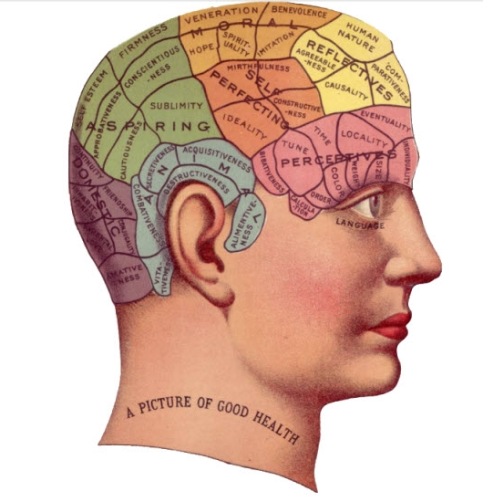
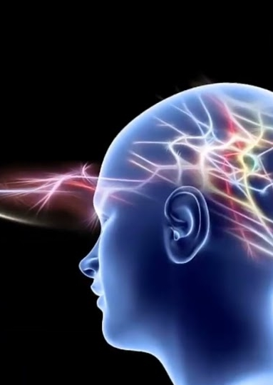
Natural Mind
Supernatural Mind
Are Colliding Right Now
Set your minds on things above, not on earthly things. Colossians 3:2 (NIV)
But we have the mind of Christ.
1 Corinthians 2:16b (NIV)
Do not be anxious about anything, but in everything, by prayer and petition, with thanksgiving, present your requests to God. 7 And the peace of God, which transcends all understanding, will guard your hearts and your minds in Christ Jesus. Philippians 4:6-7 (NIV)
Casting down imaginations (reasoning) , and every high thing that exalts itself against the knowledge of God, and bringing into captivity every thought to the obedience of Christ; 2 Corinthians 10:5 (KJV)

Slide 9
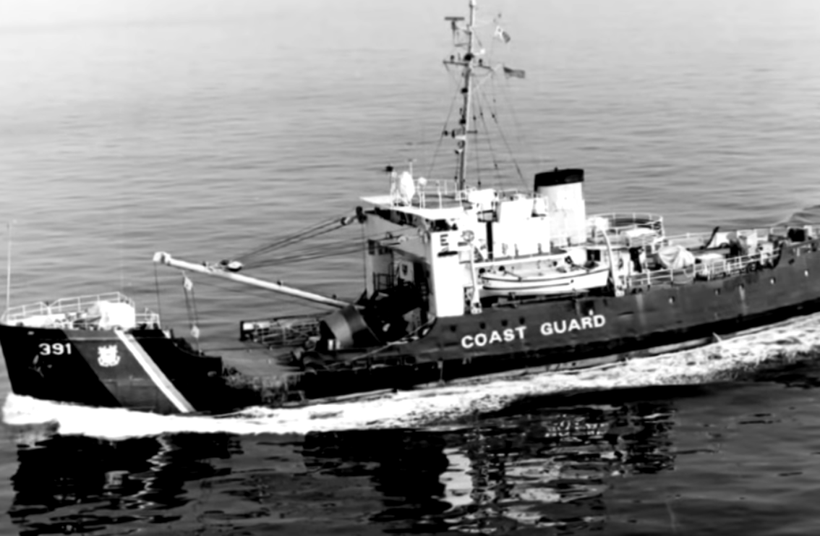
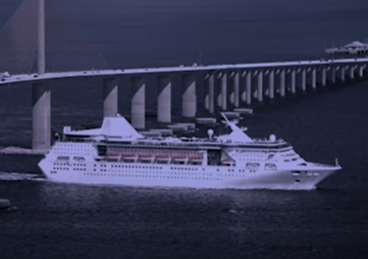
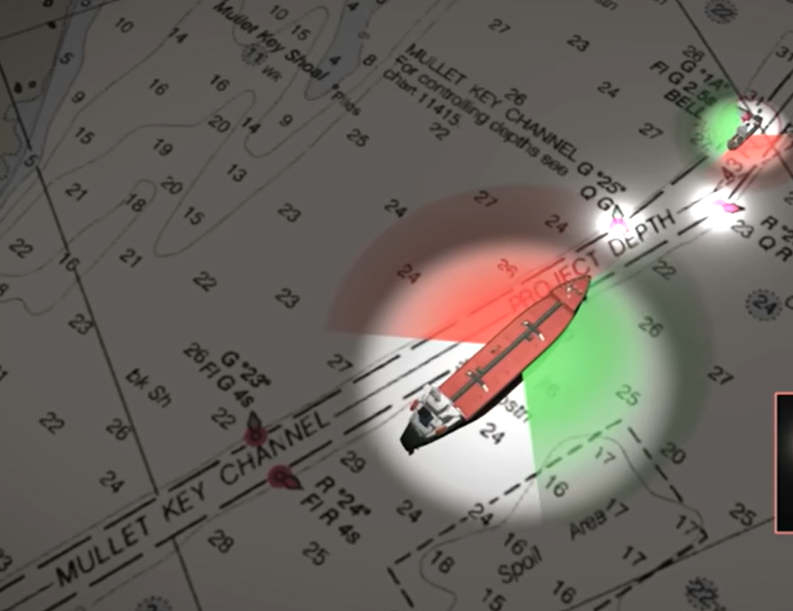
Leadership Must Be Prepared,
Anticipate, Communicate Clearly
Sinking of The USCGC Blackthorn
January 1980
Two Fog- Horn Blasts
A Starboard to Starboard passing

Slide 10
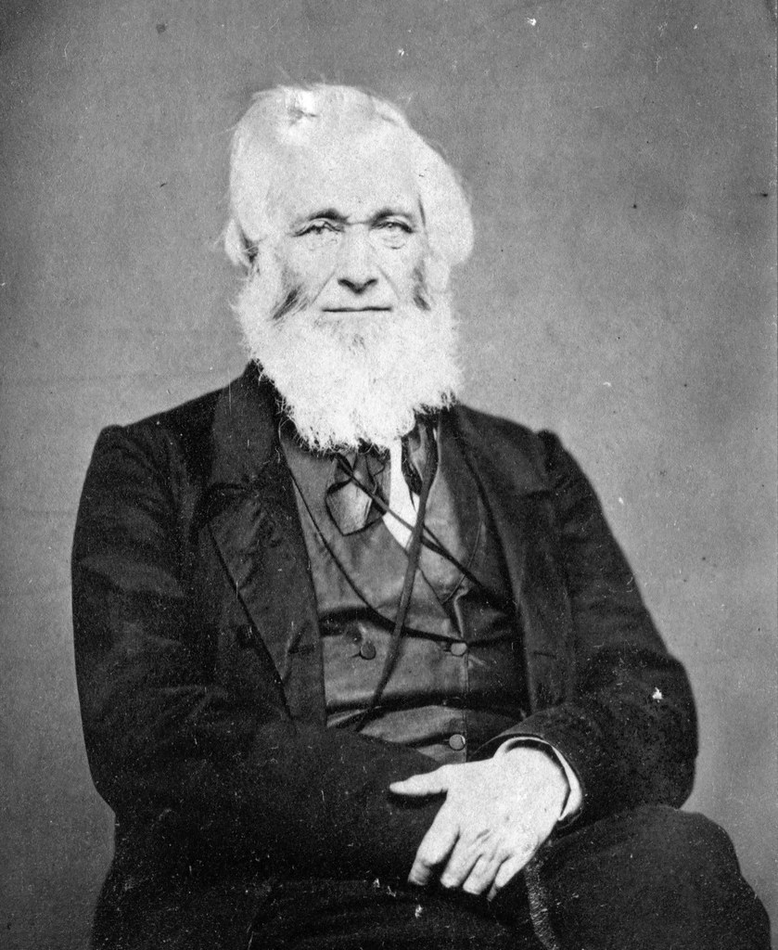
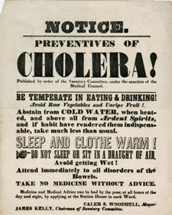
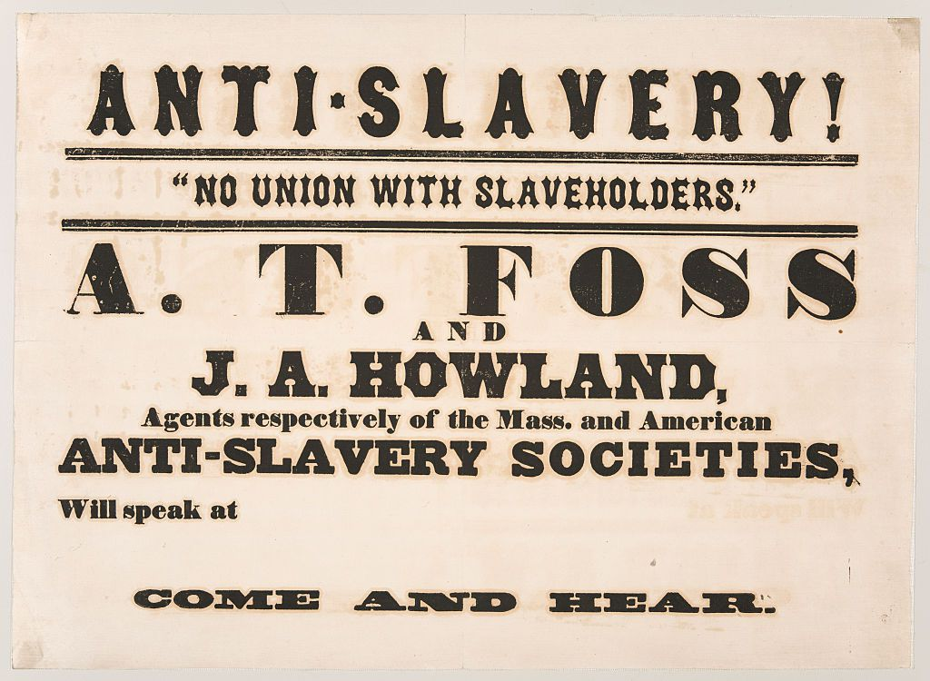
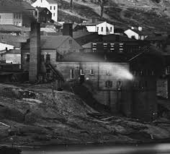
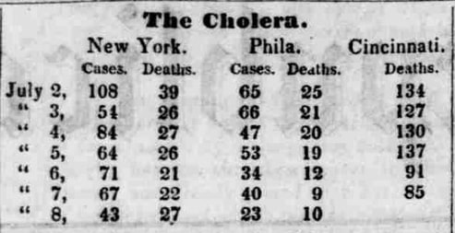
CINCINNATI AND THE 1832 BATTLE FOR TRUTH
AND THE CHOLERA EPIDEMIC
As the pestilence approached, the churches of the city held a day of fasting and prayer. My own people, in addition to this, held a special day, on our own account.
For myself, as pastor, I took the greatest pains to inform myself of the indications of the approach of the disorder, of the counteracting measures to be adopted, and the remedies to be applied. In all these matters I fully instructed myself and my people, urging them to a prompt and full preparation for whatever might occur, and to a peaceful commitment of their earthly and spiritual interests to the Divine care and keeping. - I also visited, conversed, and prayed with, my church and congregation, giving them such instructions and admonitions as needed; urging the promptest action the moment the first indications of the presence of the visitation should appear. The result was, that but one individual in my church and congregation was known to have died from that visitation. This individual was a man somewhat advanced in years (did not listen to Asa Mahan.)
Asa Mahan

Slide 11
WE ARE CRYING OUR FOR THE LORD TO PREVENT OUR DAY OF CALAMITY – HE GOES BEFORE US – HE ANTICIPATES WHAT WE NEED
HE IS THE BEST LEADER TO HELP US IN THIS TRIAL
Because of His strength will I wait upon You: for God is my defense. 10 The God of my mercy shall prevent (go before) me: God shall let me see (look triumphantly) upon mine enemies. Psalm 59:9,10
HEBREW – KAWDAM - to project (one self), i.e. to precede – to go before ; to anticipate, hasten, meet (usually for help) to meet, prevent

Slide 12
THE LORD IS THE BEST LEADER
HE PREPARED – ANTICIPATED
AND CLEARLY COMMUNICATED
FROM THE BEGINNING OF TIME – HE WAS READY
According as He has chosen us in Him (JESUS) before the foundation of the world, that we should be holy and without blame before Him in love: ⁵ Having predestinated us unto the adoption of children by Jesus Christ to Himself, according to the good pleasure of His will, Ephesians 1:4-5 (KJV)
Concerning this salvation, the prophets, who spoke of the grace that was to come to you, searched intently and with the greatest care, ¹¹ trying to find out the time and circumstances to which the Spirit of Christ in them was pointing when He predicted the sufferings of Christ and the glories that would follow.. 1 Peter 1:10-11

Slide 13
GOD NOT ONLY CREATED US
HE ANTICIPATED THE STORMS WE WOULD FACE
But now, this is what the LORD says-- He who created you, O Jacob, He who formed you, O Israel: "Fear not, for I have redeemed you; I have summoned you by name; you are Mine. ² When you pass through the waters, I will be with you; and when you pass through the rivers, they will not sweep over you. When you walk through the fire, you will not be burned; the flames will not set you ablaze. Isaiah 43:1-2 (NIV)
Humble yourselves, therefore, under God's mighty hand, that He may lift you up in due time. ⁷ Cast all your anxiety on Him because He cares for you. ⁸ Be self-controlled and alert. Your enemy the devil prowls around like a roaring lion looking for someone to devour. ⁹ Resist him, standing firm in the faith, because you know that your brothers throughout the world are undergoing the same kind of sufferings. ¹⁰ And the God of all grace, Who called you to His eternal glory in Christ, after you have suffered a little while, will Himself restore you and make you strong, firm and steadfast. ¹¹ To Him be the power for ever and ever. Amen. 1 Peter 5:6-11 (NIV)

Slide 14
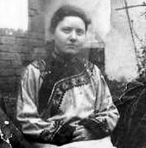
Marie Monsen And Her Breakthrough
With one hand on the lamp to put it out, the words were spoken aloud: “Never again, never again. It is only for missionaries who are a hundred per cent godly, faithful and holy, it is not for me.” But then, even before the light went out, the words sounded distinctly: “Are you not crucified with Christ?” “Yes.” - “Did you not die with Christ?” “Yes.” “Are you not risen with Christ?” “Yes.” “Christ has a right to all that is God’s, and He shares it all with His fellow-heirs.”
THE BATTLE FOR ASSURANCE - “Are you not risen with Christ?” “Yes.” “And Christ has a right to all that is God’s, and He shares it all with His fellow-heirs.” Yes” “ I saw it, I saw it! Jesus had an uncontested right to the whole inheritance, and He shared it with me and with all who are sinners redeemed by His blood. Marie Monsen –China 1915

Slide 15
God Wants Us To Know
Our Inheritance in Christ – SERIOUSLY!!!
But in these last days He has spoken to us by His Son, whom He appointed Heir of all things Hebrews 1:2
No one will be able to stand up against you all the days of your life. As I was with Moses, so I will be with you; I will never leave you nor forsake you. Joshua 1:5 (NIV)
To understand the amazing reach of these promises –we should search them out, and study them, with all the interest and curiosity of a inheritor searching the will of a rich benefactor; that we may plead them with unfailing confidence, and eager expectation, for their fulfillment. Eli Wigle

Slide 16
GOD DESIRES CERTAIN TRAJECTORIES TO MOVE FORWARD
HE REVEALS THESE PLANS –
HE WANTS US TO AGREE WITH HIM
So is My Word that goes out from My mouth: It will not return to Me empty (void), but will accomplish what I desire and achieve (Prosper) the purpose for which I sent it. ¹² You will go out in joy and be led forth in peace; the mountains and hills will burst into song before you, and all the trees of the field will clap their hands. Isaiah 55:11-12 (NIV)
For I know the plans I have for you," declares the LORD, "plans to prosper you and not to harm you, plans to give you hope and a future. ¹² Then you will call upon me and come and pray to me, and I will listen to you. ¹³ You will seek me and find me when you seek me with all your heart. ¹⁴ I will be found by you," declares the LORD, "and will bring you back from captivity." Jeremiah 29:11-14a (NIV)

Slide 17
DON’T QUIT ON THE TRAJECTORY OF REVELATION THAT GOD HAS BROUGHT FORTH – HE IS LEADING US IN FAITH AND INTERCESSION TOWARD THE SAME OUTCOME. HE IS ALSO WORKING OUT NEEDED CORRECTIONS AS WELL – SO WE CAN’T GIVE UP ON IT – BECAUSE IT LOOKS BACKWARDS OR UPSIDE DOWN. GOD HAS BEEN INDICATING IN A HUNDRED DIFFERENT WAYS AND PROPHECIES THAT THE GREATEST OUTPOURINGS OF THE SPIRIT ARE AHEAD OF US. DECEMBER 2020
November 1, 2020
“LORD WE BELIEVE THAT CHALLENGES – SUDDEN SETBACKS – PHYSICAL ATTACKS AND WEAKNESSES – NATIONAL EMERGENCIES – RELATIONSHIP TRIALS AND FINANCIAL CHALLENGES - CAN ALL BE TURNED FOR GOOD AS WE FALL IN LOVE WITH YOU AND PREVAIL IN PRAYER UPON YOUR PROMISES – TO SEE YOUR GLORY OVERRULE THE CHAOS.” 2022

Slide 18
MOSES WONDERING – “Lord What Are You Doing?”
Moses returned to the LORD and said, "O Lord, why have You brought trouble upon this people? Is this why You sent me? ²³ Ever since I went to Pharaoh to speak in Your name, he has brought trouble upon this people, and You have not rescued your people at all." Exodus 5:22-23 (NIV)
Then the LORD said to Moses, "Now you will see what I will do to Pharaoh: Because of My mighty hand he will let them go; because of My mighty hand he will drive them out of his country." ² God also said to Moses, "I am the LORD. ³ I appeared to Abraham, to Isaac, and to Jacob as God Almighty (El Shadai), but by My name the LORD (Jehovah) I did not make Myself known to them. Exodus 6:1-3
By day the LORD went ahead of them in a pillar of cloud to guide them on their way and by night in a pillar of fire to give them light, so that they could travel by day or night. Exodus 13:21-22 (NIV) (GOD WAS LEADING THEM – TO A CRISIS)
And I will harden Pharaoh's heart, and he will pursue them. But I will gain glory for myself through Pharaoh and all his army, and the Egyptians will know that I am the LORD." Exodus 14:4 (NIV)
Then the LORD said to Moses, "Why are you crying out to me? Tell the Israelites to move on. ¹⁶ Raise your staff and stretch out your hand over the sea to divide the water so that the Israelites can go through the sea on dry ground. Exodus 14:15-16 (NIV)

Slide 19
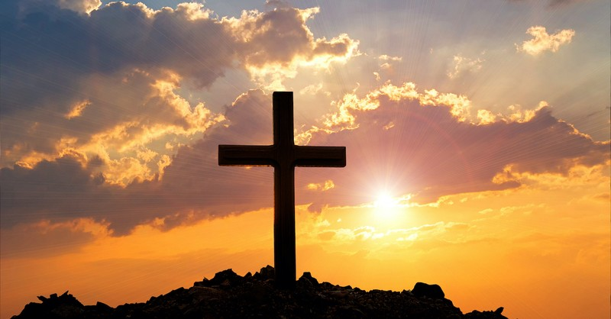
FAITH PROCLAMATION
“LORD WE ASK YOU TO ACCOMPLISH THE DESIRES ON YOUR HEART TO INTERVENE IN AMERICA AND SAVE IT FROM IT’S PRIDE, IDOLATRY, AND A LUKEWARM CHURCH AND UNBIBLICAL TYRANTS AND SYSTEMS THAT PROMOTE WICKEDNESS. OVERRULE IN THIS ELECTION TO SEAT CANDIDATES WHO REPRESENT JUDEO-CHRISTIAN VALUES. KEEP US FROM VIOLENCE AND SAVE US FROM BECOMING A BANANA REPUBLIC. IN JESUS NAME AMEN! ”

Slide 20
RECEIVING GOD’S PROVISION
1/ Breaking off the heaviness – “Lord You have anticipated what we are facing we lean into You for your merciful intervention.”
2/ Remove the roadblocks – “Lord release the grace that will overwhelm the warfare.”
3/ Breaking the spirit of delay – “Lord bring acceleration to Your promises.”
4/ Laboring from a place of FAITH – “Lord forgive us for fretting – being exhausted – and feeling defeated.”
5/ Steady growth – “Lord, by Your grace give is high fruitfulness in our growth with You and our family.”
6/ Clear instructions for strategic shifts - “Lord open our ears to hear clearly Your leading and assignments.”

Slide 21
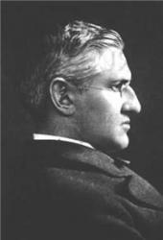
Prepare For Communion
IT IS WELL WITH MY SOUL
When peace like a river attendeth my way, when sorrows like sea billows roll; whatever my lot, thou hast taught me to say, "It is well, it is well with my soul."
Refrain
It is well with my soul; it is well, it is well with my soul.
Horatio Spafford

Slide 22
Don’s Paraphrase of 1 Corinthians 13
“If I speak or write the most powerful sermons or internet articles to release the Gospel and save my nation as a godly patriot but have no passionate love for Jesus and others around me, I am only a repeating doorbell or annoying YouTube advertisement. If I have the gift of prophecy and can foretell exactly the downfall of the deep state and the anti-Christ leaders of the earth, and if I have a faith that can prevail for mountain-moving interventions in America, but have no love for my wife, family, and church, I am going backwards. If I give all I possess to the local homeless shelter and surrender my body to the DOJ in wrongful arrests, but have not love for my neighbors and enemies, I gained nothing. (because) Love is patient, love is kind. It does not envy, it does not boast, it is not proud. It is not rude, it is not self-seeking, it is not easily angered, it keeps no record of wrongs. Love does not delight in evil but rejoices with the truth. It always protects, always trusts, always hopes, always perseveres. Love never fails. 1 Corinthians 13:1-8 (NIV)

Slide 23
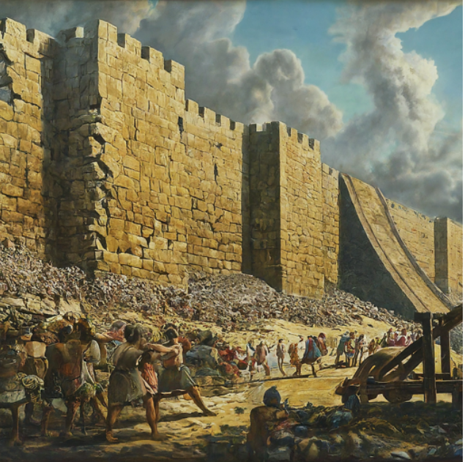
KING HEZEKIAH MADE SOME “DOOZIES” OF MISTAKES – YET GOD HAD MERCY
And the LORD was with him; he was successful in whatever he undertook. He rebelled against the king of Assyria and did not serve him. ⁸ From watchtower to fortified city, he defeated the Philistines, as far as Gaza and its territory. 2 Kings 18:7-8 (NIV)
So Hezekiah gave him all the silver that was found in the temple of the LORD and in the treasuries of the royal palace. ¹⁶ At this time Hezekiah king of Judah stripped off the gold with which he had covered the doors and doorposts of the temple of the LORD, and gave it to the king of Assyria. 2 Kings 18:15-16 (NIV)
³⁵ That night the angel of the LORD went out and put to death a hundred and eighty-five thousand men in the Assyrian camp. When the people got up the next morning--there were all the dead bodies! ³⁶ So Sennacherib king of Assyria broke camp and withdrew. He returned to Nineveh and stayed there. 2 Kings 19:35-36 (NIV)

Slide 24
Profound Mercy For A Backslidden Leader (MANASSEH)
He (Manasseh) did evil in the eyes of the LORD, following the detestable practices of the nations the LORD had driven out before the Israelites. ³ He rebuilt the high places his father Hezekiah had demolished; - he built altars to all the starry hosts. ⁶ He sacrificed his sons in the fire in the Valley of Ben Hinnom, practiced sorcery, divination and witchcraft, and consulted mediums and spiritists. He did much evil in the eyes of the LORD, provoking Him to anger. 2 Chronicles 33:2-6 (NIV)
In his distress he sought the favor of the LORD his God and humbled himself greatly before the God of his fathers. 13 And when he prayed to Him, the LORD was moved by his entreaty and listened (granted - consented) to his plea; so He brought him back to Jerusalem and to his kingdom. Then Manasseh knew that the LORD is God. 2 Chronicles 33:10-13 (NIV)

Slide 25
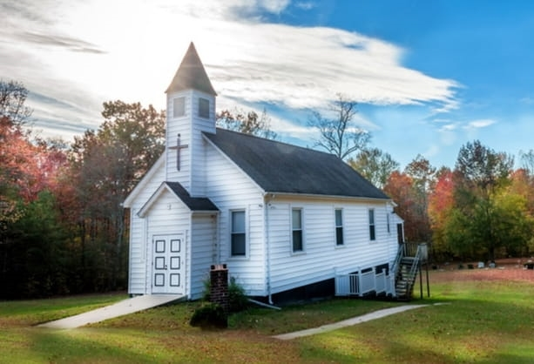
"O God, do all Your will in the Church of America ; then put her in any position which will most fully illustrate and lift up Your saving grace. No matter what it is, only let the American Church greatly glorify Your name, amen."

Slide 26
A TOUGH WORD FOR THE EVANGELICAL CHURCH
“Sending everyone to church – and medicating them on a neutral world view so that they have no feelings about anything and don’t get involved either.”
“We are not called to fill a building and get a following – we are called to spiritually influence a nation and change the culture through the Gospel.” Author Unknown

