Slide 1
LifeGate Sermon
October 6, 2024

Slide 2
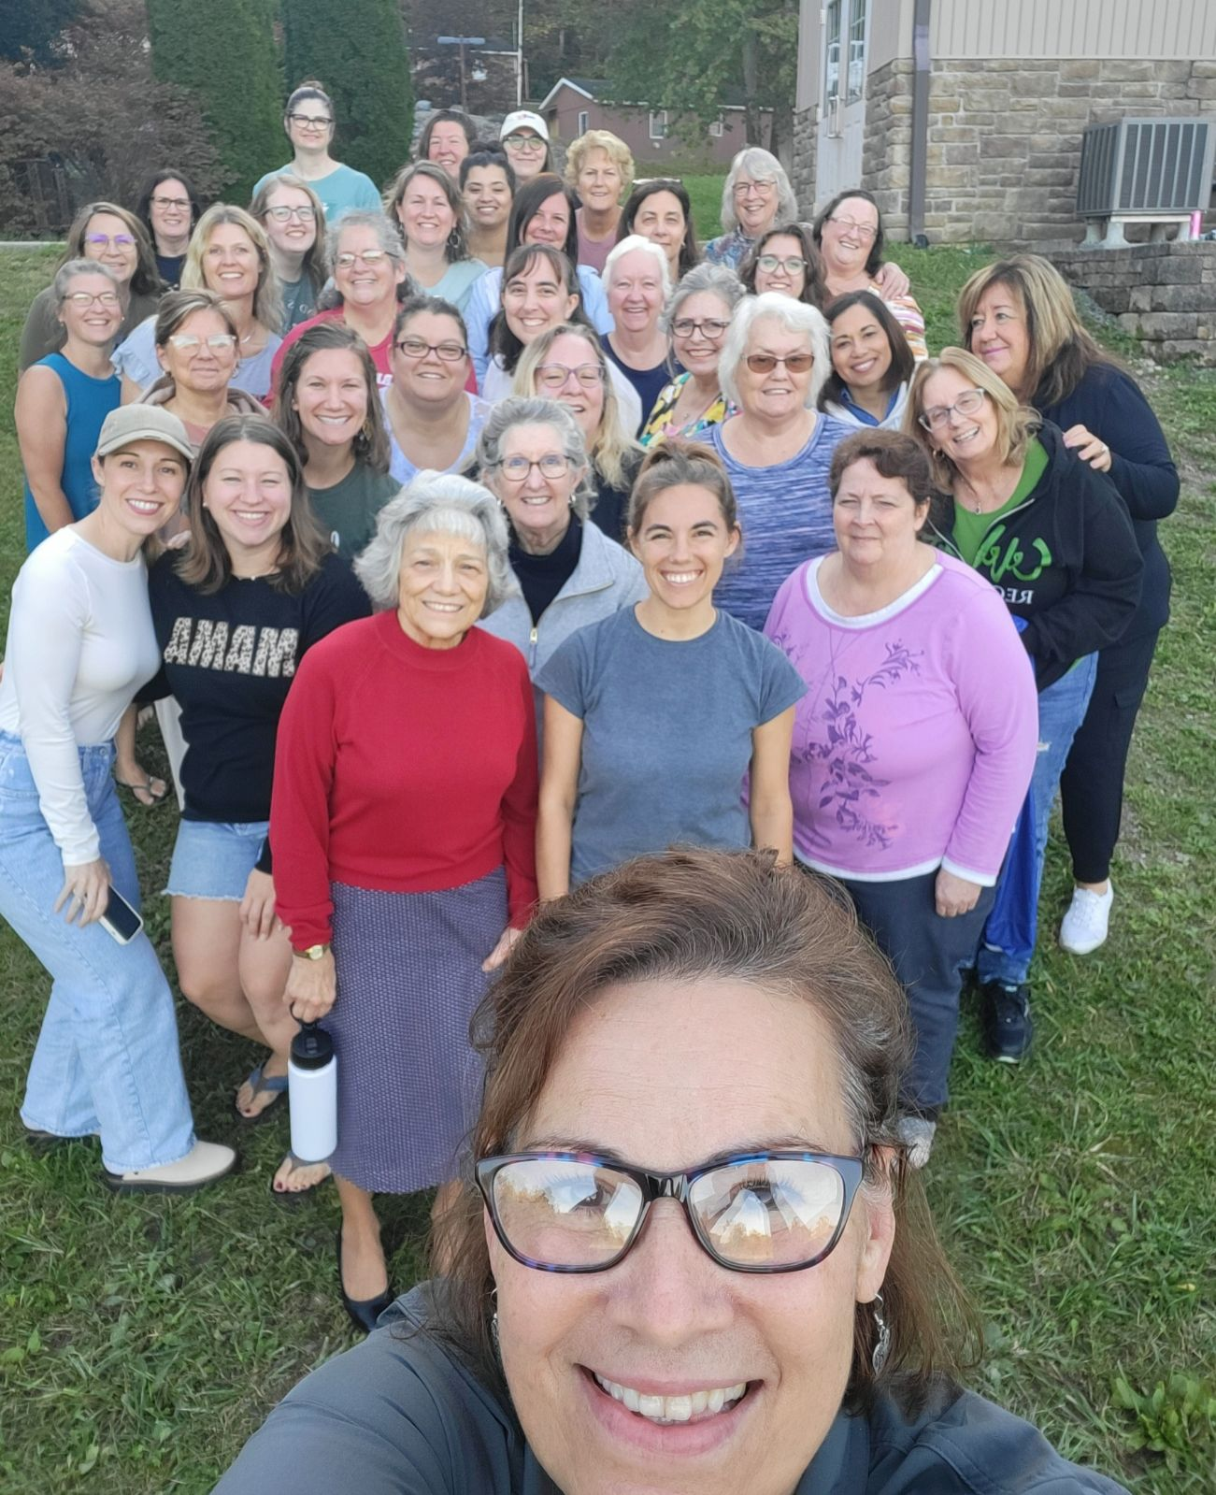

Slide 3
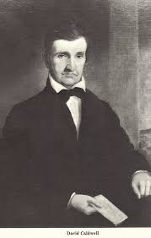
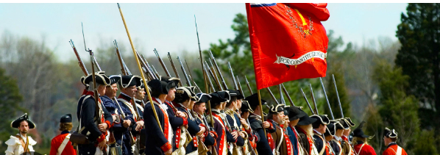
UNKNOWN BROTHER FROM LANCASTER COUNTY
THAT POWERFULLY IMPACTED
THE AMERICAN REVOLUTION AND THE 1800 REVIVAL
1781 - Lived near Greensboro North Carolina
Was in the region at the battle of Gilford Courthouse – his home and property were plundered by the British army and Tories.
Pastor David Caldwell
Builds a College in North Carolina – trained the top 5 leaders of the Revival of 1800

Slide 4
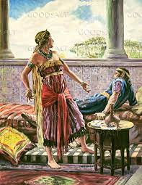
We Live in A Generation That Makes Fun of Masculinity – And Elevates Feminism
God Wants Men To Be Strong Leaders Following The Example of Jesus Christ
God Wants Women To Come Along side and Not Disengage but Co-Lead and Co-bless Their families and Communities
WE LIVE IN AN AHAB JEZEBEL GENERATION – MEN ARE TAUGHT TO BE PASSIVE MEN AND WOMEN ARE TAUGHT TO CONTROL

Slide 5
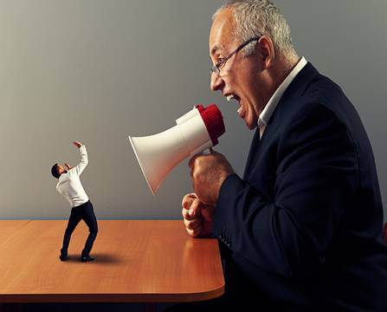
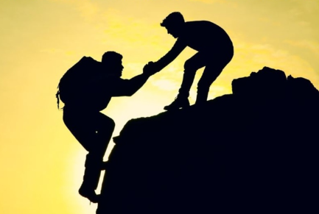
WHAT IS GODLY LEADERSHIP?
Authoritarian
LEAD BY FORCE
Servant Leadership
LEAD BY Example
I’m the head and you need to submit – and I will tell you what to do
I’m responsible to lead and protect you and help us be under the covering of Jesus – follow me

Slide 6
OUR PRACTICAL POSTURE ON EARTH
EFFECTS HOW WE ARE HELPFUL
OR HINDERING TO GOD’S PURPOSES FOR US
Husbands (MEN), in the same way be considerate as you live with your wives, and treat them with respect as the weaker partner and as heirs with you of the gracious gift of life, so that nothing will hinder your prayers.
1 Peter 3:7 (NIV)

Slide 7
WHEN WE ARE REDEEMED
THE LORD PURCHASES OUR SALVATION,
OUR HEALING, OUR DELIVERANCE,
AND THE RENEWAL OF THE MIND
¹ Therefore, I urge you, brothers, in view of God's mercy, to offer your bodies as living sacrifices, holy and pleasing to God--this is your spiritual act of worship. ² Do not conform any longer to the pattern of this world, but be transformed by the renewing of your mind. Then you will be able to test and approve what God's will is--his good, pleasing and perfect will. Romans 12:1-2 (NIV)

Slide 8
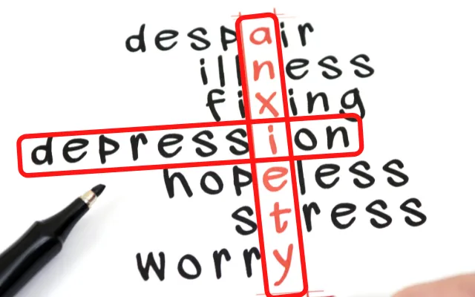
Finally, brothers, whatever is true, whatever is noble, whatever is right, whatever is pure, whatever is lovely, whatever is admirable--if anything is excellent or praiseworthy--think about such things. Philippians 4:8 (NIV)
TO THE HOLY SPIRIT
BREAK THE PARALYZING CYCLE OF HOPELESSNESS AND UNBELIEF FOR ANY INTERVENTION

Slide 9
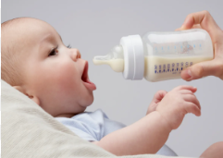
WHEN TRANSFORMATION OF THE MIND
IMPACTS THE WAY THINGS ARE DONE
WENT FROM 3-4 INCIDENCES PER MONTH – TO ZERO

Slide 10
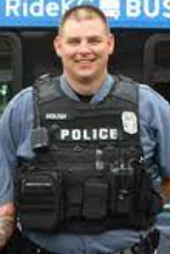
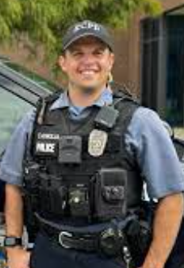
THE LORD CHANGES OUR PERSPECTIVE
JACK
CHIP
“Dad you wouldn’t understand – Because you’re a ROBOT”
FATHER WOUND - UNHEALED
DAD HATED COPS – THAT’S WHY HE BECAME A COP
Changed His whole outlook – How To meet people and bless them in the drama
BAD PEOPLE NEED – TO BE PUNISHED – A BE GIVEN THE SAME TREATMENT

Slide 11
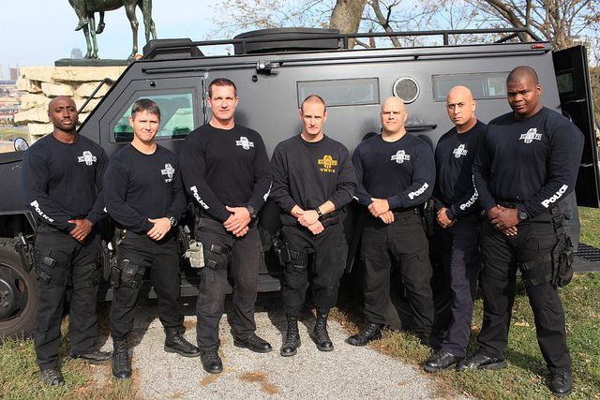
THE RESULTS
THEY DIDN’T HAVE A COMPLAINT FILED AGAINST THEM IN SIX YEARS
IN THE FIRST THREE YEARS OF THIS CHANGE THEY RECOVERED MORE DRUGS AND GUNS THAN THE PREVIOUS TEN

Slide 12
JESUS GIVES US THE POWER TO LEAD AS MEN
GODLY LEADERS
The thief comes, but to steal, and to kill, and to destroy: I am come that they might have life, and that they might have it more abundantly. John 10:10 (KJV)

Slide 14
WHAT IS A KINSMAN REDEEMER?
YOU’VE LOST EVERYTHING AND A WEALTHY BENEFACTOR BUYS
BACK YOUR ESTATE – AND PAYS ALL YOUR BACK TAXES
Then Boaz said, "On the day you buy the land from Naomi and from Ruth the Moabitess, you acquire the dead man's widow, in order to maintain the name of the dead with his property." 6 At this, the kinsman-redeemer said, "Then I cannot redeem it because I might endanger my own estate (Satan and the world doesn’t want to help us – we are of no value to them – they already have their FAVORITE SONS). You redeem it yourself. I cannot do it (Satan and the world can’t redeem us anyhow) ." 8 So the kinsman-redeemer said to Boaz, "Buy it yourself." And he removed his sandal. 9 Then Boaz announced to the elders and all the people, "Today you are witnesses that I have bought (redeemed) from Naomi all the property of Elimelech, Kilion and Mahlon 10 I have also acquired Ruth (friend) the Moabitess, Mahlon's widow, as my wife,!" Ruth 4:5-6; 8-10 (NIV)

Slide 15
IN OUR SALVATION THE LORD RANSOMS AND REDEEMS
For the Lord will ransom Jacob and redeem them from the hand of those stronger than they. Jeremiah 31:11 (NIV)

Slide 16
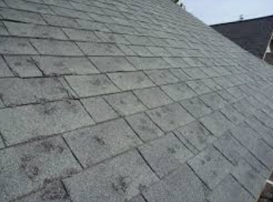
God Redeems Us – Buys Back All The
FAILURES – all the FRUSTRATIONS – And
Puts Them into the Sea Of Forgiveness
YES THAT IS COVERED
Who gave Himself for our sins, that He might deliver us from this present evil world, according to the will of God and our Father: Galatians 1:4 (KJV)
Because I know Whom I have believed, and am convinced that he is able to guard what I have entrusted to him for that day. 2 Timothy 1:12 (NIV)
Wherefore He is able also to save them to the uttermost that come unto God by Him, seeing He ever lives to make intercession for them. Hebrews 7:25 (KJV)

Slide 17
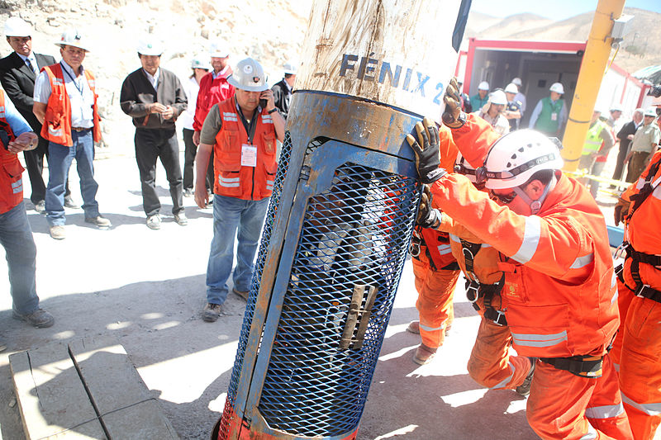
THE MIND-BLOWING IMPACT THAT
GOD CAME TO SAVE THE WHOLE WORLD

Slide 18
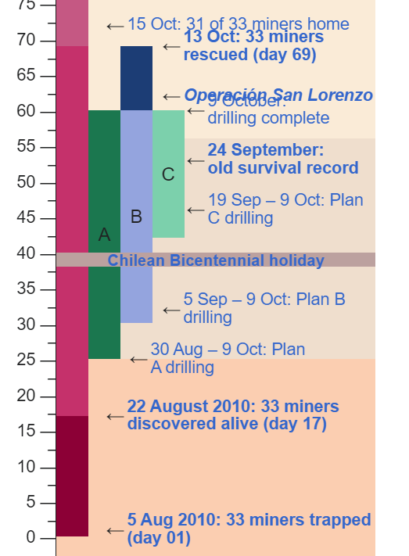
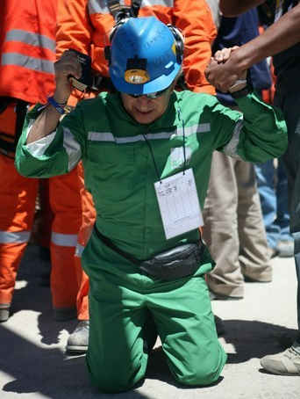
THE CHILE MINE RESCUE 2010
Why Did The Chilean Miners worship when
They came up and out of that rock fortress?
For you died, and your life is now hidden with Christ in God. Colossians 3:3 (NIV)
YOU HAVE TO ALLOW YOURSELF TO KNOW THAT YOU DON’T DESERVE TO LEAD – TO LIVE – TO BE BLESSED – BUT HE HAS RAISED YOU FROM THE DEAD

Slide 19
THE RADICAL INTERVENTION YOU HAVE
EXPERIENCED IN SALVATION DOES NOT MEAN
YOU WILL NOT EXPERIENCE HURT AND PAIN
“The Lord wants you to know that this trial will equip you to be there for others in a way that you would not have been able to without this experience. The Lord is preparing you to be a witness for others…to give hope to others.” Author Unknown “GOD DOESN’T WASTE THE MOST DIFFICULT TIMES OF OUR LIFE –HE WANTS TO REDEEM THEM FOR HIS GLORY.” – Jack Hibbs

Slide 20
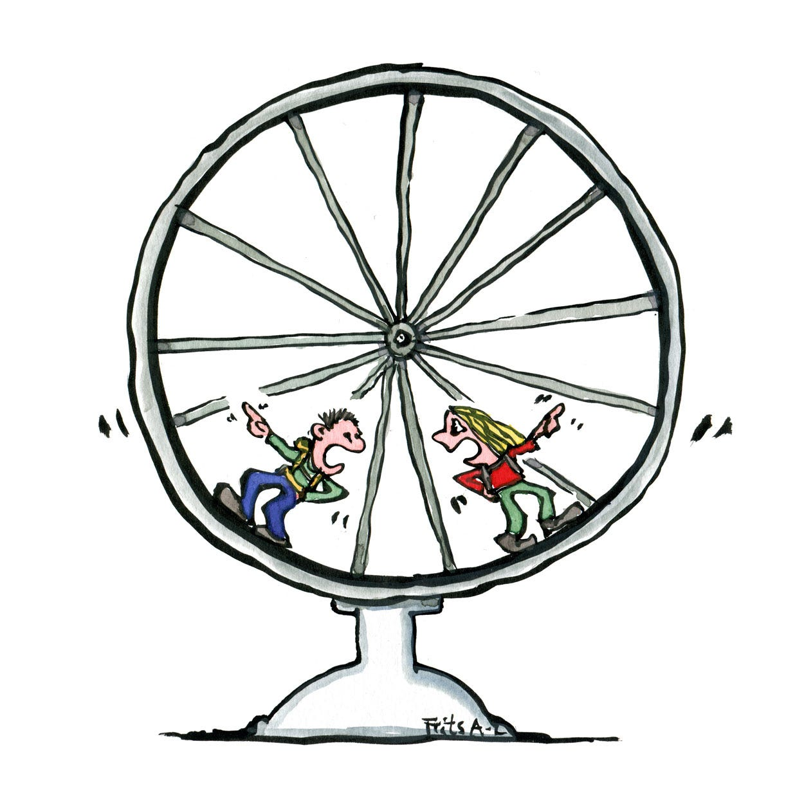
THE KEY TO THIS MOMENT OF CHANGE
IS “CRYING OUT TO GOD” WITH HOPE AND FAITH
AND LEAVING THE PAST IN THE PAST
BELIEVING FOR NEW PATHWAYS OF HEALING
HOW DO WE START AFRESH –
HOW DO WE GET TRACTION?
Therefore, strengthen your feeble arms and weak knees. ¹³ "Make level paths for your feet," so that the lame may not be disabled, but rather healed. ¹⁴ Make every effort to live in peace with all men and to be holy; without holiness no one will see the Lord. ¹⁵ See to it that no one misses the grace of God and that no bitter root grows up to cause trouble and defile many. Hebrews 12:12-15 (NIV)

Slide 21
DECLARE A NEW SEASON OVER YOUR LIFE
DISOBEDIENCE – OPENS THE DOOR
REFUSAL TO LOVE OPENS THE DOOR
NOT FORGIVING OTHERS OPENS THE DOOR
LIVING IN THE CONSTANT PAST OPENS THE DOOR
Realize I need to change
Don’t blame my spouse or others
Confess my sins and ask for forgiveness
Ask God to fill me with the FULLNESS of the Holy Spirit
Go to my spouse confess changes I need to make
In God’s Power change my THINKING and my UNBELIEF and HOPELESSNESS and my attitudes

Slide 22
PRAYER OF BREAKTHROUGH STRENGTH
OVER THE MEN OF LIFEGATE
1/ Breaking off the heaviness – Instead of all hell breaks loose. LET HEAVEN BREAK LOOSE.
2/ Remove the roadblocks – grace overwhelms the warfare – God’s Glory comes through patience – resilience
3/ Breaking the spirit of delay - Strongholds can fall – acceleration can take place.
4/ Laboring from a place of FAITH – not fretting – not exhausted – not feeling overwhelmed
5/ Steady growth – but the Lord adds to it – high productivity
6/ Clear instructions for strategic shifts - “cast your nets on the right side” - (BUILD AN ALTAR)

Slide 23
HOW TO ALLOW THE HOLY SPIRIT
TO GUIDE US FROM WALKING THROUGH THIS
GROWTH PROCESS
For this very reason, make every effort to add to your faith goodness; and to goodness, knowledge; ⁶ and to knowledge, self-control; and to self-control, perseverance; and to perseverance, godliness; ⁷ and to godliness, brotherly kindness; and to brotherly kindness, love. ⁸ For if you possess these qualities in increasing measure, they will keep you from being ineffective and unproductive in your knowledge of our Lord Jesus Christ. 2 Peter 1:5-9 (NIV)

