Slide 1
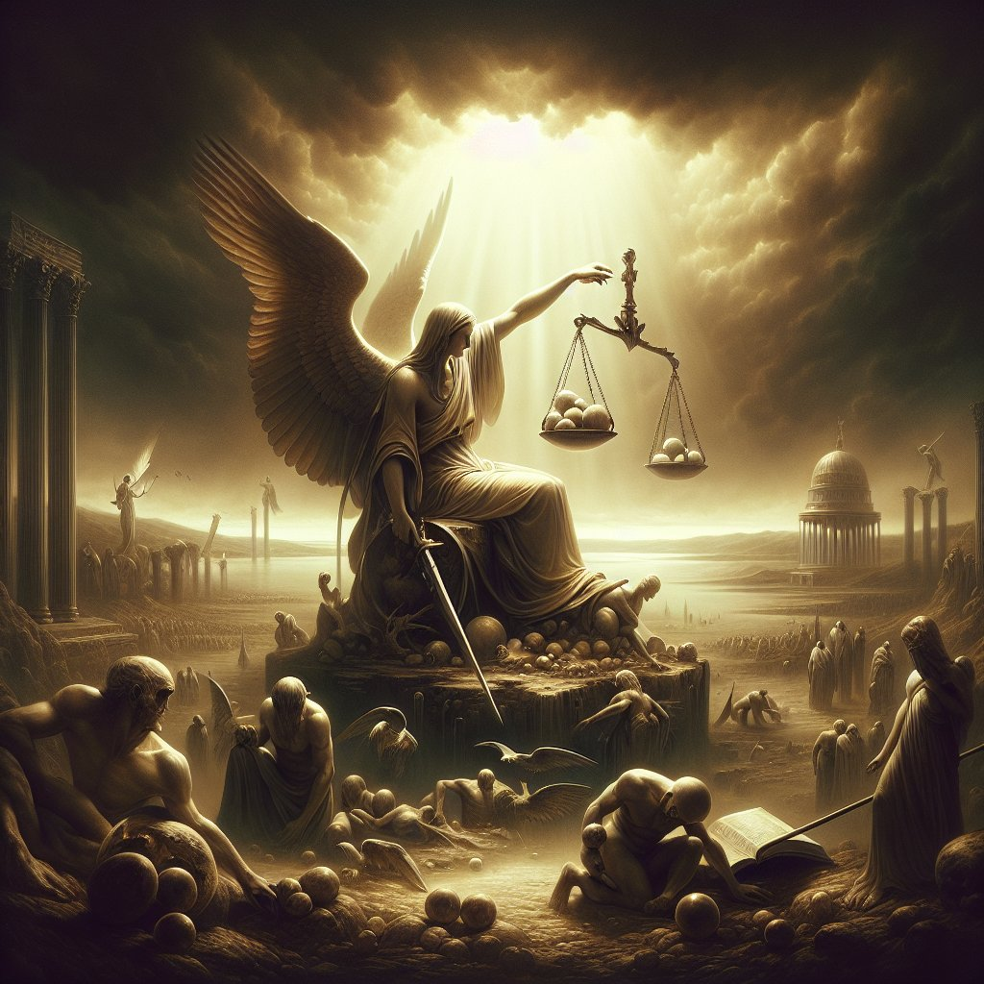
The Elusive Justice of God

Slide 2
“By the east wind, you shattered the ships of Tarshish” (Psalm 48:7, ESV)
“I will scatter them as with an east wind before the enemy; I will show them My back and not My face in the day of their disaster” (Jeremiah 18:17, NKJV)
“The east wind carries [a man] away, and he is gone; it sweeps him out of his place” (Job 27:21, NKJV)
“Measure by measure, by exile you contended with [Israel]; he removed them with his fierce breath in the day of the east wind” (Isaiah 27:8, ESV)
“Though he flourishes among the reeds, an east wind will come, the wind of the Lord coming up from the wilderness; and his fountain will become dry and his spring will dry up; it will plunder his treasury of every precious article” (Hosea 13:15, NASB)

Slide 3
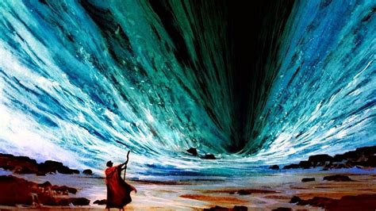
“And Moses stretched out his hand over the sea; and Jehovah caused the sea to go back by a strong east wind all the night, and made the sea dry land, and the waters were divided (Exodus 14:21, ASV)

Slide 4
In Nature and in Navigation
“An east wind is an unusual shift in the natural order. Normally winds and weather approach us from our West. The reason for this is that the earth we stand on has an axis, rotating rapidly form what we call east into west from any point on the globe. Like the trails that slide over the hood of a moving car, the atmosphere meets and moves contra the direction we’re traveling. But east winds are a strange and often violent reversal, almost like an ambush coming from behind.
-Mary Barton Nees, conceptual landscape artist
“We had king tides this weekend in the morning so a strong outflow most of the day on the inlet with an East Wind, which means the wind is going against the tide’s flow, which is always rough”

Slide 5
Individual judgment
Unbelievers – Great White Throne
Revelation 20:11-15
“And I saw the dead, small and great, stand before God, and the books were opened: and another book was opened, which is the book of life: and the dead were judged out of those things which were written in the books, according to their works
The Redeemed – Judgment Seat of Christ
Romans 14:10 – “For we will all stand before the judgment seat of God”
2 Corinthians 5:10 – “For we must all appear before the judgment seat of Christ, that each one may receive compensation for the things done in the body, according to what we have done, good or bad.”

Slide 6
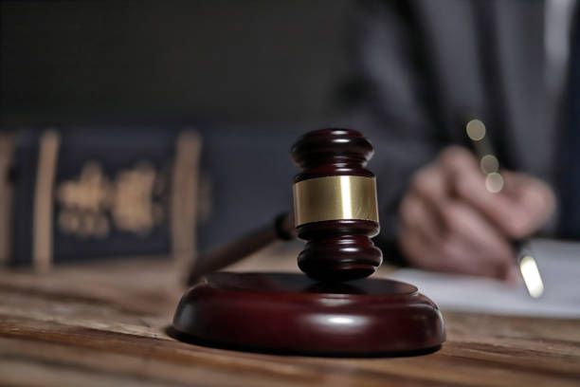
from the Greek word krima
a decree, judgments
judgment
condemnation of wrong, the decision (whether severe or mild) which one passes on the faults of others
in a forensic sense
the sentence of a judge
the punishment with which one is sentenced
condemnatory sentence, penal judgment, sentence
a matter to be judicially decided, a lawsuit, a case in court

Slide 7
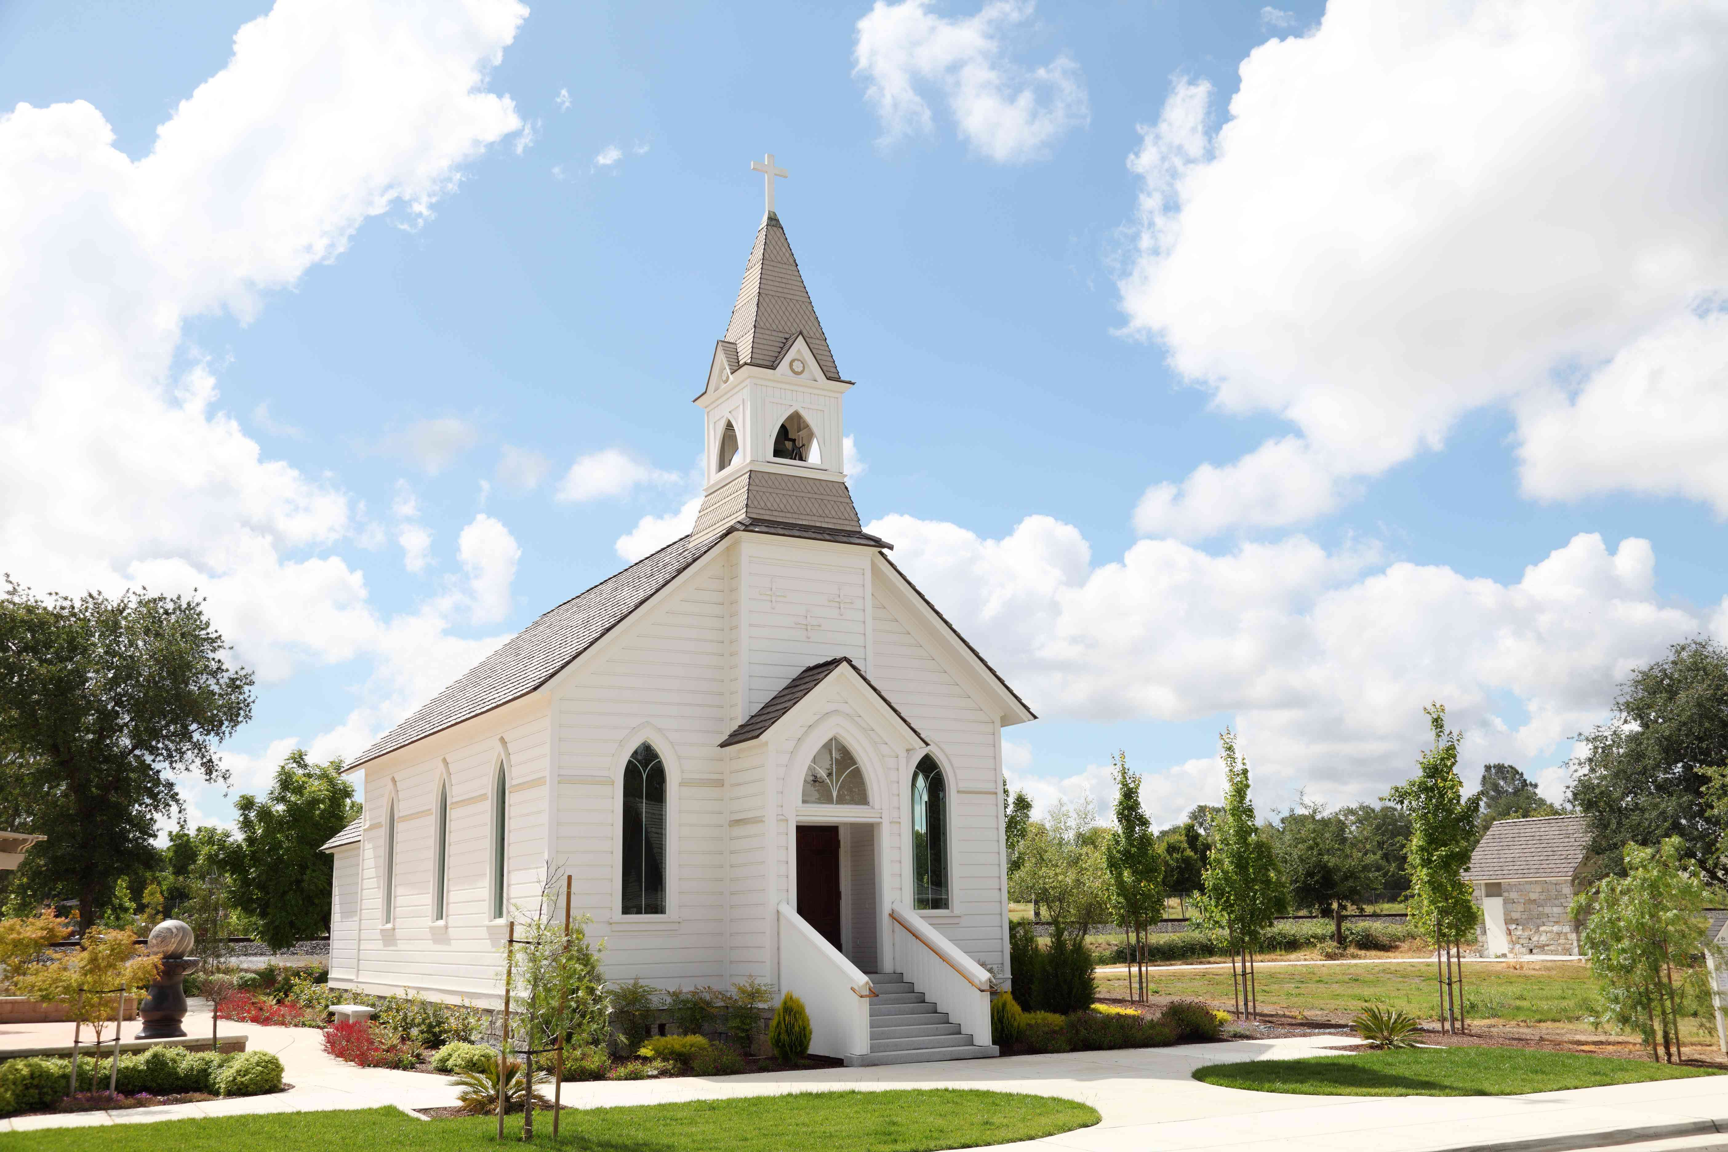
Judgment begins with the household of faith (1 Peter 4:17)

Slide 8
The Ancient of days came, and judgment was given to the saints of the Most High (Daniel 7:22)
Jesus said to them, “Truly, I say to you, in the new world, when the Son of Man will sit on his glorious throne, you who have followed me will also sit on twelve thrones, judging the twelve tribes of Israel. (Matthew 19:28)
“Or do you not know that the saints will judge the world? And if the world is to be judged by you, are you incompetent to try trivial cases?” (1 Corinthians 6:2)

Slide 9
The Psalmist’s Cry
“The ways of the wicked succeed at all times; Yet Your judgents are on high, out of his sight; As for all his enemies, he snorts at them. He says to himself, ‘I will not be moved…His mouth is full of cursing, deceit, and oppression; under his tongue is harm and injustice. He sits in the lurking places of the villages; he kills the innocent in the secret places….unfortunate people fall by his mighty power.
He says to himself, ‘God has forgotten; He has hidden His face; He will never see it.’
“Arise Lord God, lift up Your hand. Do not forget the humble. Why has the wicked disrespected God? He has said to himself, ‘You will not require an account.’
…You have been the helper of the orphan. Break the arm of the wicked and the evildoer…vindicate the orphan and the oppressed, so that man which is of the earth will no longer cause harm.” (Psalm 10:5-18)

Slide 10
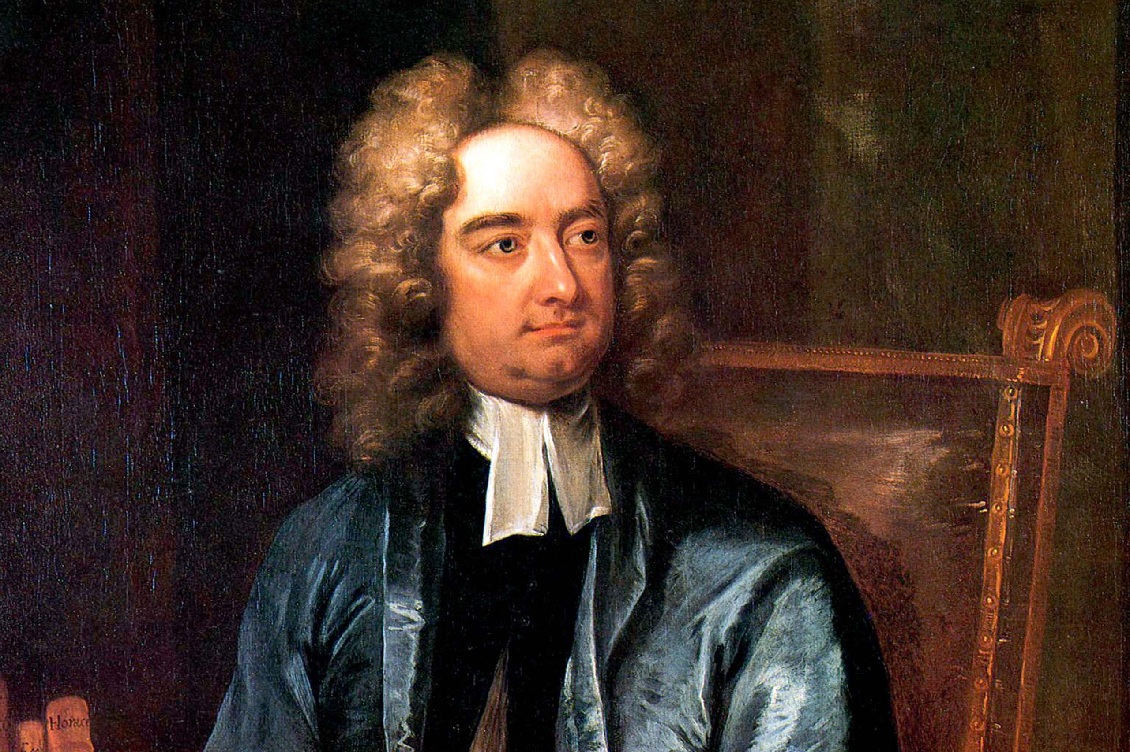
“How long, O Lord, shall I cry for help, and you will not hear? Or cry to you ‘Violence!’ and you will not save?...the law is paralyzed, and justice never goes forth. For the wicked surround the righteous; so justice goes forth perverted.” (Habakkuk 1:2, 4)
“Laws are like cobwebs, which may catch small flies, but let wasps and hornets break through.” -Jonathan Swift

Slide 11
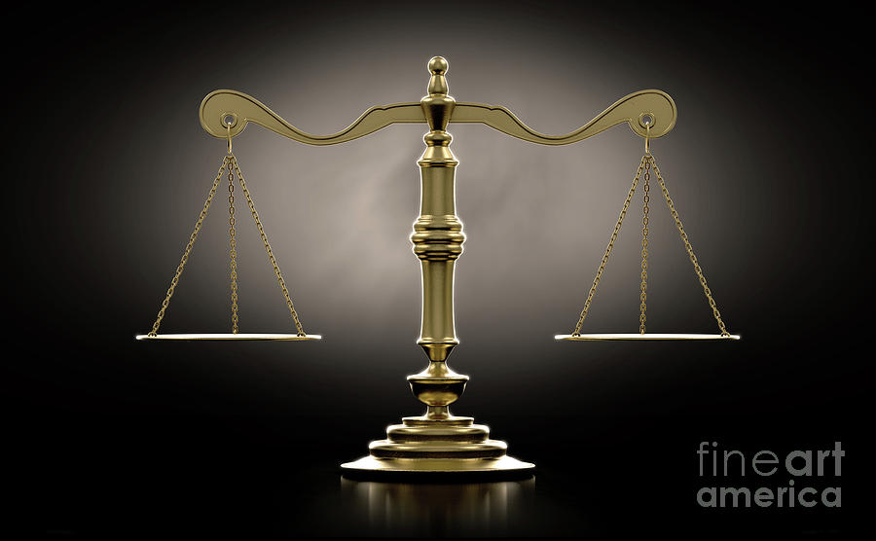
Righteousness and justice are the foundation of Your throne (Psalm 89:14, ESV)
Clouds and darkness are round about Him: righteousness and judgment are the habitation of His throne (Psalm 97:2, ESV)
I the Lord love justice; I hate robbery and wrong-doing (Isaiah 61:8, NIV)
For the Lord loves justice; he will not forsake His saints (Psalm 37:28, ESV)
Dishonest scales are an abomination to the LORD, but an accurate weight is His delight. (Proverbs 11:1)
Justice is the manifestation of the Lord’s will advancing…

Slide 12
Justice as a deterrent to wickedness
“When the sentence for a crime is not speedily executed, the hearts of men become fully set on doing evil” (Ecclesiastes 8:11, Berean Standard)
“The scepter of the wicked shall not remain over the land allotted to the righteous, lest the righteous stretch out his hands to do wrong” (Psalm 125:3, ESV)
“For rulers are not a terror to good conduct, but to bad. Would you have no fear of the one who is in authority? Then do what is good, and you will receive his approval, ⁴ for he is God's servant for your good. But if you do wrong, be afraid, for he does not bear the sword in vain. For he is the servant of God, an avenger who carries out God's wrath on the wrongdoer”Romans 13:3-6

Slide 13
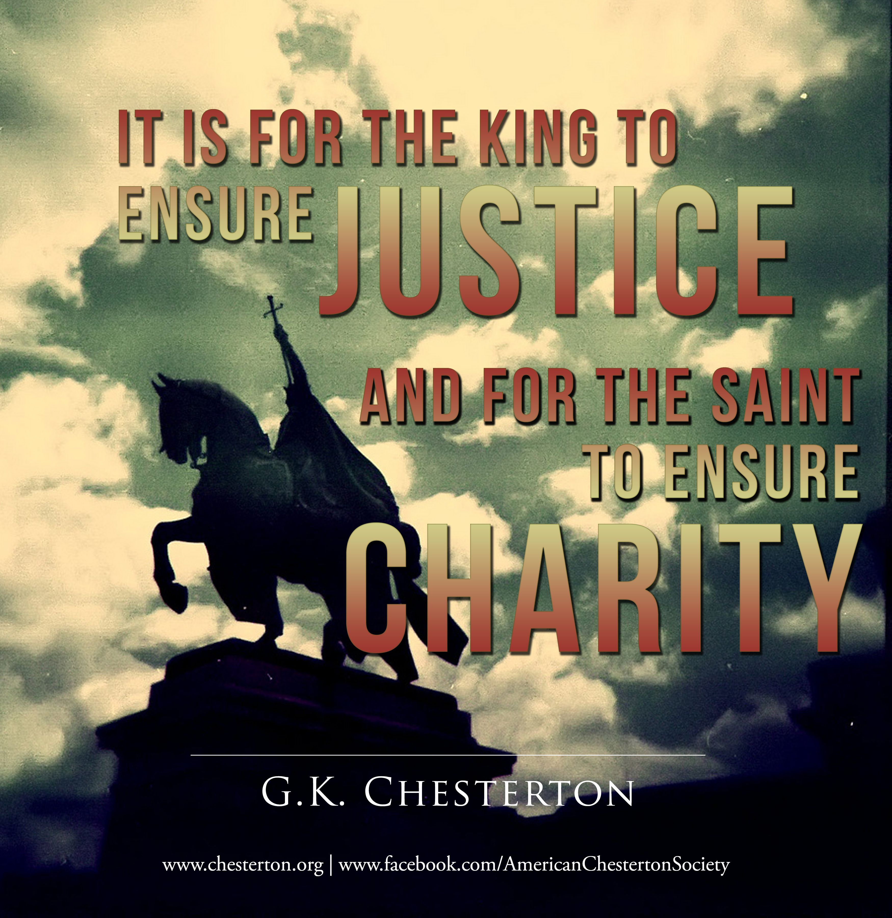
Romans 13:1-6

Slide 14
Why Pray God’s justice comes
We are forbidden to take justice into our own hand
Do not take revenge, my dear friends, but leave room for God’s wrath, for it is written: “It is mine to avenge; I will repay,” says the Lord (Romans 12:19)
Do not say, “I will repay evil”; wait for the LORD, and he will deliver you. (Proverbs 20:22)

Slide 15
A Confused church…
Civic Law vs. God’s Law
Godly Compassion or Secular Humanism?
“A God without wrath brought men without sin into a Kingdom without judgment through the ministrations of a Christ without a Cross.”
- H. Richard Niebuhr

Slide 16
…A Confused church
“We wrestle not against flesh and blood” mantra
“At the end of the age they’ll get their due”
Napoleon in exile observed of Christ, “What a conqueror! A conqueror who…wins to Himself not only one nation, but the whole human race. What a marvel! He attaches to Himself the human soul with all its energies. And how? By a miracle which surpasses all others. He claims the love of men – that is to say, the most difficult thing in the world to obtain…..He claims it; He requires it absolutely and undividedly….Alexander, Caesar, Hannibal, Lous X!V strove in vain to secure this…
He kindles the flame of a love which causes a man’s self love to die.”

Slide 17
…A Confused Church
Last Days Inertia

Slide 18
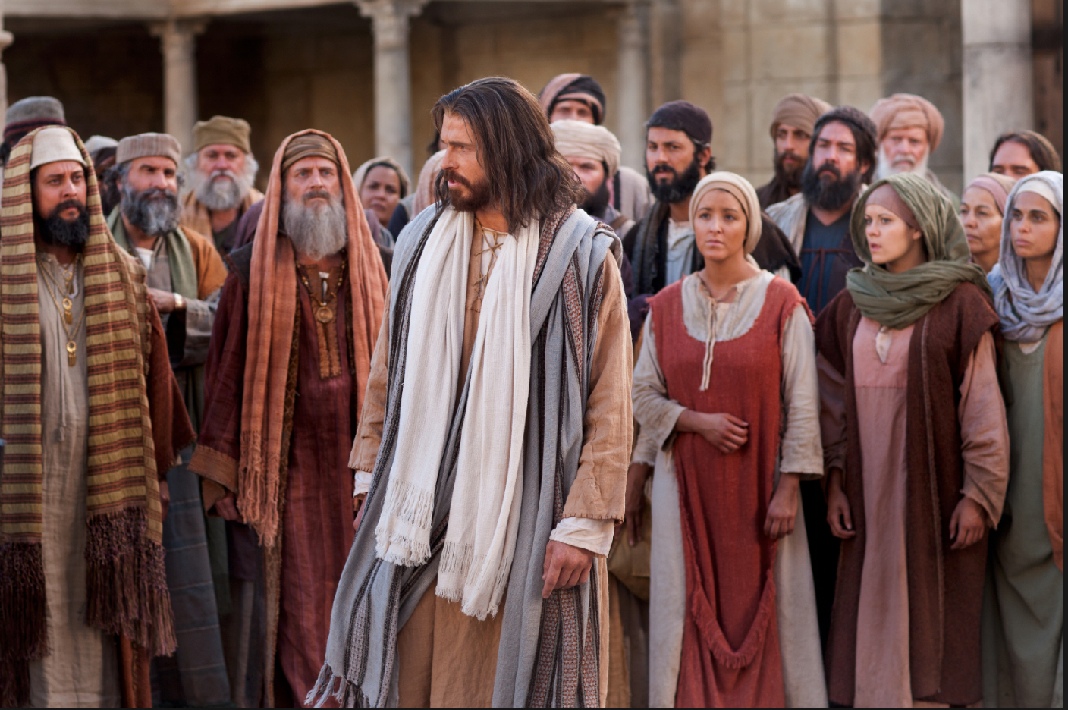
The Pharisees
Jesus told them, “you are full of hypocrisy and lawlessness” (Matthew 23:28).
Stephen called them out for receiving the law ordained by angels but failing to keep it (Acts 7:53)
The sin of the ‘lawyers’ of that time, the ‘divines’ as we should call them, was that they claimed a monopoly of the power to interpret, [the law] and yet did not exercise the power. -Ellicott’s Commentary
in Yeshua, the Life of Jesus from a Jewish Perspective, Arnold Fruchtenbaum writes that the Pharisees and Sanhedrin broke 22 of their own laws in Jesus’ arrest, trial, and sentencing.

Slide 19
"If we go out and hang two or three men," Davies said, "without doing what the law says, forming a posse and bringing the men in for trial, then by the same law, we're not officers of justice, but due to be hanged ourselves.“ "And who'll hang us?" Winder wanted to know. "Maybe nobody," Davies admitted. "Then our crime's worse than a murderer's. His act puts him outside the law, but keeps the law intact. Ours would weaken the law."

Slide 20
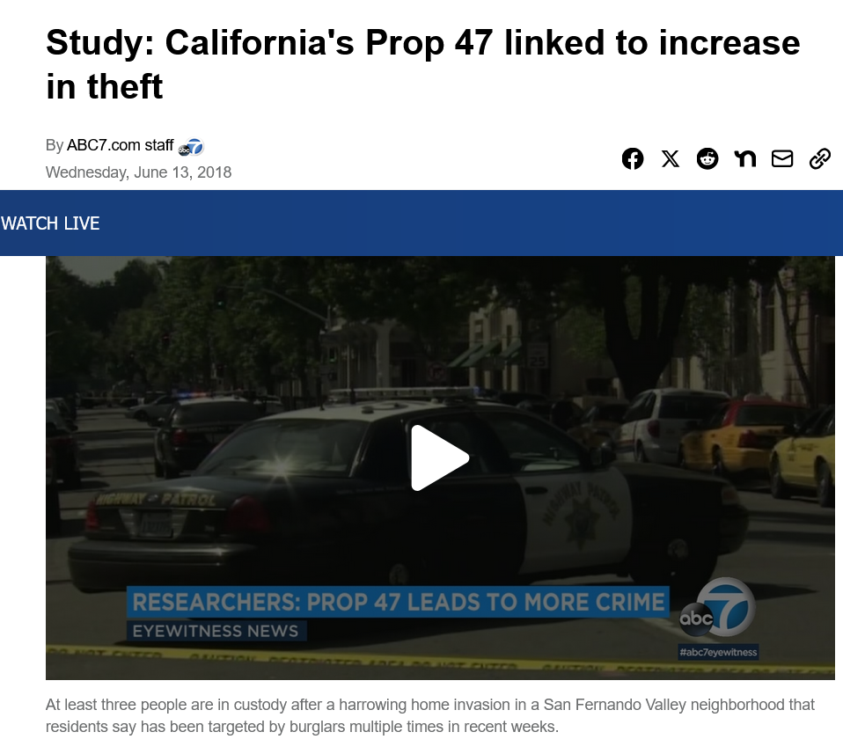
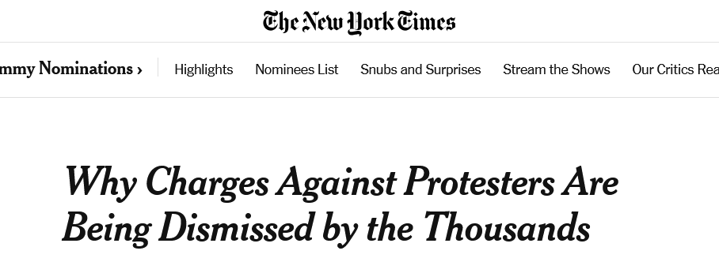
Lawlessness is a sign of the end of the age

Slide 21
“Get leave to work in this world—'tis the best you get at all; For God, in cursing, gives us better gifts than men in benediction… Get work get work; Be sure ‘tis better than what you work to get.” -Elizabeth Barrett Browning
God’s judgments are better than men’s blessings

Slide 22
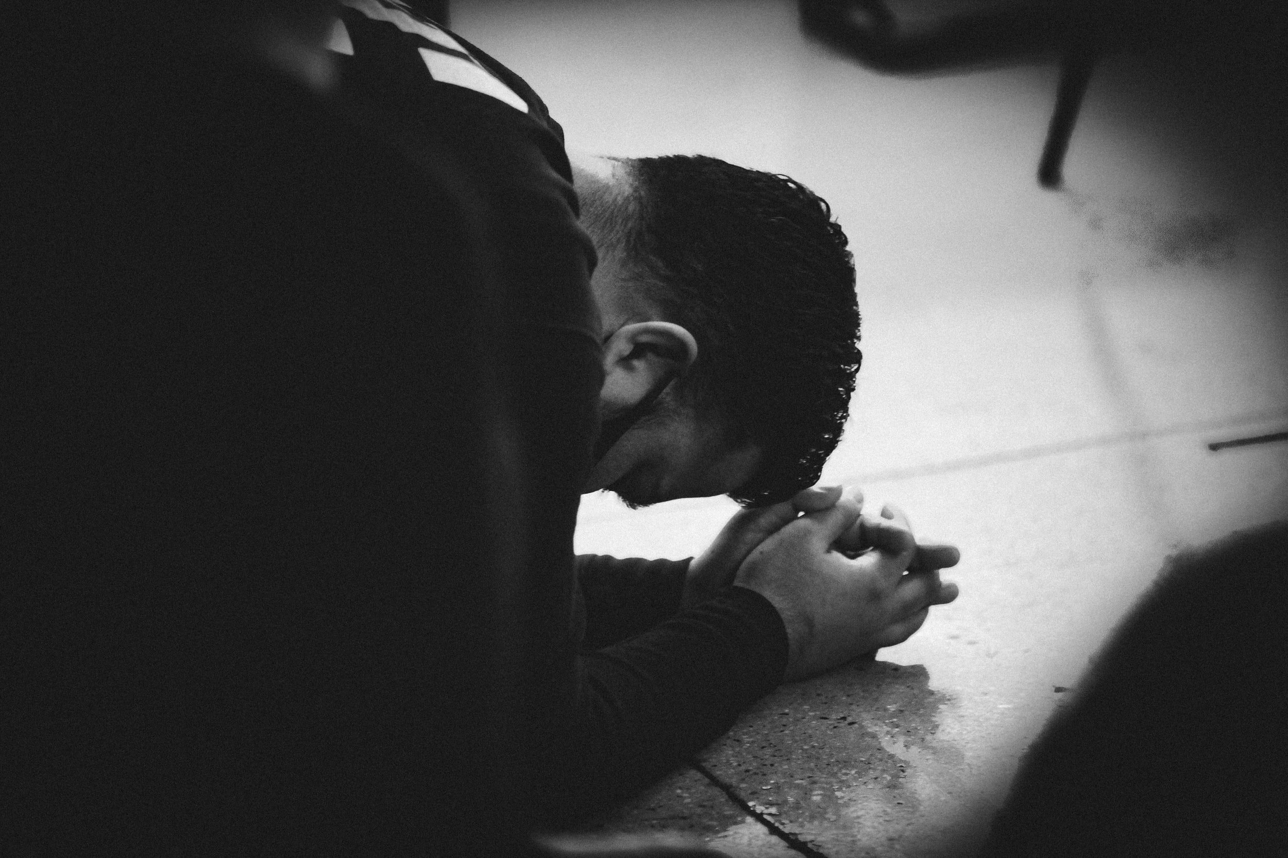
Application
Now that we know God’s will is justice, and how deeply He hates and is offended by injustice, and His goodness displayed even in judgment, we can pray without double-mindedness
That means we can
pray with confidence
pray with authority
pray with expectation

Slide 23
How to avoid praying amiss (or off course – see James 4:3)
Pray the Lord’s Prayer
Pray in the Holy Spirit
Pray the scriptures

Slide 24
Scriptures to Pray and Proclaim over…
The Church
Judges
World Systems
Psalm 82
Judges 2:16
Deuteronomy 32:36
Psalm 106:45
Ephesians 3:17-19
Colossians 3:1-3
John 17
Psalm 33:10
Job 5:12
Isaiah 8:10

Slide 25
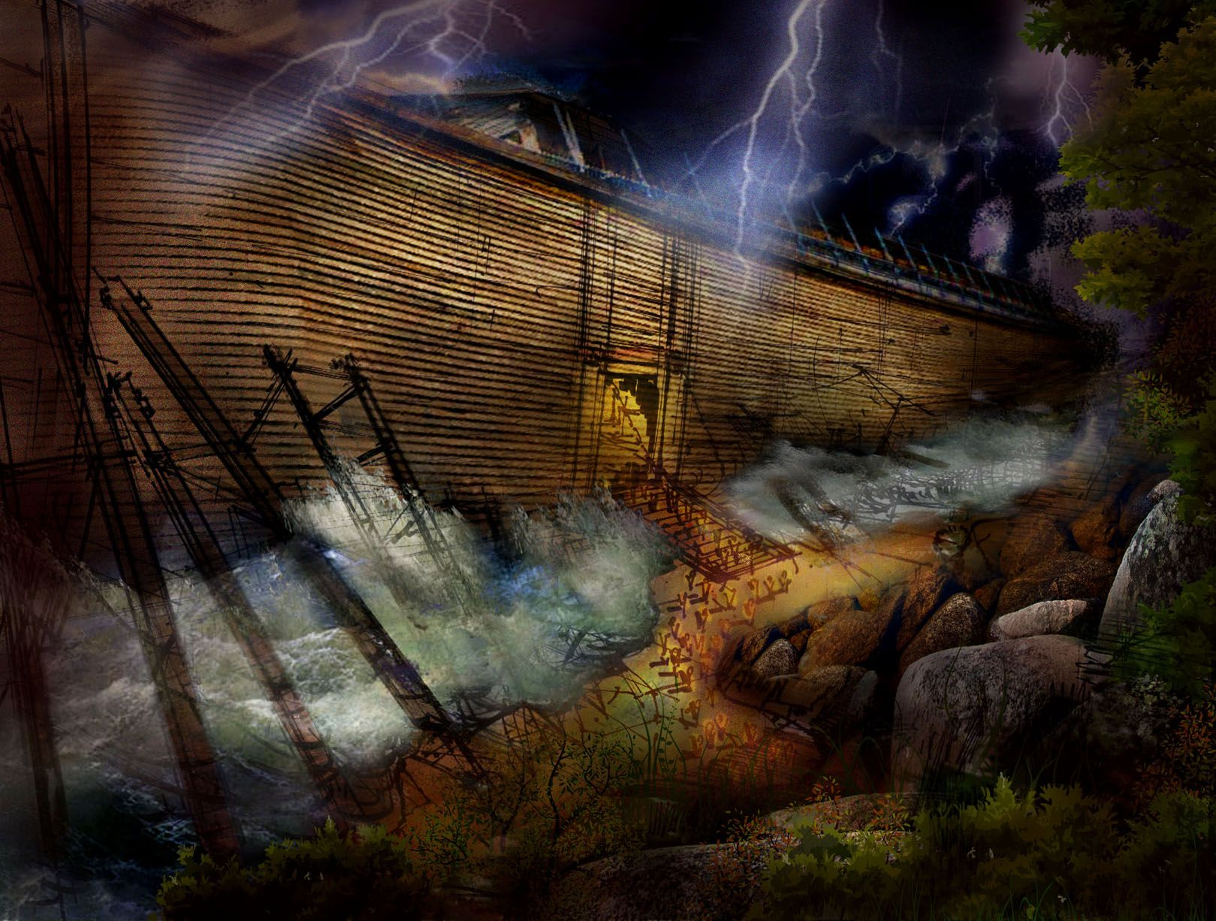
Get into the ARK

Slide 26
“Speak up for those who cannot speak for themselves, for the rights of all who are destitute.” Proverbs 31:8 (NIV) “Open your mouth with the word of truth and judge all the sons of evil.” (Aramaic bible in plain english)

