Slide 1
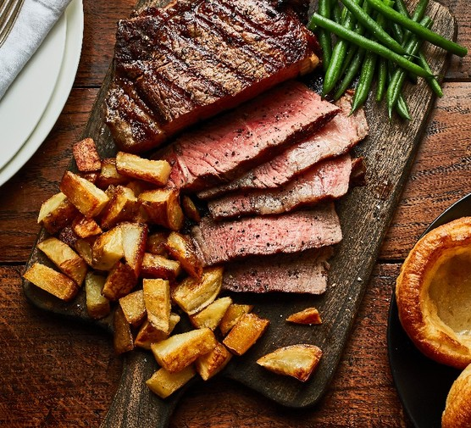
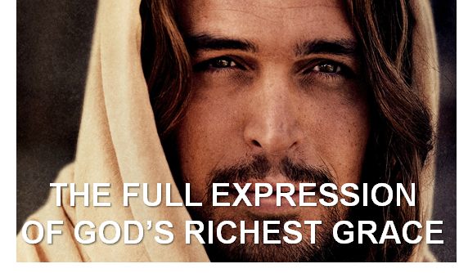
The Four Jesus Steak Meals
Summer 2024
July 21
Colossians
August 4
Romans
September 8
Ephesians
September 29
Hebrews

Slide 2
Taken From Ephesians
LifeGate Sermon
September 8, 2024

Slide 3
The Bible Is A:
For The Church

Slide 5
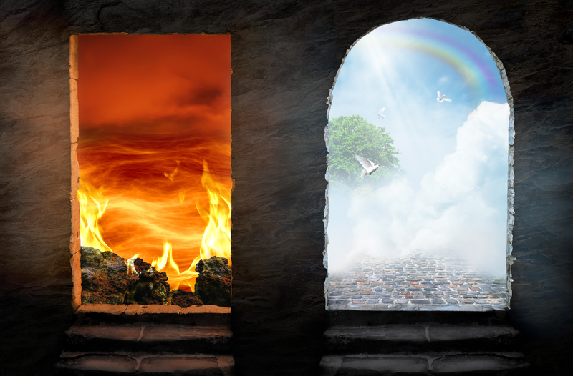
Hell
Heaven
THE STUMBLING BLOCK TO PROGRESSIVES,
ATHEISTS, SECULARISTS

Slide 6
THE FOUR MAIN VIEWS OF UNDERSTANDING MANKIND’S SHORT LIFE AND THE REST OF ETERNITY
1
Secular Humanism, Darwinism, Atheism – The universe is not CREATED – consequently, there is NO GOD, the earth and mankind are random events of chance and there is no evidence of an AFTERLIFE – no heaven or hell. No hope
2
Non-Biblical religions of the world – Muslim – Hindu – Buddhist – Mormon - Etc. Most believe in an afterlife – but not all a heaven and hell – no certainty of what will happen – no clear HOPE. (Works)
3
Universalism – Progressive Christianity – They scrub the Bible of all clear teachings on hell, God is so GOOD that everyone will be allowed into heaven. (There is an afterlife) But Jesus did not die on a cross for our sins –there may not even be sin in humans they are inherently good. Everyone is eventually saved. FALSE HOPE
4
Biblical Christianity – The Bible clearly teaches the uncompromising love of God. There is an afterlife for everyone – Those who repent and follow Jesus go to heaven the rebellious do not. Eternal Hope

Slide 7
The Harmony Between God’s
Unquenchable Love and Holiness
There is this complete harmony between God’s unquenchable love and holiness. And we are given the mission to continue to declare the saving Glory of Jesus to offer every rebellious depraved idol worshiping person in the earth salvation. He loves them dearly. He created them to find Him. He's created them to be an example of His redeeming Glory. In fact, every person ever born on the earth since Adam is to be a picture of God's redeeming Glory no matter how far they wandered away from God.
But this is also coupled with the unquenchable holiness and justice of God. God will not bring into heaven anyone who continues to worship himself above God. He will not reward them with heaven and His presence after they give Him the middle finger their whole life and trampled on His infinite love at the cross of Jesus. God gives them an opportunity on earth to repent of worshiping self and their own pleasures. But if they do not repent they will be separated from Him in hell. Yes, that is a serious truth - we understand that people stumble over this severe punishment. But the bottom line is God makes a way for them NOT TO HAVE TO experience this severe punishment. So for people to go around and say “that's so unloving” but not do anything to take advantage of the Gospel to escape judgment is just moral foolishness.

Slide 8
THE 2 STUMBLING BLOCKS OF THE RICHES OF GRACE
1
That through the RICHES OF GRACE in Jesus Christ on the Cross anyone can be saved – the worst of the worst – it’s not fair!!!!
2
That through the riches of grace on the Cross – as a follower of Christ - I must constantly check my heart and make sure I love my enemies – and bless those who persecute me – even if it isn’t fair.
Difference between MORALITY and COURAGE

Slide 10
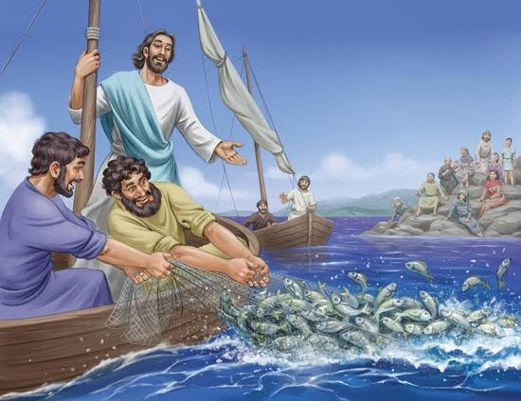
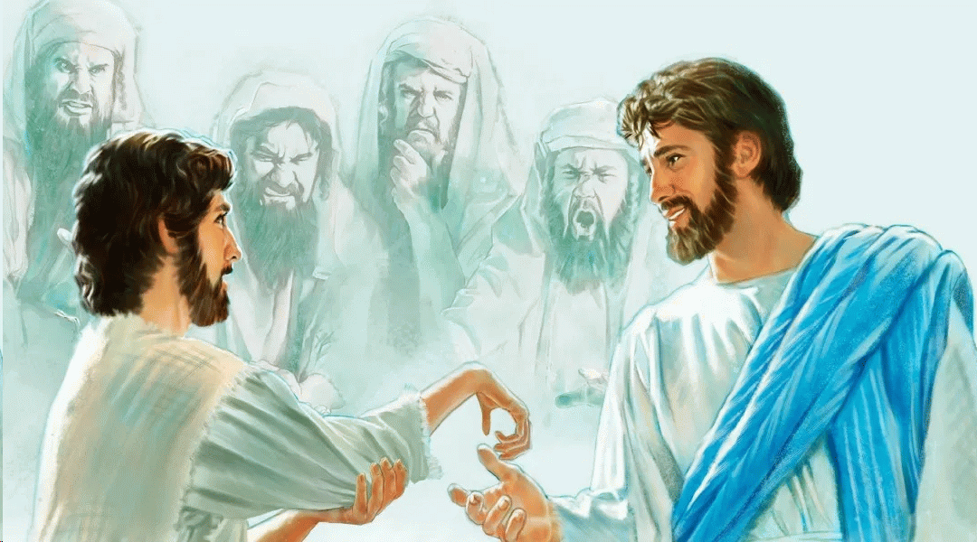
What we Begin Through RAW OBEDIENCE (Doing the
Next Thing That God tells Us) – Allows Him To Finish
The Process with a Miracle
He(Jesus) looked around at them all, and then said to the man, "Stretch out your hand." He did so, and his hand was completely restored. Luke 6:10 (NIV)
SO FOR OUR NATION – FOR THE UPCOMING ELECTION – FOR OUR FAMILIES – WE MUST DO OUR PART – GOD WILL DO HIS – WE CANNOT EXPECT MIRACLES IF WE DO NOT STRETCH OUT OUR HAND – OBEY – VOTE – PRAY -FAST

Slide 11
“So that in everything He might have the supremacy.” Colossians 1:18

Slide 12
The Principle That the person whoever goes to the greatest level of servanthood and humbling through OBEDIENCE TO THE FATHER - Will be exalted by the Father.
Humble yourselves before the Lord, and He will lift you up. James 4:10 (NIV) (Matthew 20:16 – last shall be first)
And so because Jesus went from the highest position in the universe to the lowest position and willingly laid down His life in total obedience. He was then elevated even to a higher position if that could be possible. And He's called the King of kings and Lord of lords and He is given a Name above all other names because of His great humility and the selflessness with which He lived His mission. He is forever our example motivation and inspiration for us to follow in His footsteps.

Slide 13
Here’s The Glory Of It All
The Father and Jesus – in agreement and united with the Holy Spirit – LEVERAGE THE EXALTED RULE OF JESUS AS REDEEMER AND HIGH PRIEST – To re-establish their DREAM of building a family of devoted - free-choosing lovers of God who would participate in God’s dreams – Dreams of REDEMPTION - Dreams of FELLOWSHIP – Dreams of HOLINESS – Dreams of PEACE – Dreams of RELATIONAL BEAUTY – Dreams of HEALING and FREEDOM.
“But now He has reconciled you by Christ's physical body through death to present you holy in His sight, without blemish and free from accusation” (Colossians 1) – THIS WAS HIS DREAM

Slide 14
“How much more did God's grace and the gift that came by the grace of the one man, Jesus Christ, overflow to the many?” Romans 5:15

Slide 15
The Gift Of Grace THROUGH CHRIST Is Far
Beyond The Bondage And The Curse Of Sin
-1,000,000
+1,000,000
+1,000,000,000,000
The Reversing of the curse is not an exact- equivalent – it is far more than enough to cover and restore and pay beyond anything owed
Now unto Him that is able to do exceeding abundantly above all that we ask or think, according to the power that works in us, ²¹ Unto Him be glory in the church by Christ Jesus throughout all ages, world without end. Amen. Ephesians 3:20-21 (KJV)

Slide 16
The blessing of the LORD, it makes rich, and He adds no sorrow with it. Proverbs 10:22 (KJV)

Slide 17
Foundational Verses On God’s Riches IN CHRIST
Praise be to the God and Father of our Lord Jesus Christ, Who has blessed us in the heavenly realms with every spiritual blessing (bounty) in (on account of His merits – and by virtue of union with) Christ. Ephesians 1:3
In Him (JESUS) we have redemption through His blood, the forgiveness of sins, in accordance with the riches (wealth, fullness, abundance) of God's grace that He lavished (to give in excess) on us with all wisdom and understanding. Ephesians 1:7-8 (NIV)
I pray also that the eyes of your heart may be enlightened in order that you may know the hope to which He has called you, the riches of His glorious inheritance in the saints, Ephesians 1:18 (NIV)

Slide 18
In order that in the coming ages He might show the incomparable (Beyond measure, exceeding, limitless), riches of His grace, expressed in His kindness to us in Christ Jesus. Ephesians 2:7 (NIV)
Although I am less than the least of all God's people, this grace was given me: to preach to the Gentiles the unsearchable (incalculable, exhaustless) riches of Christ, Ephesians 3:8 (NIV)

Slide 19
There is Something Very Extravagant Going on
God is not Holding Back – Wisdom, and Understanding
God lavishes spiritual blessings on us by FIRST giving us revelation and understanding of:
The Cost of Jesus’ sacrifice to provide the RICHES of grace
Their value
Their purpose
Their abundance
Their accessibility
Their indispensableness
Without the influence of God's Holy Spirit no man ever became wise unto salvation, no more than a man ever discerned an object, (no matter how perfect his eyesight), without the instrumentality of light. Adam Clarke

Slide 20
God’s Estate Planning
Now if we are children, then we are heirs--heirs of God and co-heirs with Christ Romans 8:17 (NIV)
“When an estate wills something to someone, it's called a bequest. A bequest is a gift that can be a specific item, cash, or other gifts. The testator (OWNER OF THE ESTATE) can leave a bequest to an individual, or a group of people. Bequests can include cash, stocks, investment assets, jewelry, or furniture. In a will, the word "bequeath" is used as a verb to indicate that something is being left to a beneficiary. For example, "I bequeath my home to my son Richard".
THE FATHER SAYS – BECAUSE MY SON DIED AND ROSE AGAIN FOR YOUR SINS – ONCE YOU REPENT AND ARE RECONCILED BACK TO ME – BECAUSE HE IS THE EXECUTOR OF MY ESTATE – YOU ARE A CO-HEIR WITH HIM AND ALL MY ESTATE IS BEQUEATHED TO HIM AND HE CAN BEQUEATH TO WHO-EVER FOLLOWS HIM

Slide 21
God Wants Us To Know
Our Inheritance in Christ – SERIOUSLY!!!
But in these last days He has spoken to us by His Son, whom He appointed heir of all things Hebrews 1:2
To understand the amazing reach of these promises –we should search them out, and study them, with all the interest and curiosity of a inheritor searching the will of a rich benefactor; that we may plead them with unfailing confidence, and eager expectation, for their fulfillment. Eli Wigle
THE BATTLE FOR ASSURANCE - “Are you not risen with Christ?” “Yes.” “And Christ has a right to all that is God’s, and He shares it all with His fellow-heirs.” Yes” “ I saw it, I saw it! Jesus had an uncontested right to the whole inheritance, and He shared it with me and with all who are sinners redeemed by His blood. Marie Monsen –China 1915

Slide 22
What Are Some of The Riches We Have
Received In Christ?
Reference | Riches of Grace
Romans 2:4 | The riches of His goodness and forbearance and longsuffering;
Ephesians 1:18 | The riches of the glory of His inheritance in the saints
Ephesians 2:7 | The exceeding riches of His grace in His kindness toward us through Christ Jesus
Ephesians 3:16 | According to the riches of His glory, to be strengthened with might by His Spirit
Colossians 1:27 | The riches of the glory of this mystery - which is Christ in you, the hope of glory
Colossians 2:2 | Unto all riches of the full assurance of understanding

Slide 23
Let us Peer Into Just A Little bit of
The Inheritance that is Bequeathed to the Saints
"'My son,' the father said, 'you are always with me, and everything I have is yours.” Luke 15:31
JESUS WANTS HIS BROTHERS AND SISTERS TO BE WHERE HE IS – TO INHERIT THE UNION WITH THE FATHER THAT HE HAS
Fear not, little flock; for it is your Father's good pleasure to give you the kingdom. Luke 12:32 (KJV)
He who did not spare His own Son, but gave Him up for us all--how will He not also, along with Him, graciously give us all things? Romans 8:32 (NIV)

Slide 24
Seven Specific Riches of Grace
Bequeathed to the Saints
Strong spiritual drawing, convicting, illuminating searching revelations to DRAW US TO GOD Himself – to seek to fill our VOID.
Gift of Faith and repentance and forgiveness leading to salvation and reconciliation and adoption as sons and daughters
Gift of the Holy Spirit in full-blown fillings and fruits, and giftings, and STRATEGICALLY the full measures of revival to quicken souls.
Continued hunger for fellowship, to be found pleasing to the Lord
Healing of body, soul, mind, relationships, family, community, nation
Freedom, deliverance, liberty, breaking off of yokes and curses and addictions and generational baggage.
Day-to-day and high level revelations of gifts, callings, assignments, and missions that God has called us to live out for His glory

Slide 25
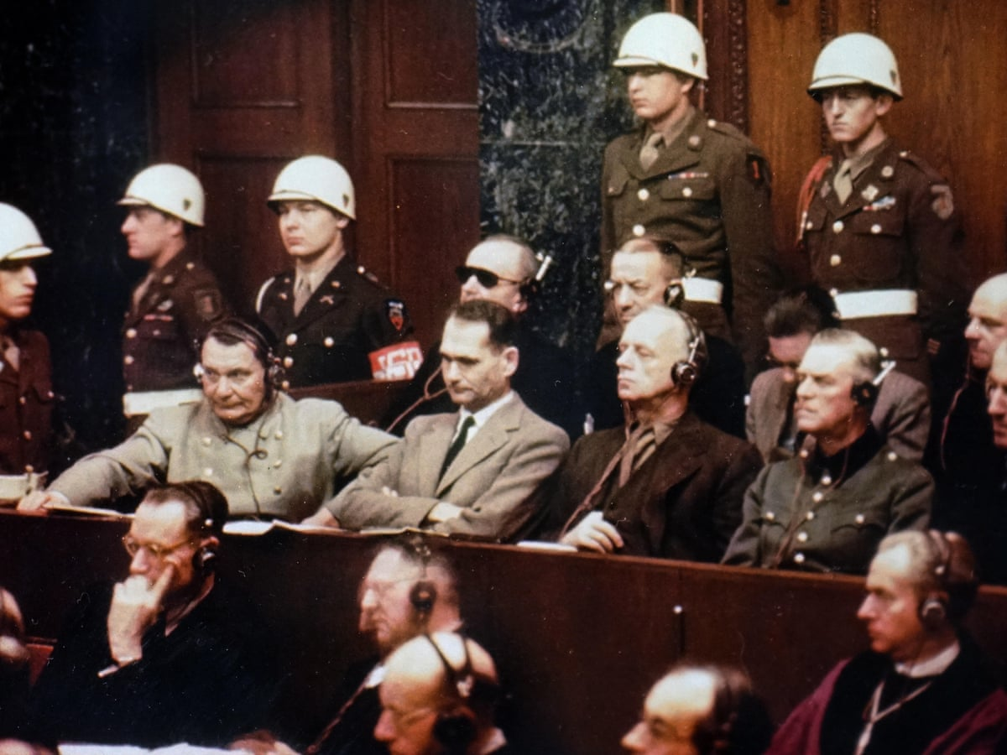
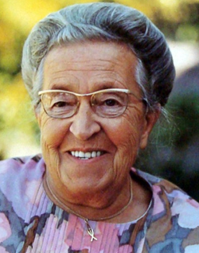
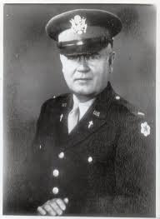
DIVINE IMPACT – The Riches of God’s Grace – Asks You to give grace to Your Enemies
Corrie Ten Boom
American Pastor and Army Captain by the name of Henry Gerecke
“Hitler’s strong boys who had scourged Christianity and broken the Ten Commandments more than any other scoundrels in history were beseeching an American housewife!!”
“How can I approach them,” he said. “How can I summon the true Christian spirit that this mission demands?”

Slide 26
THE POWER OF GOD’S LOVE
IN THE MOST DIFFICULT MOMENT IN HISTORY
“Your husband has been giving religious care of the undersigned for more than half a year. We have now heard that you wish to see him back home after his absence of several years. Because we also have wives and children we understand this wish of yours well. Nevertheless we are asking you to put off your wish to gather your family around you. Please consider that we cannot miss your husband now. During the past months he has shown us uncompromising friendliness of such a kind that we cannot be without. But for him – we find only prejudice, cold disdain, or hatred. It is impossible for any other to break through the walls that have been built up around us, in a spiritual sense even stronger than a material one. We have simply come to love him. Please leave him with us. Certainly you will feel this sacrifice and we shall be deeply indebted to you. We send our best wishes to you and your family. God be with you!”

Slide 27
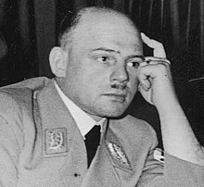
While standing on the trapdoor of the gallows, the Foreign Minister of the Reich, Joachim von Ribbentrop, was asked what his final words were - He declared that he had placed his confidence in the blood of the Lamb Who took away the sins of the world; and he turned to Gerecke and said, “I’ll see you again.”
Fritz Sauckel
Fritz had thrown himself on his Savior, and was the first of the prisoners to request Holy Communion. In the Chapel, the two men knelt down together, Chaplain and prisoner.
“Do you believe that you are a sinner?” “Yes, I believe it; I am a sinner.” “How do you know this?” “From the Word of God and the Ten Commandments. These I have not kept.” “Are you sorry for your sins?” “Yes, I am sorry that I have sinned against God.” “What have you deserved of God by your sins?” “His wrath and displeasure, temporal death and eternal damnation.” “Do you also hope to be saved?” “Yes, such is my hope.” “In whom then do you trust?” “In my dear Lord Jesus Christ.” “What then has Christ done for you that you should trust in Him?” “He died for me, and shed His blood for me on the cross for the forgiveness of sins.”
And so Gerecke administered the bread and wine to him.

Slide 28
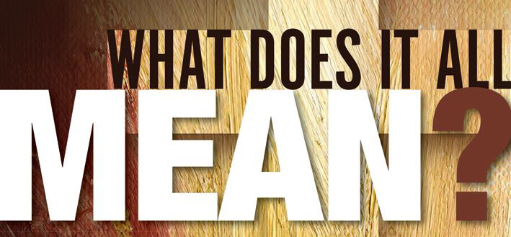
You have been given great riches in Christ to reverse the spiritual entropy of your life and world – It is so stupendously beyond measure able to:
1- FILL IN THE VOIDS IN YOUR LIFE – through the LIFE OF CHRIST- total wondrous intimacy and friendship with GOD – repent and receive.
2- HEAL THE WOUNDS IN YOUR HEART – and the communities around you.
3 – STRETCH OUT YOUR HAND IN WEAKNESS AND LET GOD BRING FORTH HIS RICHES OF SUPERNATURAL GRACE– love your families more purposefully – your neighbors – your classmates – vote in November for Judeo-Christian values – and let God take our crippled nation and make it whole

Slide 29
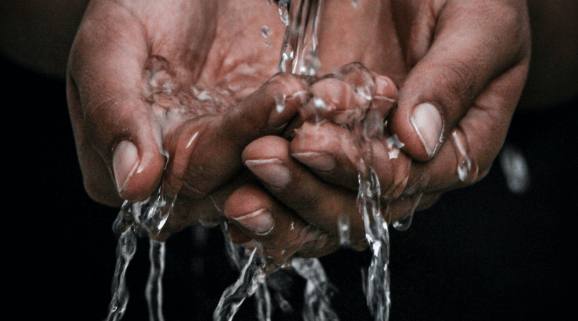
The Richest of Grace In The Washing Of The Spirit
LORD I BREAK EVERY SOUL TIE AND:
I RENOUNCE:
Every spirit attachment, lodgment, and foothold
that hinders the purposes of the Father,
Dishonors Jesus Christ, and grieves the Holy Spirit.
– LORD CUT OFF THE ROOTS OF:
APATHY/ LAZINESS/ LACK OF MOTIVATION/ DEAD RELIGION
UNFORGIVENESS/ BITTERNESS/ REJECTION/ CONTROL
SPIRIT OF OFFENSE/ HOLDING A GRUDGE/ BEING ANNOYED
DISAPPOINTMENT, DISCOURAGEMENT, RESENTMENT
FUTILITY/ DOUBT/ UNBELIEF/ DESPAIR
FEAR/ TIMIDITY/ SILENCE/ COWARDLY SPIRIT
DEPRESSION/ SELF-LOATHING – ANXIETY/ WORRY
PRIDE/ ANGER/ IMPATIENCE/ PASSIVE - AGGRESSIVE
LUST – SEXUALLY PERVERTED THOUGHTS/ DREAMS/ SPIRIT OF JEZEBEL
LOVE OF MONEY AND POSSESSIONS/ HOARDING/ LACK OF TITHING
LOVE OF COMFORT AND EASE AND PLEASURE-SEEKING/ ENTERTAINMENT
DISTRACTIONS AND DOOM-SCROLLING/ DRAMA - ADDICTION
DECEPTION/ ERROR/ UNTEACHABLENESS/ ENDLESS CONSPIRACIES

Slide 31
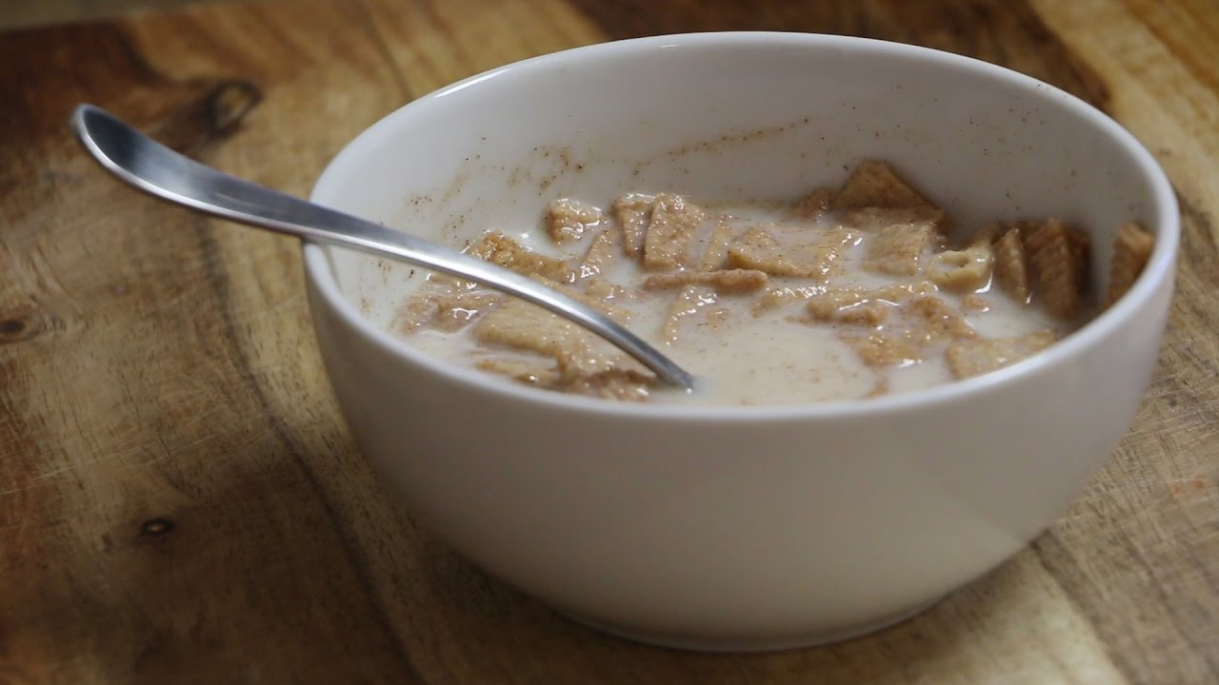
Don’t Let You Spiritual Cereal Get Soggy

Slide 32
Linguistic Theft (Chapter 4)
Redefining Words To Get Your Way
Purposefully Hijacking words and changing their definitions – then using those same words for propaganda.
Even compromised Christians hi-jack Biblical terms and twist them
Top Five WORDS that are twisted – Love, Truth, Tolerance, Justice, and Equality
Be careful even about cute phrases like – BE YOUR
AUTHENTIC SELF – “You are perfect just the way you are.” Or – “We are all messy. Learn to love your beautiful messy life.” – This is code for God would rather you be real than pushing in for accountability and holiness.” – NEWS FLASH – Life is uncomfortable

Slide 33
Is God Egotistical?
For thou shalt worship no other god: for the LORD, whose name is Jealous, is a jealous God: Exodus 34:14 (KJV)
GOD DOESN’T SEEK OUR DEVOTION AND WORSHIP BECAUSE HE’S EGOTISTICAL – BUT BECAUSE THIS IS WHAT WE WERE MADE FOR – AND IT FITS HIS GLORY AND IT PROTECTS OUR HEARTS.

Slide 34
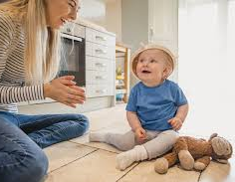
“We clearly see that God's sovereignty over the universe is just and legitimate. He rules because our good requires it, and not merely because He happens to be powerful enough to force His authority upon us.
If God did not love us, He would not bother to commit His infinite energies to administer His moral government that we so desperately need . He is working earnestly for our good, even though most of the inhabitants of this planet are in open rebellion against His fair and benevolent rule. Oh, how great is God's love! God is the only One qualified to govern the universe. For that reason it is His right TO EXPECT OUR SURRENDER AND OBEDIENCE AND WORSHIP.”
J. W. Jepson/ DL
PARENTS AND CHILDREN
Are a picture of this truth

