Slide 1
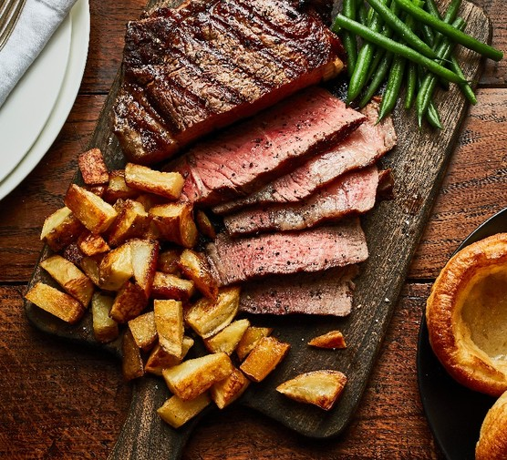
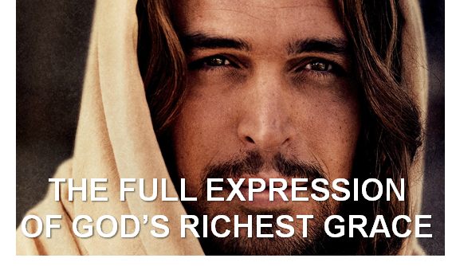
The Four Jesus Steak Meals
Summer 2024
July 21
Colossians
August 4
Romans
September 8
Ephesians
September 29
Hebrews

Slide 2
From Romans Chapter 3-5
LifeGate Sermon
August 4, 2024

Slide 3
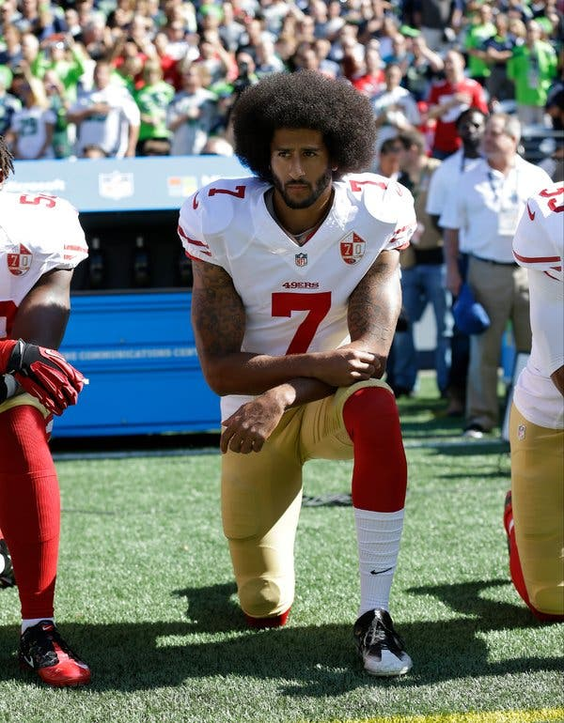
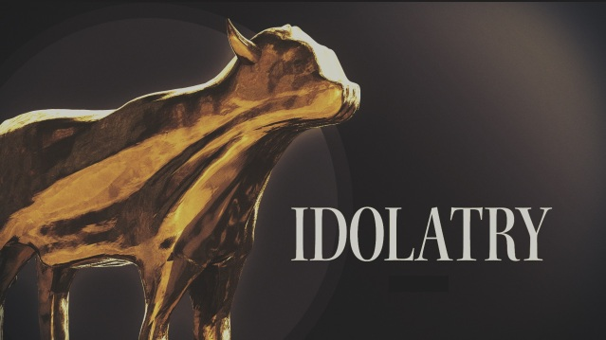
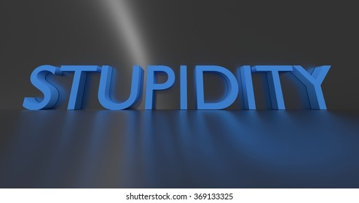
Why Does Mankind Always Lose His Way?
One Of
Gets Promoted
The heart of the wise inclines to the right, but the heart of the fool to the left. ³ Even as he walks along the road, the fool lacks sense and shows everyone how stupid he is. Ecclesiastes 10:2-3 (NIV)

Slide 4
Edifying Word from Dutch Sheets
We live in a time of global chaos, economic disasters, oppression from totalitarian tyrannies, civil government failures through dysfunctional democracies, and large numbers of sleepy church members. We must focus on King Jesus and receive a fresh outpouring and empowering of the Holy Spirit in order to advance the will of God in the earth, and the agenda of the Kingdom of God in history! The Ekklesia must refocus, reengage, and redeploy as the army of God.

Slide 5
What Comes First?

Slide 6
Words – Are Super Important
also for me, that whenever I open my mouth, words (LOGOS – utterance – reasonings – words) may be given me so that I will fearlessly make known the mystery of the gospel, Ephesians 6:19 (NIV)

Slide 7
Linguistic Theft (Chapter 4)
Redefining Words To Get Your Way
Purposefully Hijacking words and changing their definitions – then using those same words for propaganda.
Even compromised Christians hi-jack Biblical terms and twist them
Top Five WORDS that are twisted – Love, Truth, Tolerance, Justice, and Equality
Be careful even about cute phrases like – BE YOUR
AUTHENTIC SELF – “You are perfect just the way you are.” Or – “We are all messy. Learn to love your beautiful messy life.” – This is code for God would rather you be real than pushing in for accountability and holiness.” – NEWS FLASH – Life is uncomfortable

Slide 8
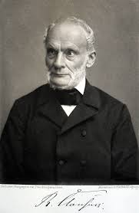
The Kingdom of God Overcomes
Spiritual Entropy
1850 – William Thomson – Lord Kelvin
Gradual Decline Into Disorder

Slide 9
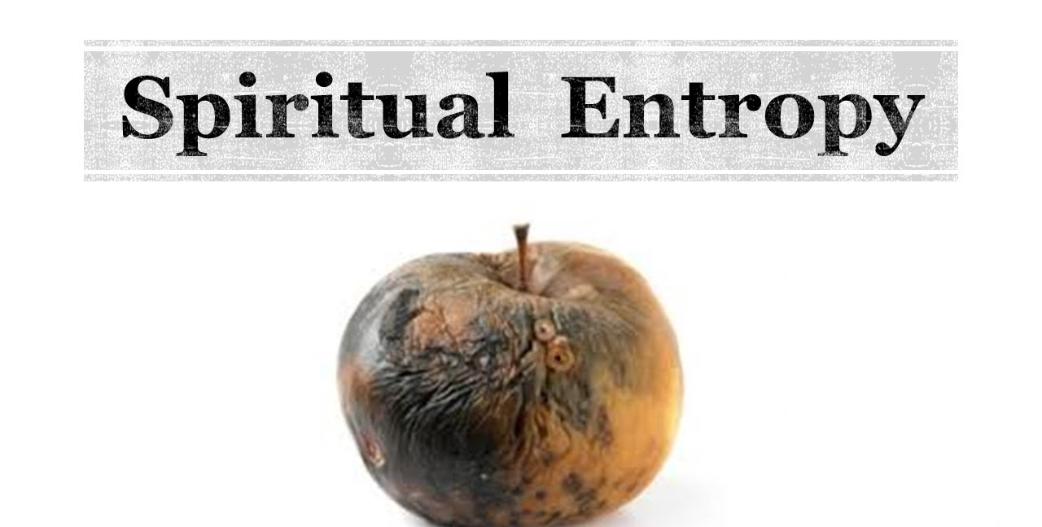
Romans One
Bondage
1 - Suppress truth - 2 Neither glorify God or give Him thanks – 3 Thinking becomes futile and hearts are darkened – 4 Became fools – exchanged Glory of God for idols – 5 Given over to Sexual immorality – 6 Exchanged truth for lies – 7 Continue to do these things and approve of those who practice them
1. The second law of thermodynamics says that entropy always increases with time"
2. - lack of order or predictability – the gradual decline into disorder.

Slide 10
Before We Fully Get Into Paul’s Terminology
Let’s Look At A Foundational Verse In Corinthians
But God chose the foolish things of the world to shame the wise; God chose the weak things of the world to shame the strong. 28 He chose the lowly things of this world and the despised things--and the things that are not--to nullify the things that are, 29 so that no one may boast before him. 30 It is because of Him (FATHER) that you are in Christ Jesus, who has become for us wisdom from God--that is, our righteousness, holiness (sanctification - purified) and redemption. 1 Corinthians 1:27-30 (NIV)
Wisdom
FOUNDATIONAL - REVELATION
Righteousness
RELATIONAL – POSITIONAL – Justified - Pardoned
You’re Hired
You’re Adopted
Holiness, Sanctification
PRACTICAL – PERSONAL (Training)
Redemption (Ransom- deliverance)
ETERNAL OUTCOME

Slide 11
GRACE IS NOT JUST AN INFLUENCE
IT IS A POWER THAT IMPACTS AND CHANGES US
Grace is going to take us from an affinity to sin to a love of God and His righteousness
Grace is going to take us from a cut-off self-serving lazy – unemployed scoundrel who is condemned to a broken humbled grateful – fully adopted servant receiving pardon and acquittal

Slide 12
The Foundation of FAITH Is Ordained As The KEY
THAT UNLOCKS the GIFT of GRACE
Therefore, the promise comes by faith, so that it may be by grace and may be guaranteed to all Abraham's offspring--not only to those who are of the law but also to those who are of the faith of Abraham. He is the father of us all. ¹⁷ As it is written: "I have made you a father of many nations." He is our father in the sight of God, in whom he believed--the God who gives life to the dead and calls things that are not as though they were. Romans 4:16-17 (NIV)

Slide 13
Romans Chapters Three and Four
Setup The Fullness Described in Romans 5
Whether you are a covenant JEW or a pagan GENTILE You have entered into spiritual entropy - ALL HAVE SINNED AND NEED A SAVIOR- There is no difference, 23 for all have sinned and fall short of the glory of God, 24 and are justified freely by his grace through the redemption that came by Christ Jesus. Romans 3:22-24 (NIV)
THE LAW WAS NOT GOING TO SAVE YOU – God made FAITH the EXCLUSIVE MEANS OF SALVATION 16 Therefore, the promise comes by faith, so that it may be by grace and may be guaranteed to all Abraham's offspring--not only to those who are of the law but also to those who are of the faith of Abraham. He is the father of us all. Romans 4:16 (NIV)

Slide 14
The Godhead Works Together – To Reverse Spiritual Entropy – and Actually Offers Blessings BEYOND MEASURE
¹ Therefore, since we have been justified (pardoned) through faith, we have peace with God (FATHER) through our Lord Jesus Christ, ² through Whom we have gained access by faith into this grace in which we now stand. And we rejoice in the hope of the glory of God. ³ Not only so, but we also rejoice in our sufferings, because we know that suffering produces perseverance; ⁴ perseverance, character; and character, hope. ⁵ And hope does not disappoint us, because God has poured out His love into our hearts by the Holy Spirit, Whom He has given us. ⁶ You see, at just the right time, when we were still powerless, Christ died for the ungodly. ⁷ Very rarely will anyone die for a righteous man, though for a good man someone might possibly dare to die. ⁸ But God demonstrates His own love for us in this: While we were still sinners, Christ died for us. ⁹ Since we have now been justified (acquitted) by His blood, how much more shall we be saved from God's wrath (29 Xs) through Him! ¹⁰ For if, when we were God's enemies, we were reconciled to Him through the death of His Son, how much more, having been reconciled, shall we be (daily – eternally) saved through His life! ¹¹ Not only is this so, but we also rejoice in God through our Lord Jesus Christ, through whom we have now received reconciliation. Romans 5:1-11 (NIV)

Slide 15
The Great Exchange – Jesus The Stand-In
Spiritual Entropy / Sin/ Curse | Divine Reversal/ Grace
Sin entered the world through one man, and death through sin | God's grace and the gift that came by the grace of the one man, Jesus Christ, overflow to the many
For if the many died by the trespass | How much more did God's grace and the gift that came by the grace of the one man, Jesus Christ, overflow to the many!
Judgment followed one sin and brought condemnation | but the gift followed many trespasses and brought justification.
By the trespass of the one man, death reigned through that one man | How much more will those who receive God's abundant provision of grace and of the gift of righteousness reign in life
One trespass was condemnation for all men | The result of one act of righteousness was justification that brings life for all men.
Through the disobedience of the one man the many were made sinners | Through the obedience of the one man the many will be made righteous.
Just as sin reigned in death | Grace might reign through righteousness to bring eternal life through Jesus Christ our Lord

Slide 16
The Gift Of Grace Is Far
Beyond The Bondage And The Curse Of Sin
-1,000,000
+1,000,000
+1,000,000,000,000
The Reversing of the curse is not an exact- equivalent – it is far more than enough to cover and restore and pay beyond anything owed
Now unto Him that is able to do exceeding abundantly above all that we ask or think, according to the power that works in us, ²¹ Unto Him be glory in the church by Christ Jesus throughout all ages, world without end. Amen. Ephesians 3:20-21 (KJV)

Slide 17
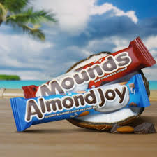
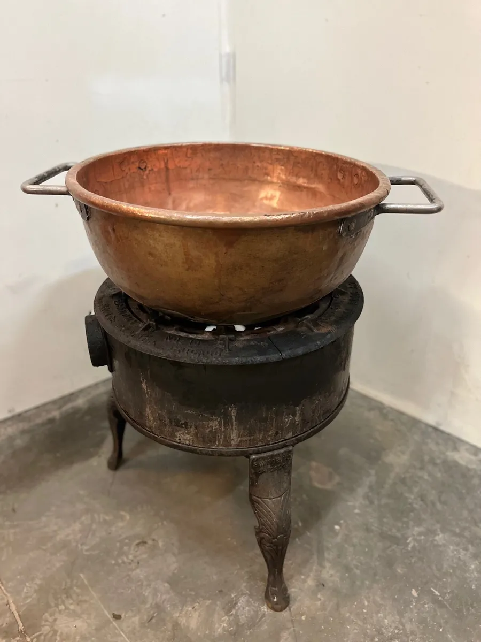
God is Going to Restore All Things
And Even Make It Better Than Original
I consider that our present sufferings are not worth comparing with the glory that will be revealed in us. ¹⁹ The creation waits in eager expectation for the sons of God to be revealed. ²⁰ For the creation was subjected to frustration, not by its own choice, but by the will of the one who subjected it, in hope ²¹ that the creation itself will be liberated from its bondage to decay and brought into the glorious freedom of the children of God. ²² We know that the whole creation has been groaning as in the pains of childbirth right up to the present time. ²³ Not only so, but we ourselves, who have the firstfruits of the Spirit, groan inwardly as we wait eagerly for our adoption as sons, the redemption of our bodies. Romans 8:18-23 (NIV)

Slide 18
There Will Be A Unique Flavor In Heaven – Starting with the Glory of Jesus Showing us His Sacrificial Scars – that brought His glory of OVERCOMING LOVE into Heaven– and brought us our SALVATION
Selfish – pouting sinners turned into gloriously resurrected triumphant servants of the MOST HIGH GOD – will flavor heaven forever as a TESTIMONY of God’s marvelous HOW MUCH MORE GRACE!!!

Slide 19
The Old Testament Prophecies
Of Reversing The Curse
⁸ This is what the LORD says: "In the time of my favor I will answer you, and in the day of salvation I will help you; I will keep you and will make you to be a covenant for the people, to restore the land and to reassign its desolate inheritances, ⁹ to say to the captives, 'Come out,' and to those in darkness, 'Be free!' "They will feed beside the roads and find pasture on every barren hill. Isaiah 49:8-9 (NIV)
To provide for those who grieve in Zion-- to bestow on them a crown of beauty instead of ashes, the oil of gladness instead of mourning, and a garment of praise instead of a spirit of despair. They will be called oaks of righteousness, a planting of the LORD for the display of his splendor. ⁴ They will rebuild the ancient ruins and restore the places long devastated; they will renew the ruined cities that have been devastated for generations. Isaiah 61:3-4 (NIV)

Slide 20
The Old Testament Prophecies
And I will restore to you the years that the locust hath eaten, the cankerworm, and the caterpiller, and the palmerworm, my great army which I sent among you. Joel 2:25 (KJV)
"In that day I will restore David's fallen tent. I will repair its broken places, restore its ruins, and build it as it used to be, Amos 9:11 (NIV)
The LORD will restore the splendor of Jacob like the splendor of Israel, though destroyers have laid them waste and have ruined their vines. Nahum 2:2 (NIV)
At that time I will gather you; at that time I will bring you home. I will give you honor and praise among all the peoples of the earth when I restore your fortunes before your very eyes," says the LORD. Zephaniah 3:20 (NIV)

Slide 21
You have been given great riches in Christ to reverse the spiritual entropy of your life and world – It is so stupendously beyond measure able to:
1- FILL IN THE VOIDS IN YOUR LIFE – through the LIFE OF CHRIST- total wondrous intimacy and friendship with GOD.
2- HEAL THE WOUNDS IN YOUR HEART – and the communities around you.
3 – PROPEL YOU OUT OF ANY BONDAGE – ADDICTION – DEPRESSION – SELF-CENTERED COMPULSIONS – by penetrating your darkened thinking and giving you full BLAZING REVELATION OF WHO CHRIST REALLY IS!!!!

