Slide 1
Is the church a spiritual melting pot?
How do we assimilate people into the Church?

Slide 2
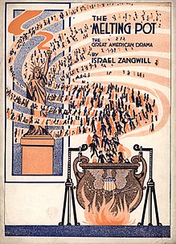
Where did the phrase “melting pot” come from?
Many credit it to playwright, Israel Zangwill’s play by the same name in 1908, about a Russian-Jewish immigrant family.
As early as 1845, Ralph Waldo Emerson wrote about
[America as the Utopian product of a culturally and
racially mixed "smelting pot“].
Some say the “melting together” metaphor was in use by 1780’s.
Multiculturalism has replaced this concept with the idea of America as a “salad bowl.”

Slide 3
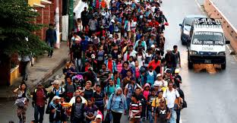
Winning, equipping, and assimilating!
The strategy of the Church has typically been…
First, we do the evangelism.
Then we do the discipleship.
Finally, people are to be “assimilated” into the corporate Church.
Problem is – discipleship takes a while.
Assimilation often can’t wait that long!

Slide 4
What did Jesus do at age 23,25,28?
https://www.facebook.com/steve.lindemuth.1/posts/pfbid02KFKCXf4DFitRVYMKXHTep2iLr6x81JzGn3WxnBVeLAWbDPB8pT5F73KsvUaaWoCXl?notif_id=1721868300828977&notif_t=feedback_reaction_generic&ref=notif
Carpenter, carpenter, better carpenter!!
Jesus almost made it his ambition to lead a quiet life and work hard with his hands.
“He who is faithful in little, will be faithful in much.” (Luke 16:10)
“The passion in young people is great!...But, you’ve go to be faithful in the little, before you’re a voice to the world.”
“We’ve got a lot of people clamoring to be voices. We need fewer voices and better examples…”
Francis Chan

Slide 5
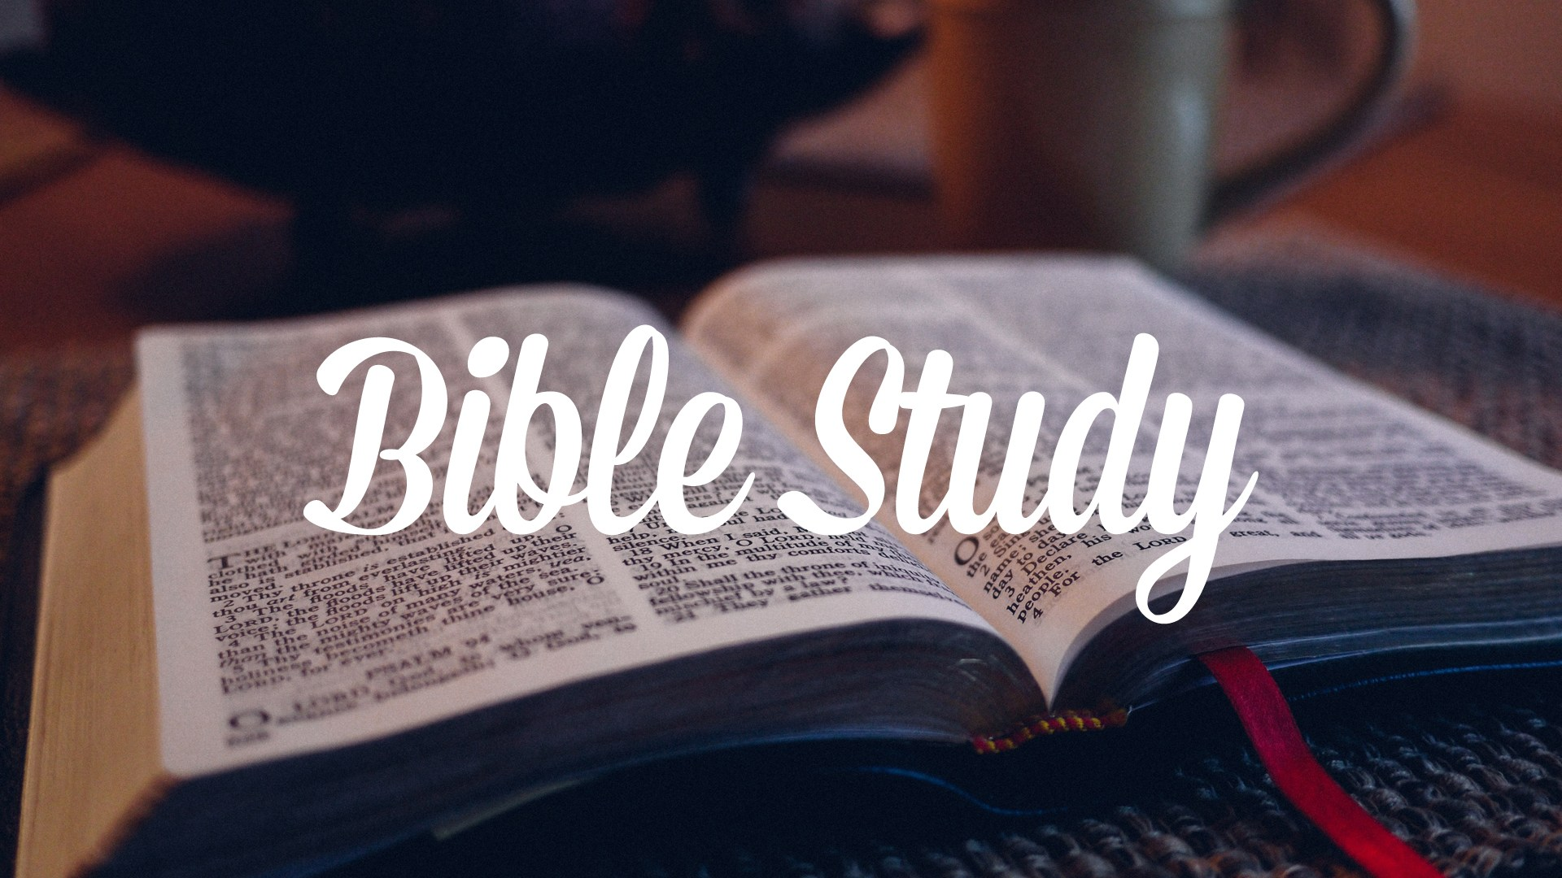
Discipleship and Assimilation need to happen simultaneously! Young Christians need to be mentored in both the spiritual disciplines and in actual ministry experience. We need to be teaching the basics about our faith, as well as providing opportunities for those to minister in the faith.

Slide 6
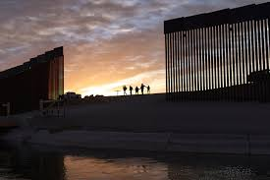
Is the Church doing an adequate job with assimilation today?
Heaven has a wall, a gate and a strict immigration policy. Hell has open borders.

Slide 7
Acts 17:16-34 (In Athens)

Slide 8
“People of Athens! I see that in every way you are very religious. ²³ For as I walked around and looked carefully at your objects of worship, I even found an altar with this inscription: to an unknown god. So you are ignorant of the very thing you worship—and this is what I am going to proclaim to you.”
Paul is speaking in a complimentary way.
He is trying to build some common ground with the people of Athens.
The Greek meaning is ‘fearing evil spirits’ (very religious).
The Athenians had built an altar to an “unknown god,” for fear of either missing blessings, or receiving punishment (Life Appl. B Comm.)
How many times do we only speak to God when we are seeking either blessing or mercy?
https://www.instagram.com/reel/C9FPvrAOuYw/?igsh=djRqbnJhbDZpcGk0
Are we many times not unlike the Athenians?
We worship God, all the while being very ignorant of His true character.
Talk with God even when “you don’t want nothing”

Slide 9
¹⁵ The Son is the image of the invisible God, the firstborn over all creation. ¹⁶ For in him all things were created: things in heaven and on earth, visible and invisible, whether thrones or powers or rulers or authorities; all things have been created through him and for him. ¹⁷ He is before all things, and in him all things hold together. (Col. 1:15-17)

Slide 10
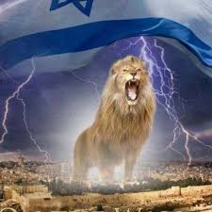
²⁶ From one man he made all the nations, that they should inhabit the whole earth; and he marked out their appointed times in history and the boundaries of their lands. ²⁷ God did this so that they would seek him and perhaps reach out for him and find him, though he is not far from any one of us. ²⁸ ‘For in him we live and move and have our being.’
“that they would search for God and perhaps grope for him and find him..” (NRSV)
The picture of the way a person in darkness searches for God.
Like me trying to find my way to the stairs in our basement at night.
God is intricately involved in our personal and worldly affairs, our appointed times in history and the boundaries of our lands.
A stark contrast to the Greek gods who lived in seclusion and could not be reached or approached.

Slide 11
we should not think that the divine being is like gold or silver or stone—an image made by human design and skill. ³⁰ In the past God overlooked such ignorance, but now he commands all people everywhere to repent.
“but now he commands everyone everywhere to turn away from idols and turn to him.” (NLT)
What are the idols that you’re dealing with?
What / who are the idols we are dealing with in the Church?
We are not to be followers of men, but of Christ Jesus!
We are not to demand one style of worship, but to worship in Spirit & in truth!
We are to keep our focus on the Author & Perfector of our faith.
To turn away, means to turn around and do a 180.

Slide 12
Many people try to excuse their sin by saying, “I was born this way.” Which is why Jesus said, “you must be born again.”

Slide 13
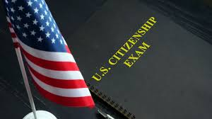
Conclusion:
A country without borders, won’t be much of a country for long!
People need to be assimilated, as citizens, into an American culture, that “melts” together.
Large groups of people living in separated sects, making their own rules, runs counter to having one, American culture.
A church without spiritual boundaries, won’t be a very effective church!
Babes in Christ need to be matured in the faith and given some tasks to do.
True disciples become more like Jesus and allow the Holy Spirit to change them. They get rid of their idols.
Otherwise, we end up with a compromised Church.
People slip in, and slip right back out.

