Slide 1
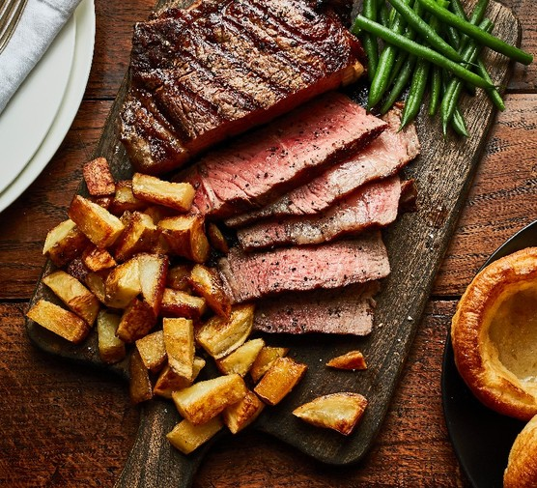
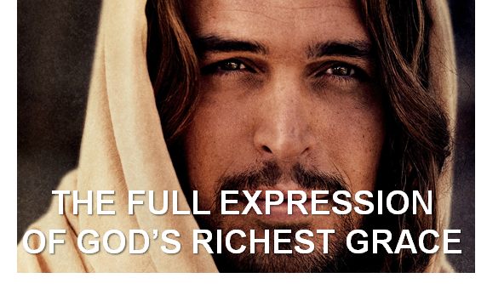
The Four Jesus Steak Meals
Summer 2024
July 21
Colossians
August 4
Romans
September 8
Ephesians
September 29
Hebrews

Slide 2
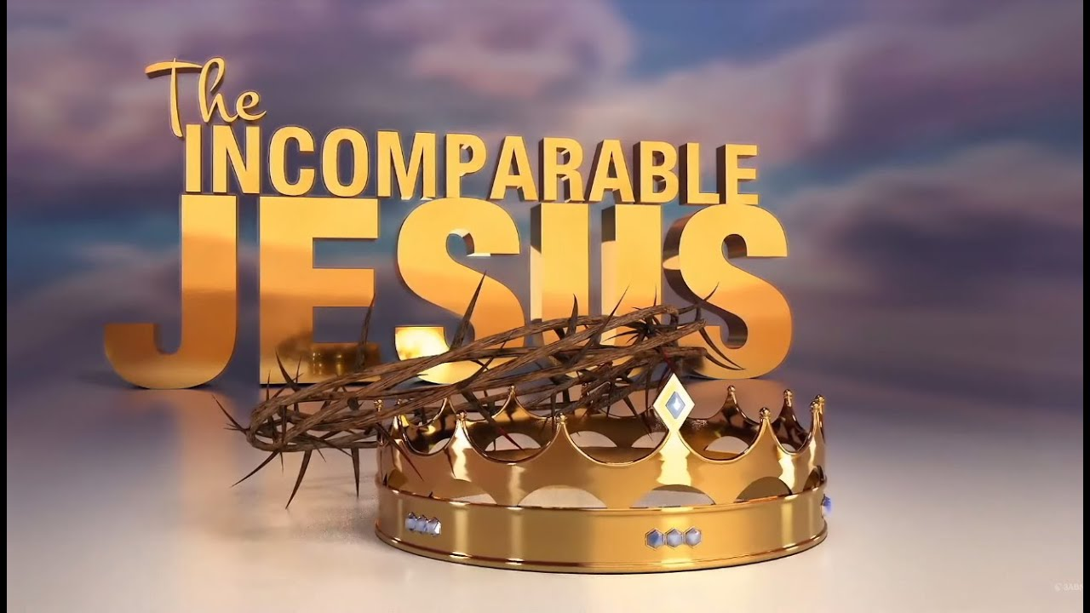
REAL
From Colossians Chapter 1
LifeGate Sermon
July 21, 2024

Slide 3
SO HOW DO WE KEEP FEEDING ON JESUS DAILY IN THE MIDST OF THE HYPER- CRAZY SEASON OF HUMAN HISTORY WE ARE IN?
Because of the increase of wickedness, the love of most will grow cold, 13 but he who stands firm to the end will be saved. 14 And this gospel of the kingdom will be preached in the whole world as a testimony to all nations, and then the end will come. Matthew 24:12-14 (NIV)
Since, then, you have been raised with Christ, set your hearts on things above, where Christ is seated at the right hand of God. ² Set your minds on things above, not on earthly things. ³ For you died, and your life is now hidden with Christ in God. ⁴ When Christ, who is your life, appears, then you also will appear with him in glory. Colossians 3:1-4 (NIV)

Slide 4
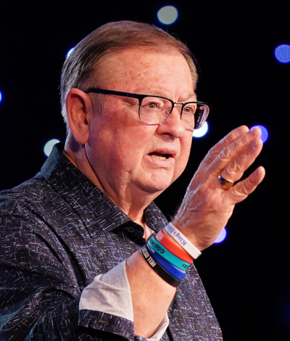
Edifying Word from Tim Sheets
The true church, Christ’s bride, must now step to His (Jesus’) side in new, visible, and vocal ways. As He takes center stage, we must stand with Him. We will not be spineless or weak, and we will not be intimidated, subjecting ourselves to godless dynasties. We will not bow to authoritarian leaders in America or any other government. We will not be bland Christians presenting bland services, preaching bland messages. We will step to Christ’s side and stand with Him in great boldness.

Slide 5
In these next eight months, we will see the King of Kings begin to take center stage. The starring role in this supernatural time will not be politicians clinging to power in nations they’ve gripped with iron fists. No, the starring role has been reserved for another, He who declared, “All power is given to Me in heaven and in earth” (Matthew 28:18). The starring role has been reserved for the resurrected King of Glory. Tim Sheets

Slide 6
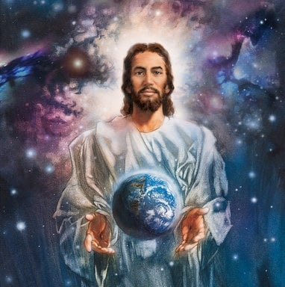
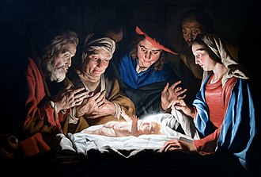
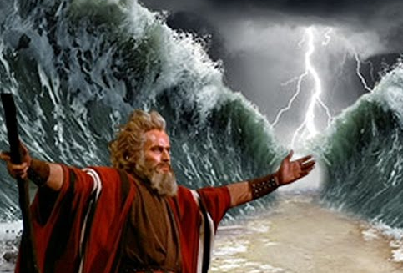
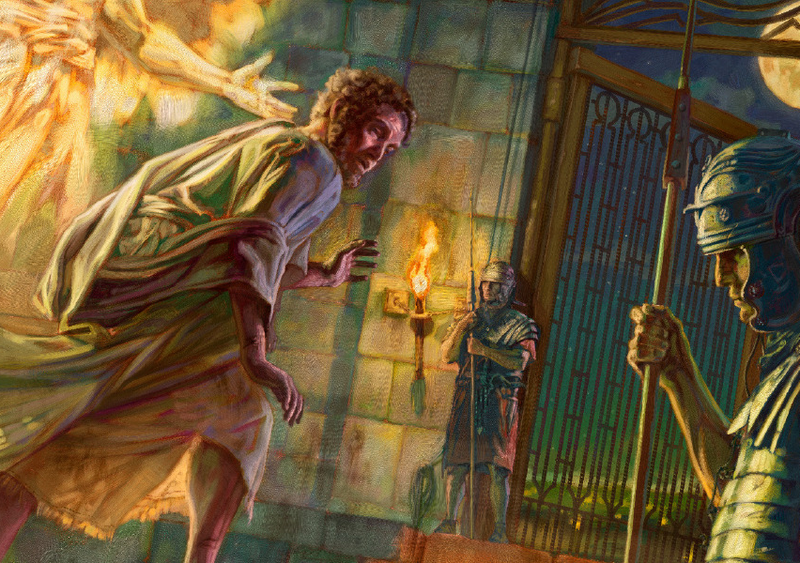
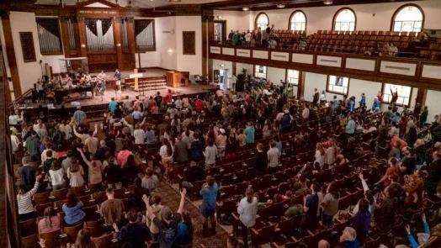
Understanding God And His
Types of Control
Direct Control
Interventional/
Providential Control
Moral/ Indirect Control

Slide 7
The Lord God of the universe delights in the mind-blowing juxtaposition of revealing Himself as being the Creator of the universe and yet actively humbling Himself and laying down His glory and coming into the earth as part of His creation to RESCUE THE UNDERSERVING.
Your attitude should be the same as that of Christ Jesus: ⁶ Who, being in very nature God, did not consider equality with God something to be grasped, ⁷ but made Himself nothing, taking the very nature of a servant, being made in human likeness. ⁸ And being found in appearance as a man, He humbled himself and became obedient to death-- even death on a cross! ⁹ Therefore God exalted Him to the highest place and gave Him the name that is above every name, ¹⁰ that at the name of Jesus every knee should bow, in heaven and on earth and under the earth, ¹¹ and every tongue confess that Jesus Christ is Lord, to the glory of God the Father. Philippians 2:5-11 (NIV)

Slide 8
Jesus Does The Unthinkable – Leaves Perfection and Glory and Comes down into Grit and Grime
Jesus Himself empties Himself of His sovereign totality and still maintains His God-level consciousness as the Father’s Son through a sinless Spirit-filled life while in a human body. Heroically. He lives out a perfect example of what the Father intended every man to be (Hebrews 1:3) which was to be fully surrendered to the Father's gracious, fair, and holy will and to live a relationship-focused missional life to the Father’s glory perfectly modeling the love of God through grace and truth.

Slide 9
Why Would God Do Something So Stupendous For People So Stupid?
God is highly invested in every part of His creation – especially His image bearing humans.
(God consulted His own happiness in deciding to create us and then rescue us) (Charles Finney)
God wanted to reveal His unsearchable wisdom and glory to the universe – (Romans 11:33; Ephesians 3:10)
God uses the display of His sacrificial love to break into the “selfish dream state” of hardened hearts – His Love displayed breaks off the veil and causes us to repent – 2 Corinthians 5:14, 15)

Slide 10
The Principle That “He or She who goes to the greatest level of servanthood and humbling through complete OBEDIENCE TO THE FATHER - Will be exalted by the Father.
Humble yourselves before the Lord, and he will lift you up. James 4:10 (NIV) (Matthew 20:16 – last shall be first)
And so because Jesus went from the highest position in the universe to the lowest position and willingly laid down His life in total obedience. He was then elevated even to a higher position if that could be possible. And He's called the King of kings and Lord of lords and He is given a Name above all other names because of His great humility His great servant heart and the selflessness with which He lived His mission. He is forever our example motivation and inspiration for us to follow in His footsteps.

Slide 11
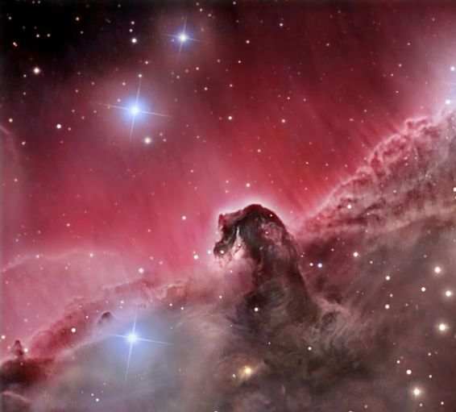
Jesus’ Highest Accomplishments Is Not
The Billions of Galaxies He Created
EVERYTHING JESUS DID IN CREATION AND IN THE HEAVENS THROUGHOUT ETERNITY WAS NOT AS GLORIOUS AS HIM BECOMING LIMITED AS A MAN THROUGH EMPTYING HIMSELF AND GIVING HIMSELF UP AS A SACRIFICE – TO REDEEM MANKIND – AND IN THE END TO REDEEM ALL CREATION BACK OUT OF BONDAGE AND DECAY
¹⁹ The creation waits in eager expectation for the sons of God to be revealed. ²⁰ For the creation was subjected to frustration, not by its own choice, but by the will of the one who subjected it, in hope ²¹ that the creation itself will be liberated from its bondage to decay and brought into the glorious freedom of the children of God. Romans 8:19-21 (NIV)

Slide 12
Now That We Setup Who The Incomparable
Jesus Is – Let’s Look A Colossians One
15 He is the image of the invisible God, the Firstborn (of sinless men to raise from the dead) over all creation. 16 For by Him all things were created: things in heaven and on earth, visible and invisible, whether thrones or powers or rulers or authorities; all things were created by Him and for Him.
(THE FATHER’S IMAGINATION THOUGHT OUT THE DESIGN OF THE UNIVERSE – JESUS GLORIOUS MATCHLESS POWER MANIFESTED AND THE HOLY SPIRIT’S EXERTED GLORY TO IMPLEMENT AND FINISH THE WORK)

Slide 13
Colossians One
17 He is before all things (THAT WERE CREATED), and in Him all things hold together. 18 And He is the Head of the body, the church (HAVING A FAMILY – A BODY WAS VERY VERY VERY IMPORTANT TO GOD – IT WAS NOT A SIDE SHOW – IT WAS VERY CENTRAL); He is the beginning and the Firstborn from among the dead (of sinless men to raise from the dead), so that in everything He might have the supremacy.
For God was pleased to have all His fullness dwell in Him (EVEN THOUGH HE HAD GIVEN UP HIS GOD-SIZED GLORY TO BECOME A HUMAN SLAVE), 20 and through Him to reconcile to Himself all things, whether things on earth or things in heaven, by making peace through His blood, shed on the cross. (LAYING DOWN HIS LIFE AS AN ETERNAL FINAL SACRIFICE – PAYMENT OF SIN – TO STILL BRING ABOUT THE PROMISE OF A FAMILY.)

Slide 14
Colossians One
Once you were alienated from God and were enemies in your minds because of your evil behavior. ( WE SAID - I DON’T WANT TO SERVE THE SELF-DECLARED CREATOR – I DON’T WANT TO BE ACCOUNTABLE TO HIM – IT WILL INTERRUPT MY LIFE – IT WILL MAKE ME HAVE TO STOP PURSUING MY FLESH AGENDAS)
22 But now He has reconciled you by Christ's physical body through death to present you holy in His sight, without blemish and free from accusation—(HE PROVED HIMSELF TO ME – AND BROKE THROUGH MY LAME EXCUSES AND MADE ME SO SENSITIZED TO HIS LOVE AND ENAMORED WITH HIS GLORY THAT I COULD NOT HELP BUT WANT TO SERVE HIM.)
23 if you continue in your faith, established and firm, not moved from the hope held out in the Gospel. This is the Gospel that you heard and that has been proclaimed to every creature under heaven, and of which I, Paul, have become a servant. Colossians 1:15-23 (NIV)

Slide 15
I would Believe In Jesus If There was
Any Shred Of Evidence (Chpt. 7)
If you can’t know everything for sure – you can’t know ANYTHING for sure.
Religion is child abuse
Men are not equal with God – if there is a God men are BETTER
Belief in God is wishful thinking
Religion Keeps people from asking questions
True Christianity invites – TESTING – QUESTIONING – But it requires you to TURN TO THE WORD and have faith God will give you the answers – teach your children to QUESTION THINGS – But to also know there ARE ANSWERS.

Slide 16
Here’s The Glory Of It All
The Father and Jesus – in agreement and united with the Holy Spirit – have DREAMS – and VISIONS – to build a family of co-dependent and free-choosing lovers of God who would participate in God’s dreams – Dreams of REDEMPTION - Dreams of ONENESS – Dreams of HOLINESS – Dreams of PEACE – Dreams of RELATIONAL BEAUTY – Dreams of ADVENTURE AND DISCOVERY.
“But now He has reconciled you by Christ's physical body through death to present you holy in His sight, without blemish and free from accusation” – THIS WAS HIS DREAM

Slide 17
Do We Care About God’s Dreams?
WHY DON’T WE CARRY THE DREAMS OF GOD AND THE BURDEN OF THE LORD AT A HIGHER LEVEL?
We are ignorant of His dreams and don’t know – or can’t identify His dreams and burden of the Lord –
We don’t want to carry His burden – we want our own dreams accomplished

Slide 18
The Lord Has A Dream:
For every discouraged Believer overwhelmed by problems and heaviness
For every wounded wife who has no hope
For every husband who is depressed and broken
For every soul in bondage and who is defeated
For every teenager who hates themselves
For every grandmother who is lonely and uncared for
For every intercessor who is broken over the delay
For every pastor who is discouraged and ready to quit
For every couple who is fighting all the time
For every church that is discouraged and divided
For all those fighting bondages of smoking, drinking, and drugs that hamper the vitality of walk with God
For a people under stress from wicked systems and leaders longing for freedom

