Slide 1
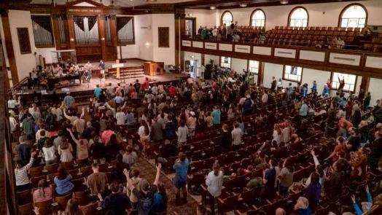
The “Lordship Of Jesus Christ”
Is the Highest Theme of This Unfolding
World-Wide Intervention
LifeGate Sermon
July 7, 2024

Slide 2
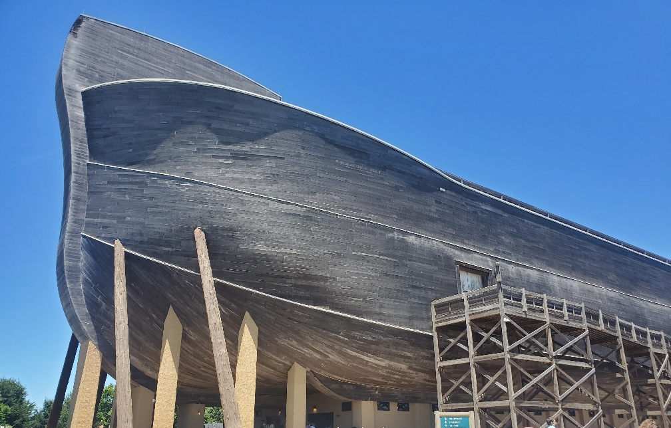
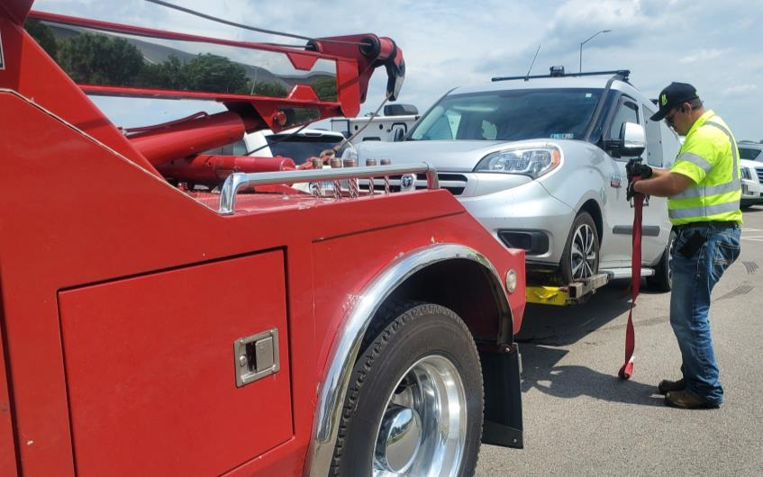
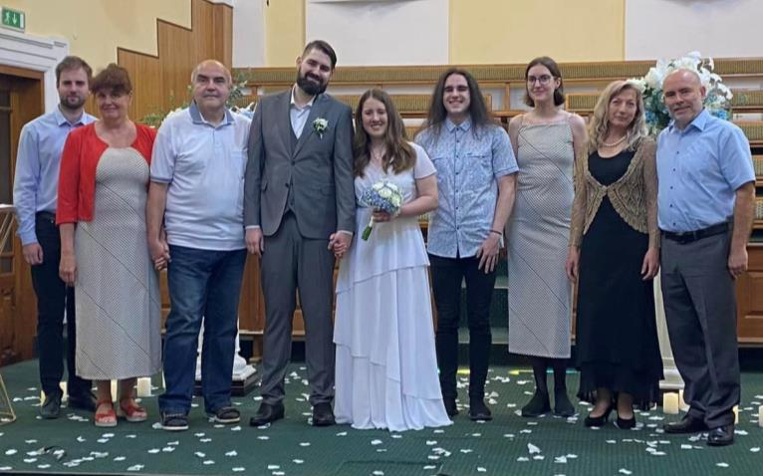
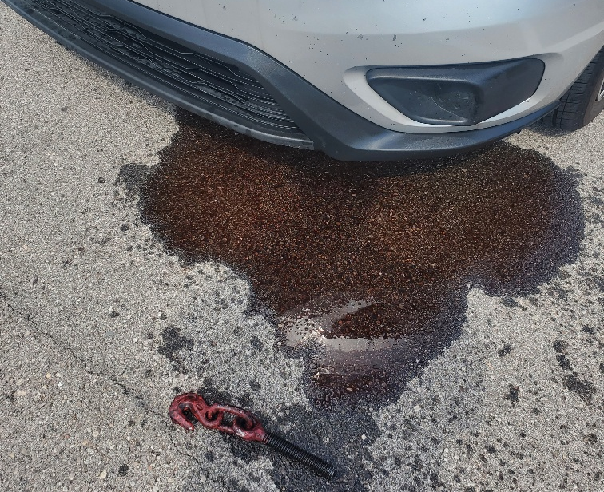

Slide 3
And we know that in all things God works for the good of those who love him, who have been called according to his purpose. Romans 8:28 (NIV)
In Him we were also chosen, having been predestined according to the plan of Him who works out everything in conformity with the purpose of His will, Ephesians 1:11 (NIV)

Slide 4
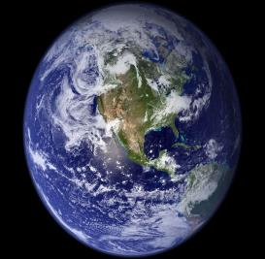
Our Life Is A Precious Gift That We Screwed Up
That’s Why We need Intervention From Heaven
FREE WILL
IS DANGEROUS
AND MUST
BE TESTED
BEFORE GOD
BRINGS US
HOME
If only for this life we have hope in Christ, we are to be pitied more than all men. 20 But Christ has indeed been raised from the dead, the first-fruits of those who have fallen asleep. 1 Corinthians 15:19-20
For you died, and your life is now hidden with Christ in God. ⁴ When Christ, who is your Life, appears, then you also will appear with Him in glory. Colossians 3:3-4 (NIV)

Slide 5
But thanks be to God! He gives us the victory through our Lord Jesus Christ.
1 Corinthians 15:57 (NIV)

Slide 6
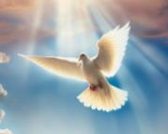
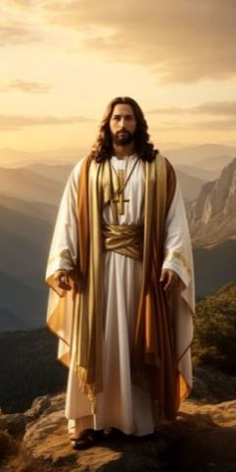
The Central Revelation of the NEW TESTAMENT
Is Jesus Is THE SAVIOR OF THE WORLD Followed
Immediately by The Holy Spirit is the Helper and Revealer
Do you not know that the wicked will not inherit the kingdom of God? Do not be deceived: Neither the sexually immoral nor idolaters nor adulterers nor male prostitutes nor homosexual offenders ¹⁰ nor thieves nor the greedy nor drunkards nor slanderers nor swindlers will inherit the kingdom of God. ¹¹ And that is what some of you were. But you were washed, you were sanctified, you were justified in the Name of the Lord Jesus Christ and by the Spirit of our God.
1 Corinthians 6:9-11 (NIV)

Slide 7
Because Christ Is The Victor
And The Holy Spirit Is Given As Our Helper
It Puts Me In A Position To Stand In The Gap
For My Family, My Church, And My Nation
I know that when I come to you, I will come in the full measure of the blessing of Christ. ³⁰ I urge you, brothers, by our Lord Jesus Christ and by the love of the Spirit, to join me in my struggle (to labor in partnership) by praying (earnestly) to God for me. Romans 15:29-30 (NIV)

Slide 8
Are You Hungry For The Lord To Have His Way
The soul that is full loathes even the honeycomb; but to the hungry soul every bitter thing is sweet. Proverbs 27:7 (KJV)
Why do we use the word “Lordship”?
⁹ That if you confess with your mouth, "Jesus is Lord," and believe in your heart that God raised him from the dead, you will be saved. ¹⁰ For it is with your heart that you believe and are justified, and it is with your mouth that you confess and are saved. Romans 10:9-10 (NIV)
GREEK – Kyrios - supremacy; supreme in authority, i.e. controlling influence
"Why do you call me, 'Lord, Lord,' and do not do what I say?” Luke 6:46 (NIV)

Slide 9
Jesus Clearly Spoke of Lordship
"If anyone comes to me and does not hate his father and mother, his wife and children, his brothers and sisters--yes, even his own life--he cannot be My disciple. Luke 14:26 (NIV)
And anyone who does not carry his cross and follow Me cannot be My disciple. Luke 14:27 (NIV)
In the same way, any of you who does not give up everything he has cannot be my disciple. Luke 14:33 (NIV)
The Lordship of Christ, is when WE ACKNOWLEDGE HIS OWNERSHIP AND GIVE UP OUR PERSONAL RIGHTS. This also involves total and unreserved obedience. For example, if Jesus is the Lord of someone's life, they are going to do what He tells them to do. Obviously, from Luke chapter 14 - dying to self is a precondition to live under the Lordship of Jesus Christ. When people surrender all to Jesus, they acknowledge that He is the Lord and owner of their life and everything they have.

Slide 10
We Are Not Seeking Salvation From Hell Alone
We Are Seeking The Lord of Lords

Slide 11
THE “LORD WORKS IN US A GRACE THAT BREAKS PASSIVITY”
Sacrifice thank offerings to God, fulfill your vows to the Most High, ¹⁵ and call upon Me in the day of trouble; I will deliver you, and you will honor me." Psalm 50:14-15 (NIV)
Return, O Israel, to the LORD your God. Your sins have been your downfall! ² Take words with you and return to the LORD. Say to him: "Forgive all our sins and receive us graciously, that we may offer the fruit of our lips. Hosea 14:1-2 (NIV)

Slide 12
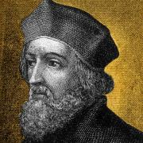
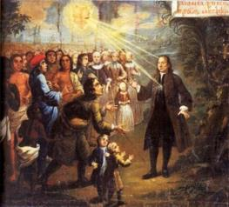
The Moravians Caught the Fire From John Huss and Carried It To The Wesley’s
John Huss
Two distinct lines of preparation and spiritual effort for the blessing are evident. One was prayer; the other was 'individual work with hearts that needed healed.' We are told that 'men and women met for prayer and praise at one another's homes and the Church of Berthelsdorf was crowded out.' Then the Spirit came in great power. Then the entire company experienced the blessing at one and the same time.'

Slide 13
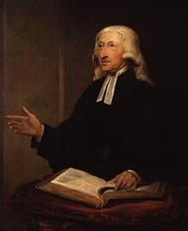
One Of The Prayer Meetings
That Changed the World
Brother Lecky in his "History of Morals" says of John Wesley's conversion Wednesday, May 24, 1738 in the prayer meeting of Moravian Brethren in Aldersgate street: "What happened in that little room was of more importance to England than all the victories of Prime Minister Pitt by land or sea.
John Wesley
WHAT IS HAPPENING RIGHT NOW IN THE INNER SANCTUARY OF SEARCHING GRACE AND BAPTISMS IN THE SPIRIT WITHIN CHURCH LEADERS AND LONELY INTERCESSORS ACROSS AMERICA IS FAR MORE IMPORTANT THAN THE DECISIONS TAKING PLACE IN THE SUPREME COURT AND THE POTENTIAL TURN AROUND AGAINST TYRANNICAL GOVERNMENT IN AMERICA THIS FALL. (Although these things are being used of God for His purposes.)

Slide 14
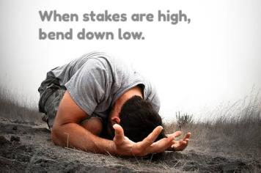
Help Us To Be WISE Sons and Daughters
And Position Ourselves In The Womb
Of Faith and Help Birth The Breakthroughs
That Will Shake Our E-town Region And The USA
Pains as of a woman in childbirth come to him, but he is a child without wisdom; when the time arrives, he does not come to the opening of the womb. Hosea 13:13 (NIV)
"When birth pangs signaled it was time to be born, Ephraim was too stupid to come out of the womb. When the passage into life opened up, he didn't show. Hosea 13:13 (MSG)

Slide 15
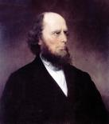
Bringing The Lordship Of Christ To A Town Is A Spiritual Battle In The Church
The great move of God in Rochester New York began under the most unfavorable circumstances that could well be imagined. It seemed as though Satan had interposed every possible obstacle to a breakthrough. The three churches were at odds; one had no pastor, one was divided and about to dismiss their pastor. An elder of the third Presbyterian church had brought a charge of unchristian conduct against the pastor of the first church. After the work began, one of the first things was, the great stone church had a wall collapse, and created a panic. Then one of the churches went on and dismissed their pastor right in the middle of the work. Many other things occurred, so that it seemed as if the devil was determined to divert the public mind from the subject of engaging the Kingdom of God for a spiritual awakening. But there were a few remarkable cases of the spirit of prayer being upon key intercessors, which assured us that God was there, and we went on: and the more Satan opposed, the Spirit of the Lord lifted up the standard higher and higher, till finally a wave of salvation rolled over the place. 1832

Slide 16
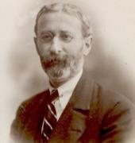
Walking Forward on Faith
Not Knowing All The Details
George Lang
Finally it is the prayer of faith that prevails, that is the supplication of righteous men, women, and children of God. God grants our requests if we come to Him with true heart confidence. Faith, therefore, is sustained, first, by looking to the promised Word of God. Second, by being certain that the thing sought is of His will. We need to step out in faith when the command is placed in our spirit to walk forward -without knowing how the answer will unfold. George Lang

Slide 17
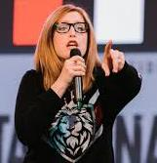
The Holy Spirit Makes
Jesus Obvious In Our Lives
“The Spirit of Truth wants to make Jesus obvious in your home, your job, your school, wherever else you live and have a voice of influence. He wants to set you free from deception to walk in the powerful truth of Who Jesus really is.”
Lydia Marrow
Coming back from Missions Trip from Malaysia

Slide 18
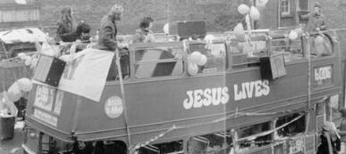
THE LORDSHIP OF CHRIST – HUGELY IMPACTS US AS A FAMILY OF GOD - There is coming a Great Interconnectedness in The Body Giving Each Other Grace While holding each other accountable
Do not let any unwholesome talk come out of your mouths, but only what is helpful for building others up according to their needs, that it may benefit those who listen. ³⁰ And do not grieve the Holy Spirit of God, -- Be kind and compassionate to one another, forgiving each other, just as in Christ God forgave you. Ephesians 4:29-32 (NIV)
God intended that all these waves of Recovery (and reformation) to blend together into one glorious whole with a balance of truth and a dynamic of life, but instead there was limitation of vision, each one thinking that the part he held was the whole. Arthur Wallis 1962

Slide 19
Making Jesus The Main Focus – While Accommodating
The Holy Spirit More
"Our method of proclaiming salvation is this: to point out to every heart the loving Lamb, who died for us, and although He is the Son of God, offered Himself for our sins ... by preaching His blood, and His love unto death, even the death on the cross, never, either in discourse or in argument, to digress for even fifteen minutes from sharing about the loving Lamb: Count Zinzendorf
We have no hope in winning souls, praying down blessings, breaking through the principalities over our cities, welcoming the gifts, fruits and miracles and deliverances of the Kingdom of God without accommodating the Holy Spirit.

Slide 20
The Lordship of Christ Makes Us
Gobsmacked over His glory
Overwhelmed with wonder, surprise, or shock : astounded dumbfounded - flabbergasted.
One thing have I asked of the Lord, that will I seek, inquire for, and [insistently] require: that I may dwell in the house of the Lord [in His presence] all the days of my life, to behold and gaze upon the beauty [the sweet attractiveness and the delightful loveliness] of the Lord - 5 For in the day of trouble He will hide me in His shelter; -- 8 You have said, Seek My face [inquire for and require My presence as your vital need]. My heart says to You, Your face (Your presence), Lord, will I seek, inquire for, and require [of necessity]. Psalm 27:4-8 (AMP)

Slide 21
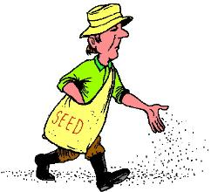
Sow Seeds Of Faith After It’s Kind
Praise Strategies
For Difficulties
And Burdens
If you are under stress and anxiety – PRAISE THE LORD HE CARES FOR YOU AND WILL TAKE CARE OF YOU AND HANDLE YOUR ISSUES – (1 Peter 5:7)
If you are under a physical attack – PRAISE THE LORD HE IS JEHOVAH RAPHA - YOUR HEALER AND WELL ABLE TO RAISE YOU UP (Exodus 15:26; Jeremiah 17:14)
You are under financial pressure – learning to steward better – but also facing the mounting inflation – PRAISE THE LORD HE IS JEHOVAH JIREH – Your Provider (Genesis 22:14)

Slide 22
Strategies of Praise
If you are under stress with relationships – PRAISE THE LORD HE IS ABOVE THE EDGINESS AND EMOTIONS YOU FEEL AND DESIRES PEACE AND RECONCILIATION – (Proverbs 16:7; Isaiah 9:6; Hebrews 13:20; 1 Peter 4:8)
You are under Concerns for Ministry for laborers – for salvation – for revival – for deliverance and discipleship –– PRAISE THE LORD HE IS HEAD OF THE CHURCH – HE HAS SUPREMACY IN ALL THINGS – (Colossians 1:18)
If you are cultural heaviness and burden for your region and nation – PRAISE THE LORD HE IS THE LORD OVER THE GOVERNMENTS AND PEOPLES WORKING THINGS ACCORDING TO THE COUNSEL OF HIS WILL - (Psalm 33:10,11; Ephesians 1:11)

Slide 23
God Is Who He Says He Is
Therefore, I Am Under His Lordship
And I Am:
A Child of God John 1:12)
Washed, Sanctified, Justified (1 Corinthians 6:11)
More than a conqueror through Him who loves me (Rom. 8:37)
Chosen race, royal priesthood, Holy nation (1 Peter 2:9)
Friend of God (John 15:15)
Heirs of God and co-heirs with Christ (Romans 8:17)
New Creation (2 Corinthians 5:17)

Slide 24
LORDSHIP Prayer Of Faith
Lord Jesus,
I believe with all my heart in your Coming To Save me from myself
I believe with all my heart You died because of MY SINS
I believe with all my heart You took the keys of DEFEAT from Satan
I believe with all my heart You rose from the dead
I believe with all of my heart that You are seated at the Father’s right hand
I TURN AWAY from my SELF WILL and sin and turn to YOU
I give you the drivers wheel of my life – take control of my destiny
Forgive me of my sins and addictions and stubborn rebellion
Make my heart NEW
Cause me to join YOU WHERE YOU ARE WORKING
Help me to bring Your VICTORY into every situation
Help me to PRAISE YOU in the storm
In the name of the Father, Son and Holy Spirit AMEN!!!!!

Slide 25
PRACTICAL APPLICATION
LEVERAGE THE VICTORY OF JESUS THROUGH ELEVATING HIS LORDSHIP OVER ALL YOUR LIFE
NEVER CEASE PRAYING - STAND AND DECREE HIS LORDSHIP OVER YOUR LIFE – YOUR FAMILY – YOUR CHURCH – YOUR NATION
PRAISE YOUR WAY THROUGH BURDENS
TURN EVERY OUTRAGE INTO OUTPOURINGS OF PRAYER AND EXPECTATION OF INTERVENTION

